Slide 1
Gateway to Leyte Gulf, The Philippines
The Bridge
Multilingual Perspective
The use of linguistic resources in both languages

Slide 2
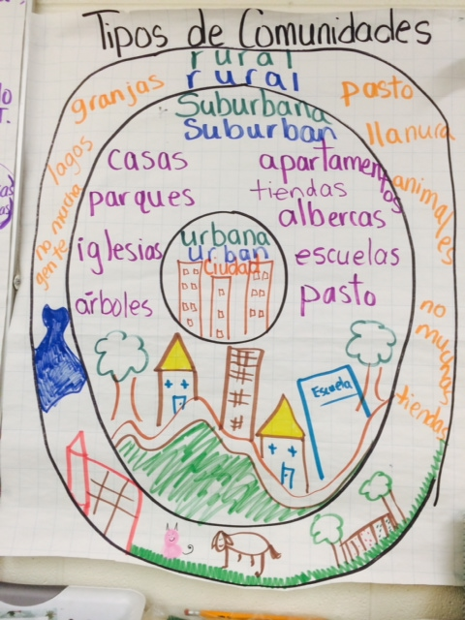
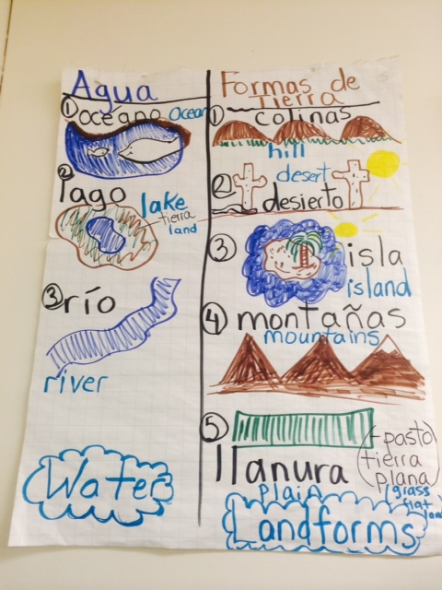

Slide 3
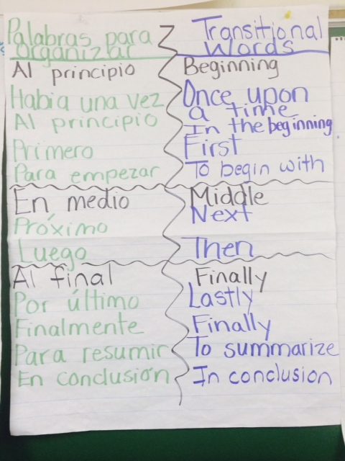
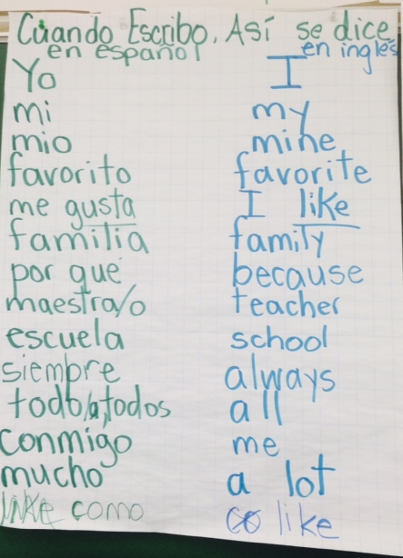

Slide 5
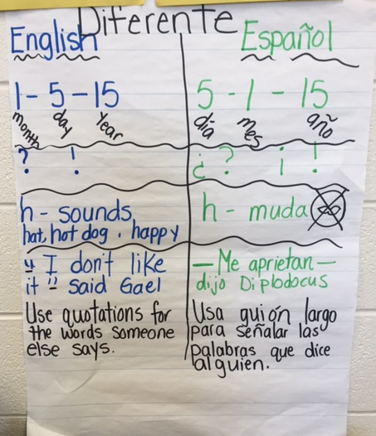

Slide 6
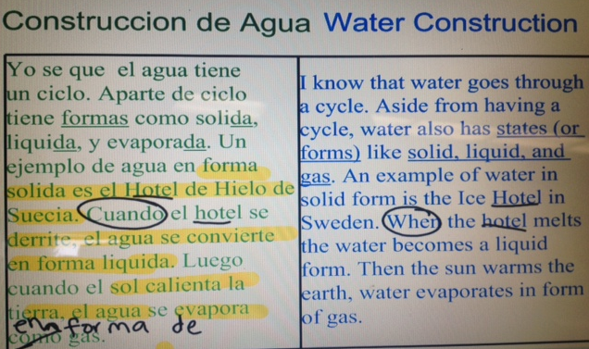
Así se Dice
Mira la estructura de Palabras

