Slide 1


Wednesday, June 24, 2015
What practices support biliteracy (instruction and assessment)?
Cheryl Urow Karen Beeman
Cheryl@TeachingForBiliteracy.com
Karen@TeachingForBiliteracy.com
Notes:
Welcome to the T4BSI sponsored by The Center which is a non-for-profit organization that, through one of its projects called the IRC or Illlinois… has been serving Illinois for over 30 years. and brief introductions of C & K – how many have worked with us? We are interactive, and will be interactive throughout. But first, a welcome…

Slide 2

Wednesday, June 24, 2015
Gots and Wants
Students and Teachers (Part 3 of yesterday’s content)
Big Ideas/Essential Understandings
Standards
Oracy and Background Knowledge:
  Instruction
  Asessment
Beeman and Urow
Teaching for Biliteracy Summer Institute 2015
Notes:
The content that we will review this morning refers to the content, and additional content, in chapters 1 & 4 of the text – and the handouts you received this morning.

Slide 3
Gots and Wants
From Tuesday, June 23rd

Slide 4
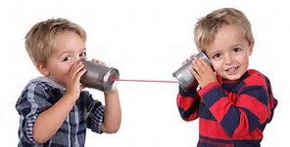


Gots
Oracy is key!
Affirming common struggles
  Spanish language growth
  Implementation of DL
Connect with other DL classrooms
and schools

Slide 5
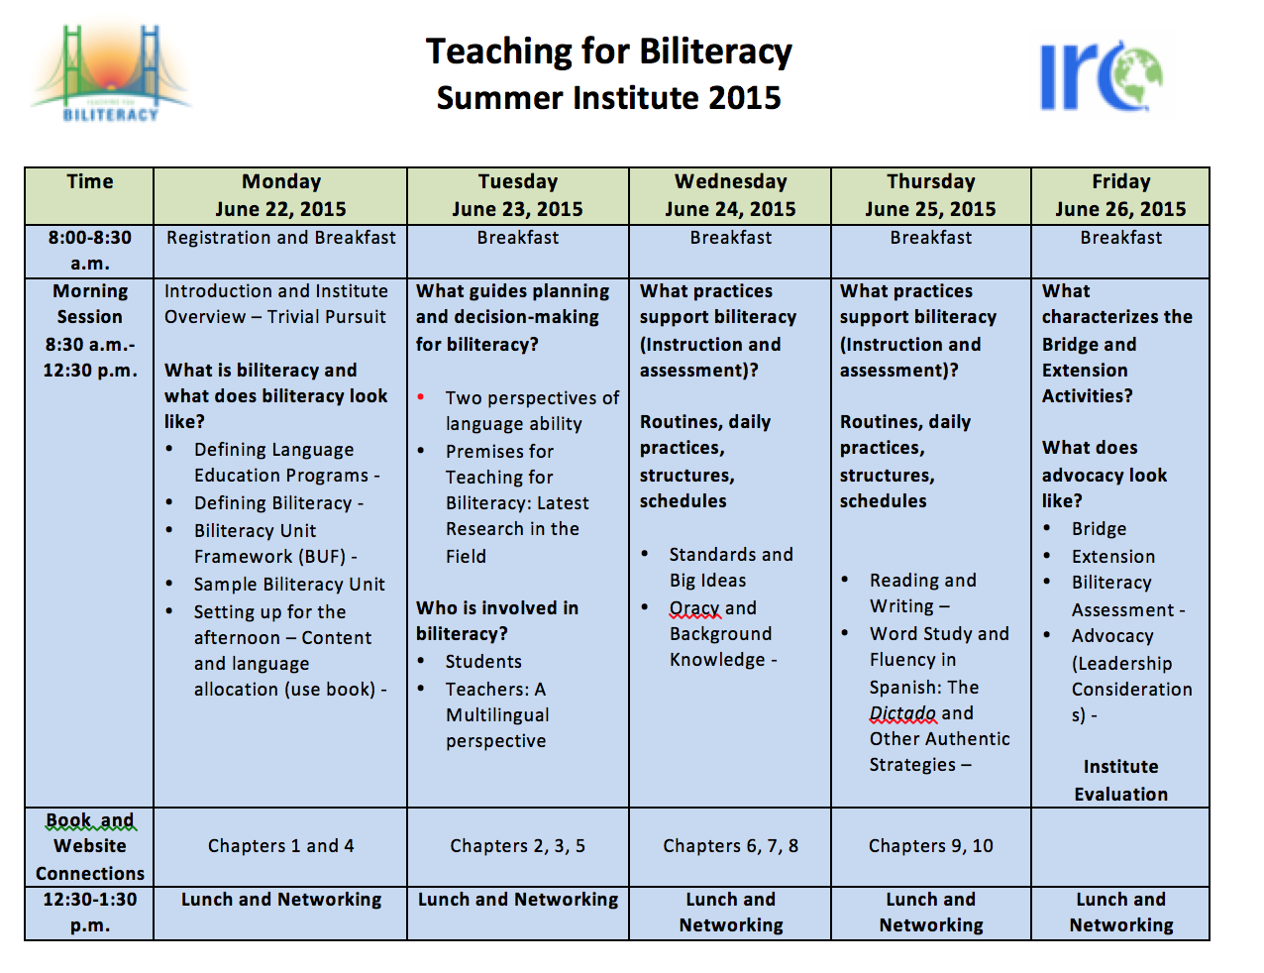
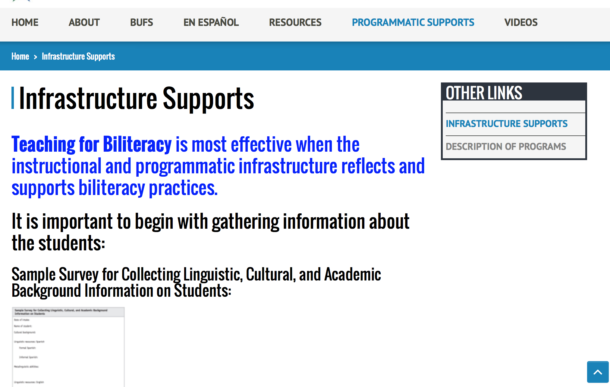
Wants
How to get Kinder students up to grade level
within 90/10 DL model?

Slide 6
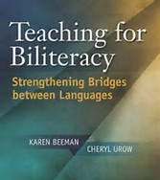
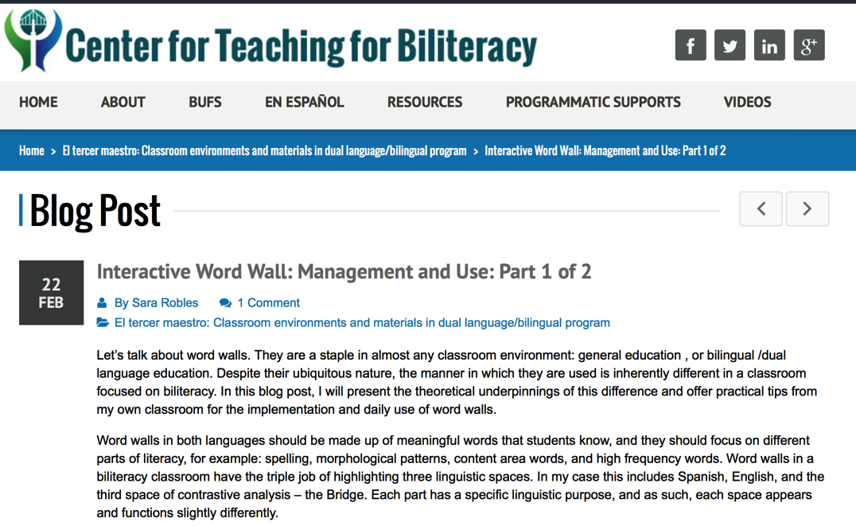

Classroom environment walkthrough forms, reference to improve teacher practice
p. 123

Slide 7
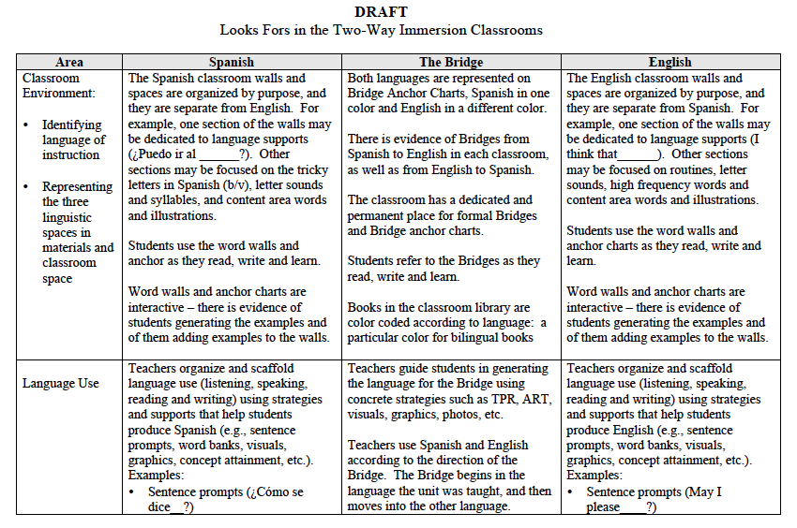
Biliteracy Look Fors-Coming to Website in July

Slide 8
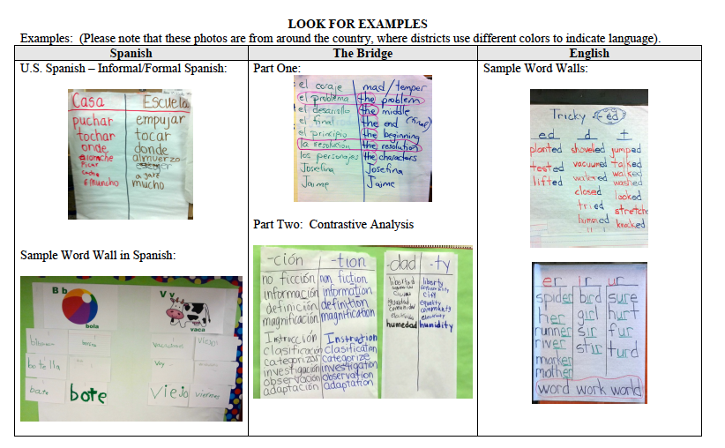

Slide 9
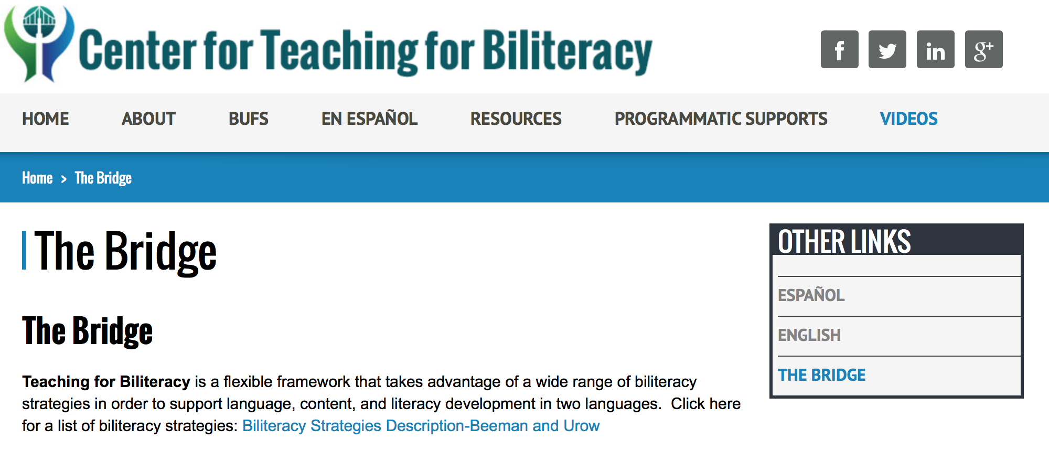
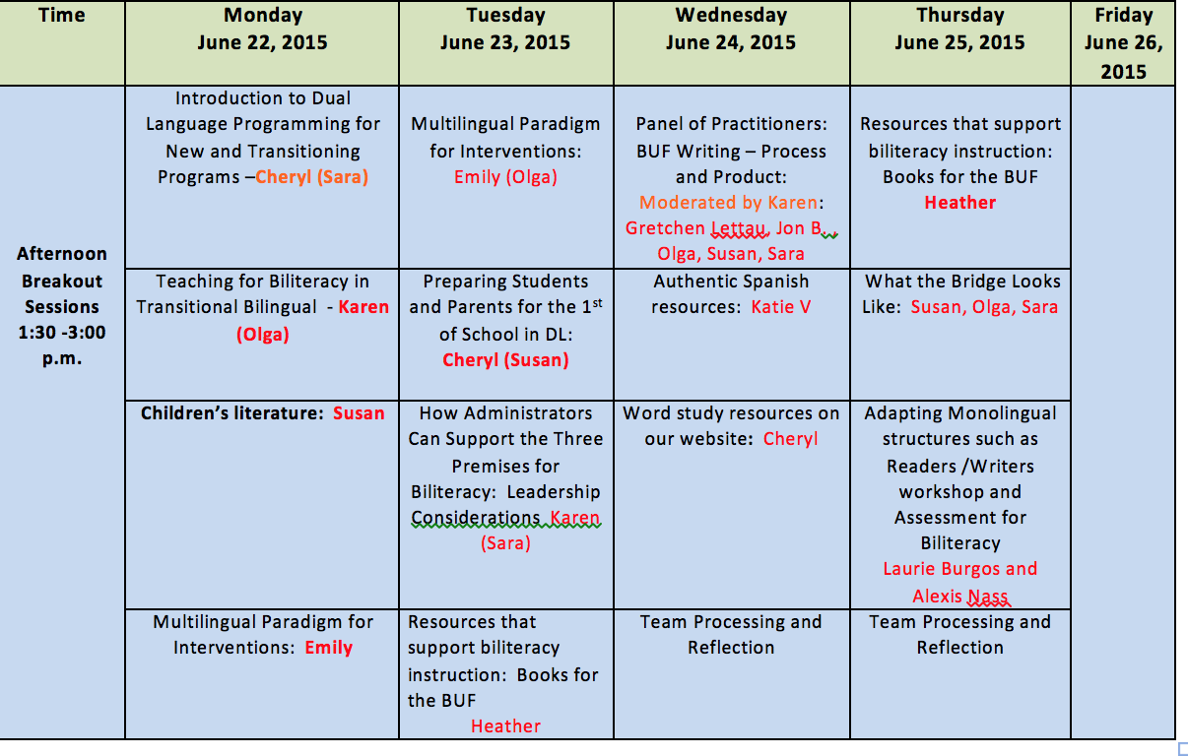
Clarification around Bridge;
do we Bridge content or literacy big idea?

Slide 10
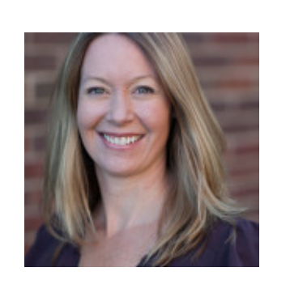
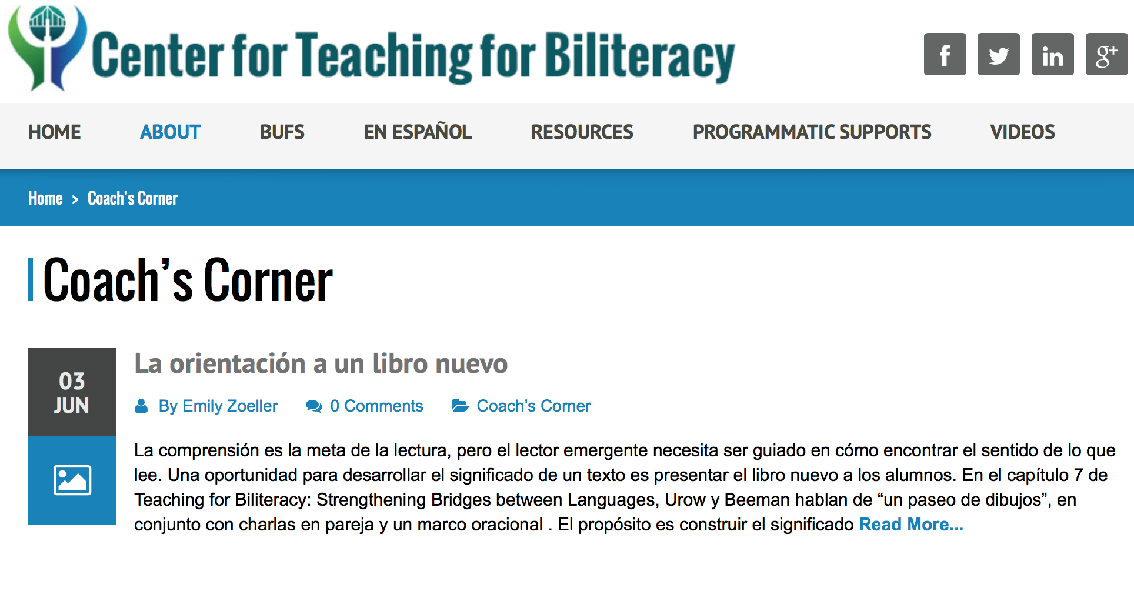
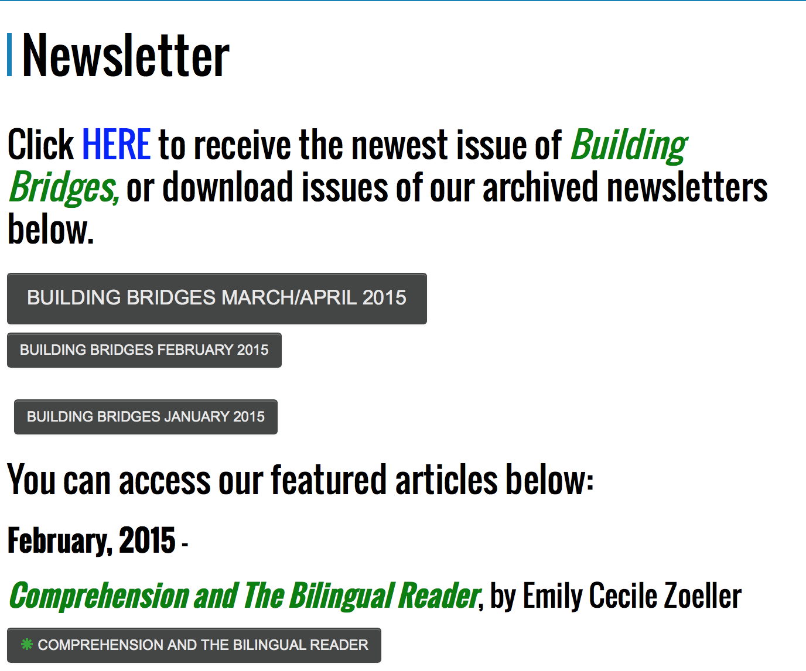
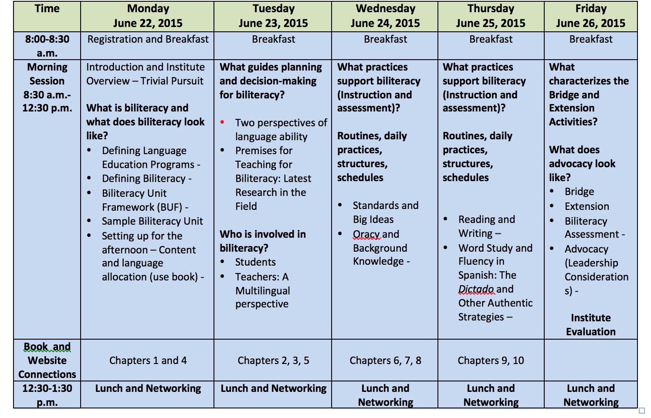
Interventions for dual language learners

Slide 11
Summative assessment in the multilingual perspective

Slide 12
What to do when we are told that ELA is ESL curriculum?
Extension in English

Slide 13
Wednesday afternoon breakout sessions
1:30 – 3:00 p.m.
Dessert at 1:15!!
Notes:
KAREN – you start here!

Slide 14
Wednesday afternoon breakout sessions
Salon A – Panel of Practitioners: BUF Writing Process – Olga, Sara, Susan, Jon, Gretchen
Salon B – Team Processing and Reflection
Salon C – La enseñanza de la lectoescritura inicial en español – Cheryl
Salon D – Finding and Using Authentic Spanish Resources – Katie Vazquez, Woodstock, IL.
Beeman and Urow
Teaching for Biliteracy Summer Institute 2015
Notes:
Asterix because it will be repeated on Tuesday

Slide 15
What practices support biliteracy (instruction and assessment)?
Biliteracy Units are anchored in big ideas (essential understandings) that come from Standards
Notes:
KAREN – you start here!

Slide 16
What was I teaching the 2nd graders?
Science
Language Arts
Spanish:
The Bridge:
English

Slide 17
Open Sort
With your team, sort these statements into categories that make sense to you.
Be prepared to share your thinking.

Slide 18
The Big Idea
Is grounded in State and National Academic Standards
Comes from the work of Wiggins and McTighe, Understanding by Design
“I want my students to understand that…” and “For example, …”
Is also known as an essential understanding.

Slide 19
The Big Idea
Beginning with the Big Idea moves lesson planning away from activity based planning to concept based planning, and facilitates meeting the goals of the Common Core Standards.

Slide 20
Big Ideas
When serving a wide range of learners – as is typical in a bilingual setting – big ideas provide a common cognitive focus for all learners, even when differentiated tasks are required for diverse students to learn those ideas and to demonstrate their learning.

Slide 21
Big Ideas
Yes
No
Animals have a life cycle. Some hatch, others are born.
The baby chicks hatched from an egg.
Like all wars, the Civil War had multiple causes.
The North and South disagreed over slavery.
All families celebrate holidays & traditions;
however families celebrate in different
ways depending on the cultures & heritage
to which they have been exposed.
The Hmong wedding celebration is a
two day process that includes several
feasts and ceremonies.

Slide 22
Big Ideas
Yes
No
Authors choose a genre according to the message they want to send.
Poetry
.
When reading informational text,
good readers make logical inferences
using evidence from the text.
Inferences can be made from studying photos and captions in a text.

Slide 23
To be a big idea…
The statement must have more than two examples.
It must be an enduring understanding, NOT a DETAIL.
It must be able to complete the sentence prompt, “I want my students to understand that…”

Slide 24
Is it a big idea?
…Genre.

Slide 25
Is it a big idea?
…Genres come in many formats with specific elements.

Slide 26
Is it a big idea?
…how to classify animals.

Slide 27
…scientists classify animals according to their physical characteristics and adaptations to their environment. These classifications include: mammals, reptiles, fish, amphibians, insects, and birds.

Slide 28
Is it a big idea?
…immigrants face many challenges as they adapt to a new environment.

Slide 29
Is it a big idea?
…text themes.

Slide 30
Is it a big idea?
…Writers communicate a message , moral, or theme when they write a poem or story.

Slide 31
Is it a big idea?
…fractions, percentages, and decimals.

Slide 32
Is it a big idea?
…fractions, decimals and percentages area all ways of expressing the relationship of a part to the whole.

Slide 33
Big Ideas
Concept A
Concept B
Authors choose language and structures in order to create images and convey their message.
Pushes and pulls can have different strengths and directions.
The letter g can change its sound depending upon the vowel that follows it.
Two dimensional shapes have perimeter and area, and there is a specific way to calculate each.
Readers use information from a text and their own experiences in order to draw conclusions and make inferences.
The U.S. Civil War, like all wars, had many causes.

Slide 34
Big Ideas
Sound can make matter vibrate, and vibrating matter can make sound.
Concept A
Concept B

Slide 35
Big Ideas
Concept A
Concept B
Sound can make matter vibrate, and vibrating matter can make sound.

Slide 36
Big Ideas
We all have families. Our families have some things in common and also have differences.
Concept A
Concept B
Sound can make matter vibrate, and vibrating matter can make sound.

Slide 37
Big Ideas
Concept A
Concept B
Sound can make matter vibrate, and vibrating matter can make sound.
We all have families. Our families have some things in common and also have differences.

Slide 38
Big Ideas
There have been many different explorers throughout history, and there have been many different reasons for exploration.
Concept A
Concept B
Sound can make matter vibrate, and vibrating matter can make sound.
We all have families. Our families have some thing in common and also have differences.

Slide 39
Big Ideas
Concept A
Concept B
Sound can make matter vibrate, and vibrating matter can make sound.
We all have families. Our families have some thing in common and also have differences.
There have been many different explorers throughout history, and there have been many different reasons for exploration.

Slide 40
Big Ideas
Texts have main ideas and supporting details that can be summarized and paraphrased.
Concept A
Concept B
Sound can make matter vibrate, and vibrating matter can make sound.
We all have families. Our families have some thing in common and also have differences.
There have been many different explorers throughout history, and there have been many different reasons for exploration.

Slide 41
Big Ideas
Concept A
Concept B
Texts have main ideas and supporting details that can be summarized and paraphrased.
Sound can make matter vibrate, and vibrating matter can make sound.
We all have families. Our families have some thing in common and also have differences.
There have been many different explorers throughout history, and there have been many different reasons for exploration.

Slide 42
Big Ideas
Information from various sources can be gathered, compared and contrasted, and integrated.
Concept A
Concept B
Texts have main ideas and supporting details that can be summarized and paraphrased.
Sound can make matter vibrate, and vibrating matter can make sound.
We all have families. Our families have some thing in common and also have differences.
There have been many different explorers throughout history, and there have been many different reasons for exploration.

Slide 43
Big Ideas
Concept A
Concept B
Texts have main ideas and supporting details that can be summarized and paraphrased.
Sound can make matter vibrate, and vibrating matter can make sound.
We all have families. Our families have some thing in common and also have differences.
Information from various sources can be gathered, compared and contrasted, and integrated.
There have been many different explorers throughout history, and there have been many different reasons for exploration.

Slide 44
Big Ideas
Opinion texts include a point of view and supporting details, and are enhanced by specific text structures.
Concept A
Concept B
Texts have main ideas and supporting details that can be summarized and paraphrased.
Sound can make matter vibrate, and vibrating matter can make sound.
We all have families. Our families have some thing in common and also have differences.
Information from various sources can be gathered, compared and contrasted, and integrated.
There have been many different explorers throughout history, and there have been many different reasons for exploration.

Slide 45
Big Ideas
Concept A
Concept B
Texts have main ideas and supporting details that can be summarized and paraphrased.
Sound can make matter vibrate, and vibrating matter can make sound.
We all have families. Our families have some thing in common and also have differences.
Information from various sources can be gathered, compared and contrasted, and integrated.
Opinion texts include a point of view and supporting details, and are enhanced by specific text structures.
There have been many different explorers throughout history, and there have been many different reasons for exploration.
Notes:
Text structures like connecting words, topic sentence, and concluding statement.

Slide 46
Closed Sort
Match language arts (literacy) big ideas with content area big ideas.
Be prepared to share your thinking.

Slide 47
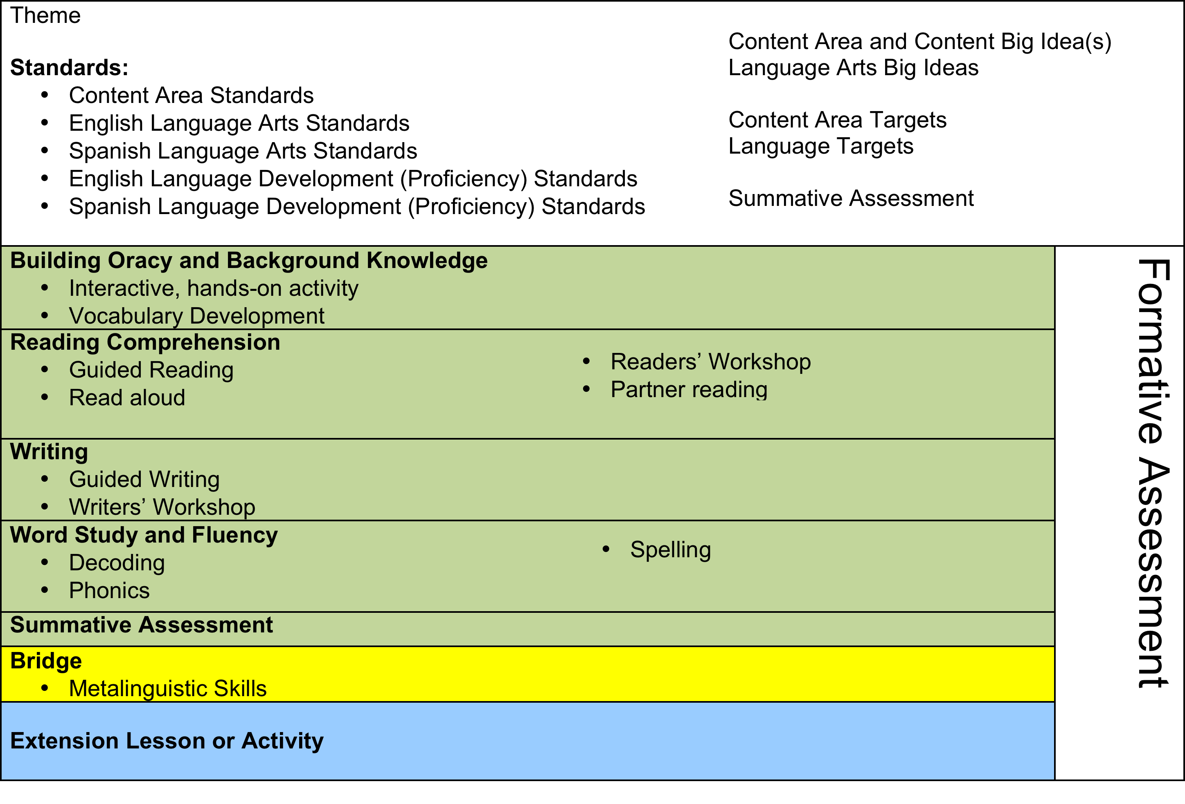
BILITERACY UNIT FRAMEWORK (BUF)

Slide 48
What is the Big Idea of the BUF in Chapter 4?
Authors use a wide variety of literary elements and techniques in fictional narratives.
Context: Animal adaptations (body parts, behavior, environment)
Vocabulary: plot, setting, character, dialogue, conflict, mood, tone, voice, imagery, personification…
Moving from the Concrete to the Abstract: point of view of the crayfish leads us to understand personification.

Slide 49
BILITERACY UNIT FRAMEWORK (BUF)
NON-NEGOTIABLE: BILITERACY UNITS ARE ANCHORED IN BIG
IDEAS THAT ARE STANDARDS BASED.
ALL BILITERACY UNITS HAVE A LANGUAGE ARTS BIG IDEA(S) AND
MOST OFTEN A CONTENT AREA BIG IDEA.

Slide 50
La “ch”
Cheles
chish
Chilpete
Chinto
Chipuste
Chonte
Choca
Notes:
No quiero tocar eso porque me ma cheles. Sin el chipete, no se puede sazonar bien ¡Qué chish….. Qué pasóa aquí? Van de verde chinto. Pedro es un chipuste de gente, o dejaron chipustes de lodo. Ese chonte (poli) tiene una choca (moneda)

Slide 51
La “ch”
Cheles – nervios / nerves
Chish – hediondo / bad smell
Chiltepe – chile chapín / pepper from Guatemala
Chinto – color fuerte / strong color
Chipuste – pequeño / small
Chonte – policía / police officer
Choca – moneda o no vé bien / coin or blind
Notes:
No quiero tocar eso porque me ma cheles. Sin el chiltepe, no se puede sazonar bien ¡Qué chish….. Qué pasóa aquí? Van de verde chinto. Pedro es un chipuste de gente, o dejaron chipustes de lodo. Ese chonte (poli) está choca (no ve bien)

Slide 52
BILITERACY UNIT FRAMEWORK (BUF)
NON-NEGOTIABLE 1: BILITERACY UNITS ARE ANCHORED IN BIG
IDEAS THAT ARE STANDARDS BASED.
ALL BILITERACY UNITS HAVE A LANGUAGE ARTS BIG IDEA(S) AND
MOST OFTEN A CONTENT AREA BIG IDEA.
NON-NEGOTIABLE 2: ALL BILITERACY UNITS ARE FOCUSED ON
MEANINGFUL CONTENT. FOR THAT REASON, LANGUAGE ARTS IS
INTEGRATED WITH CONTENT AREA STANDARDS.

Slide 53
What practices support biliteracy (instruction and assessment)?
Biliteracy Units are anchored in big ideas (essential understandings) that come from Standards
Notes:
KAREN – you start here!

Slide 54
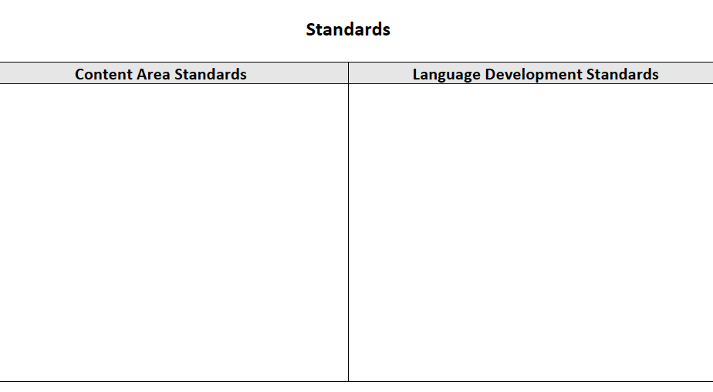
Brainstorm all possible standards

Slide 55
Parallel Lines
Share the Language standards your wrote.
How do language standards tell you what to teach?

Slide 56
Academic Language (WIDA)
 | Performance Criteria | Features
Discourse Level | Linguistic Complexity (Quantity and variety of text) | Amount of speech/text Structure Density Organization and cohesion Variety of sentence types
Sentence Level | Language Forms and Conventions (Types, array, and use of language structures) | Grammatical structures Conventions, mechanics and fluency Match of language forms to purpose/perspective
Word/Phrase Level | Vocabulary Usage (Specificity of word or phrase choice) | General, specific, and technical language Multiple meanings of words and phrases Formulaic and idiomatic expressions Nuances and shades of meaning

Slide 57
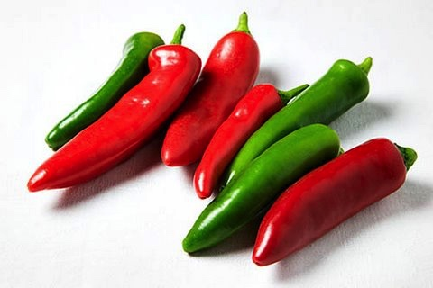
Describe the chiles
Notes:
As a poet – discourse??????
As a scientist???????
As a mathematician???????

Slide 58
WIDA 2007
Resource Guide

Slide 59
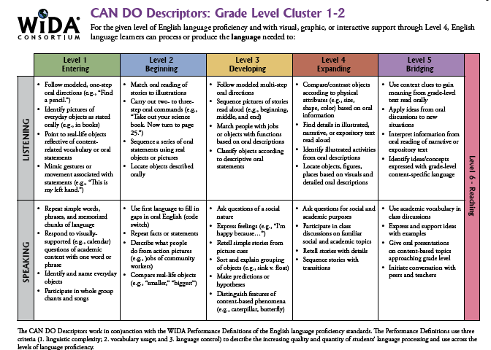
Sample Student Profile for:
Isabel
Baseline
First Trimester
Second Trimester
Third Trimester
Notes:
We agreed to collect data on student language proficiency using the CAN Dos 4 times a year in a formative manner. This will be done in English and in Spanish.

Slide 60
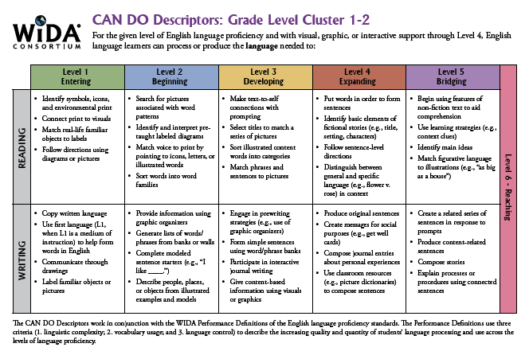
Sample Student Profile for: Isabel (continued)
Baseline
First Trimester
Second Trimester
Third Trimester

Slide 61
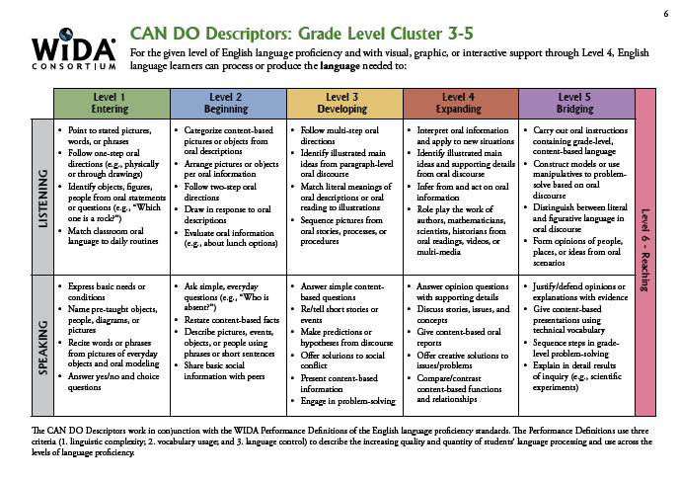
Lesson Planning Guide

Slide 62
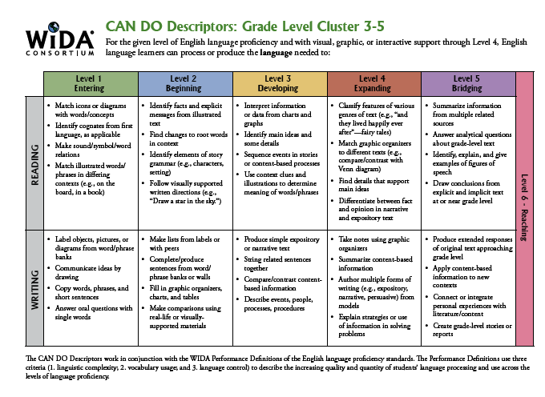
Lesson Planning Guide (continued)

Slide 63
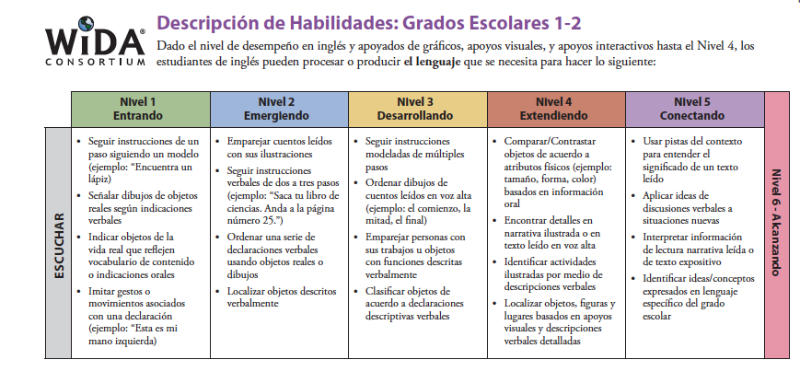
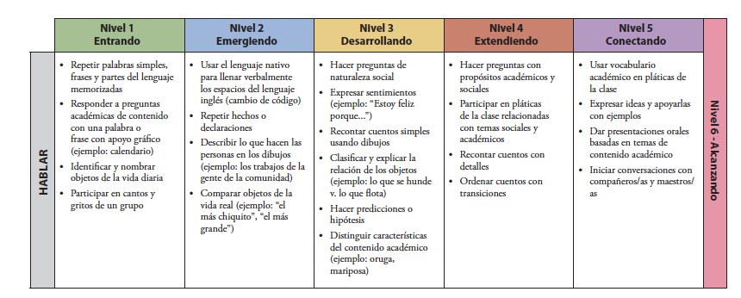

Slide 64
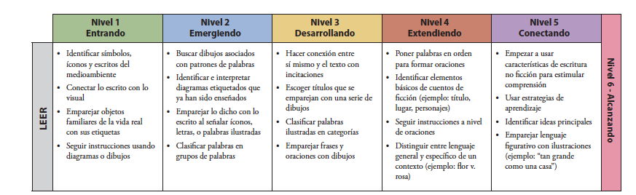
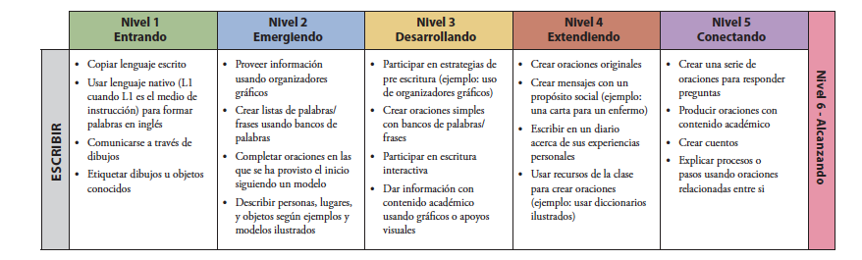

Slide 65
Parallel Lines
What content area standards did you include?
How do they tell you what to teach?

Slide 67
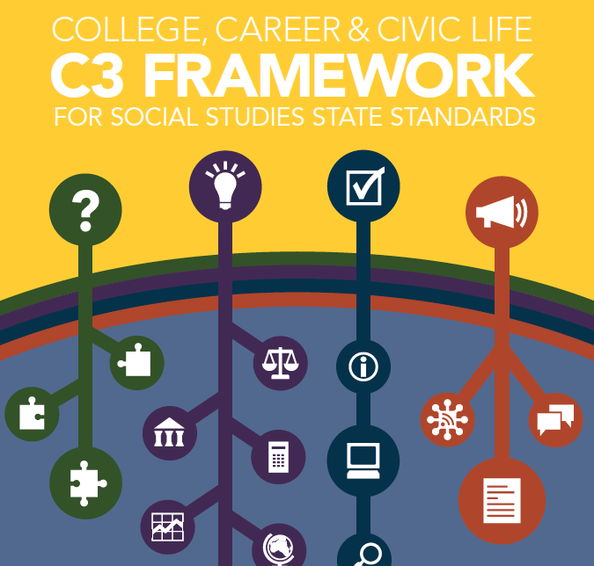

Slide 68
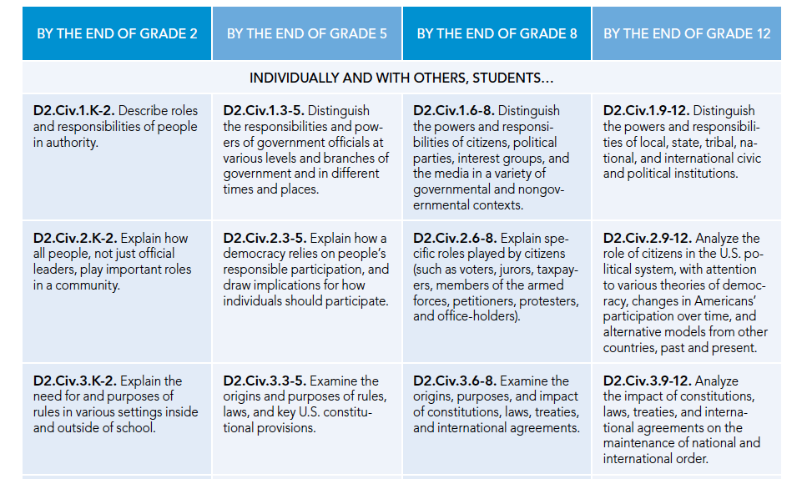

Slide 69
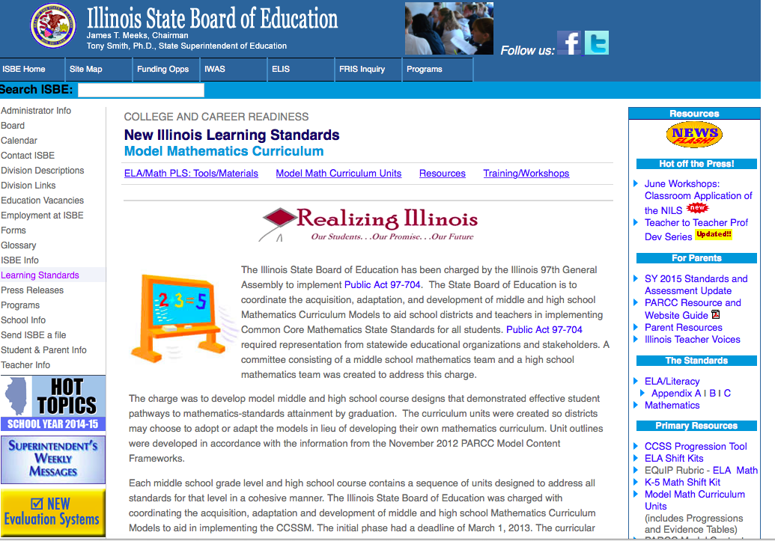

Slide 70
English Language Arts Standards
CCSS FOR ELA
READING Literature | READING Information-al Text | READING Foundation--al Skills | WRITING | LISTEN-ING AND SPEAK-ING | LANGUAGE

Slide 71
Los estándares de Artes de Lenguaje K-5 (Spanish Language Arts)
Lectura Literatura | Lectura Texto Informativo | Lectura Destrezas Fundamen-tales | Escritura | Audición y expresión oral | Lenguaje

Slide 72
English Language Arts Standards
CCSS FOR ELA
READING Literature | READING Information-al Text | READING Foundation--al Skills | WRITING | LISTEN-ING AND SPEAK-ING | LANGUAGE
Big ideas are written from these three areas of the standards.
They address reading behaviors and concepts. And they are
the same in Spanish.

Slide 73
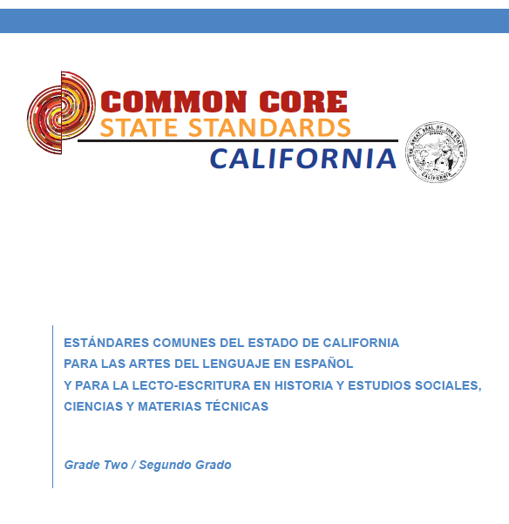

Slide 74
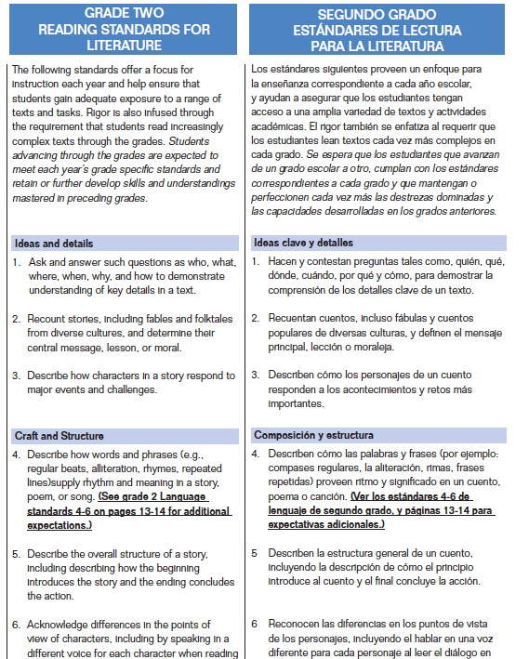

Slide 75
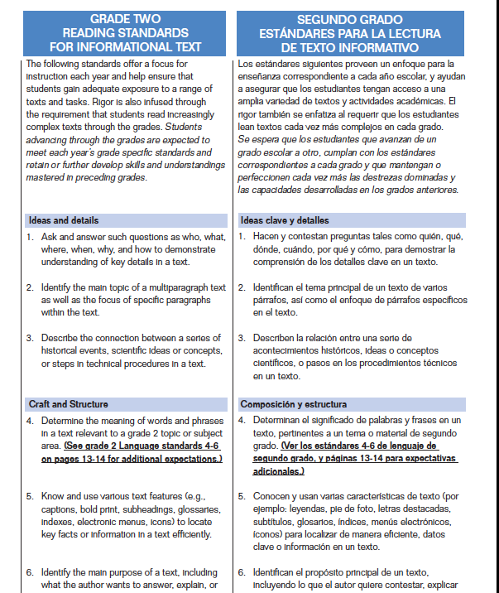

Slide 76
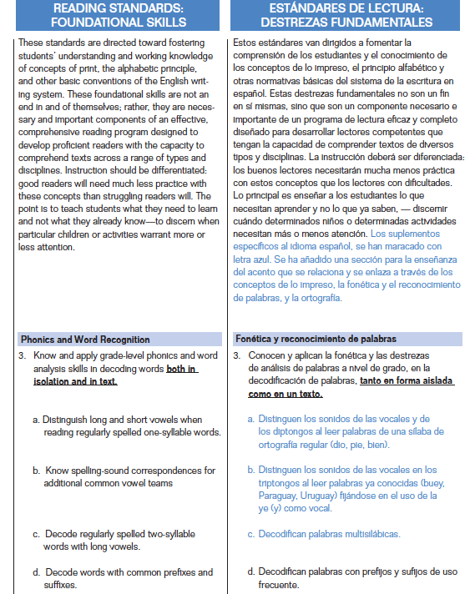

Slide 77
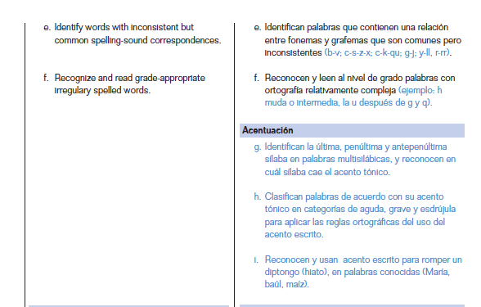

Slide 78
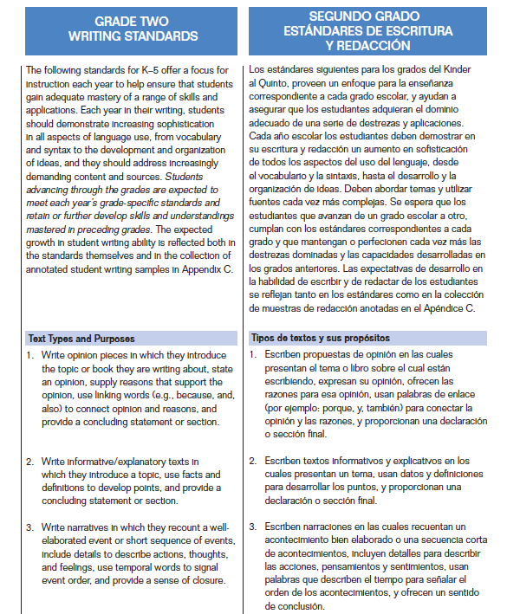

Slide 79
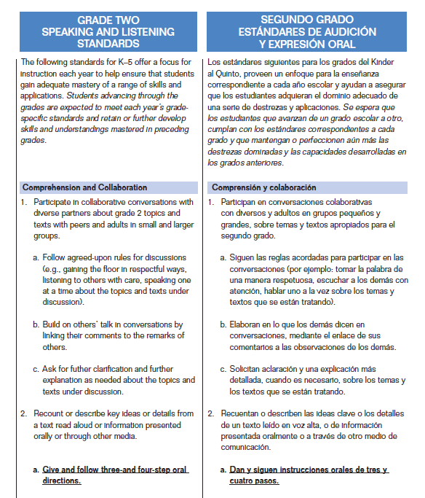

Slide 80
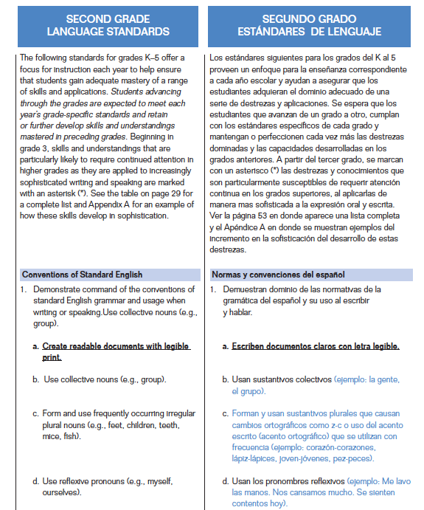

Slide 81
English Language Arts Standards
CCSS FOR ELA
READING Literature | READING Information-al Text | READING Foundation--al Skills | WRITING | LISTEN-ING AND SPEAK-ING | LANGUAGE
SIMILAR | SIMILAR | DIFFERENT | SIMILAR | SIMILAR | DIFFERENT
The Bilingual CCSS identify how Spanish instruction should look different from English instruction.

Slide 82
To summarize:
Big ideas come from standards.
Language Arts big ideas come from:
  Informational Text
  Literature
  Writing

Slide 83
To summarize (2):
Skills are integrated and taught in each unit.
The Bilingual CCSS identify how Spanish skills differ from English skills. This helps us to teach “Spanish a la Spanish” and not “a la English.”
Language Arts skills come from:
  Foundational Skills
  Listening and Speaking
  Language

Slide 84
Bilingual CCSS for Language Arts
Lectura Literatura | Lectura Texto Informativo | Lectura Destrezas Fundamen-tales | Escritura | Audición y expresión oral | Lenguaje
Similitudes | Similitudes | Diferencias | Similitudes | Similitudes | Diferencias

Slide 85
¿Dónde se usan los estándares en el programa bilingüe?
Español | El puente | Inglés / ESOL
Lectura: Literatura Texto Informativo Destrezas fundamentales “al español” Escritura Audición y expresión oral integrado en la instrucción Lenguaje | Enfatizar explícitamente la transferencia de: Literatura Texto Informativo Escritura Destrezas fundamentales y de Lenguaje: Aspectos similares Sonido de las consonantes (/b/, /t/ /p/, etc.) Aspectos diferentes Sonido de las vocales Artículos (el, la, los, las) Acento escrito | Reading: Literature Informational Text Foundational Skills (within an ESOL Context) Writing Foundational Skills in English (teach English “a la English”) Language Standards for English

Slide 86
What practices support biliteracy (instruction and assessment)?
The link between Big Ideas, Standards, and Oracy and Background Knowledge Development
Notes:
KAREN – you start here!

Slide 87
Identify the strategies used in Monday’s videos

Slide 88
Fuerzas y Movimientos Video
As you watch this video of a 4th grade dual language classroom identify the big ideas for CONTENT and for LANGUAGE ARTS

Slide 89

Fuerzas y Movimientos Video
As you watch the video again, identify the academic language being taught
Also, identify the language supports that are present:
  Sensory Supports (movement, realia, pictures)
  Graphic Supports (charts, timelines)
  Interactive Supports (sentence prompts, word banks, cooperative learning)

Slide 90
Biliteracy strategies teach language and content together

Slide 92
Assessment Sort
Create categories with your terms.
Now sort based on formative and summarive assessment.
Select the assessment tools you could use to assess oracy and background knowledge.

Slide 93
Defining our Assessment Terms
Sort the terms according to the different types of assessment.
Instructional Common Interim Standardized
Individualized
Teacher Tools
Classroom Measures
Commercial Measures
Criterion –referenced Tests
Notes:
ASK them to find examples of these in their sort.
Discuss what provides them the best information to adjust instruction based on student learning.

Slide 94
Fuerzas y Movimientos Video
As you watch the video one last time, think about how you could assess oracy and background knowledge
  Checklists
  Rubrics
  Student self-assessment

Slide 95
The same strategies are used for instruction AND assessment of language

Slide 96
Wedesday afternoon breakout sessions
1:30 – 3:00 p.m.
Dessert at 1:15!!
Notes:
KAREN – you start here!

Slide 97
Tuesday afternoon breakout sessions
Salon A – Panel of Practitioners: BUF Writing
Salon B – Team Processing and Reflection
Salon C – Initial Literacy Instruction in Spanish (This workshop will be conducted in Spanish).
Salon D – Find and Using Authentic Spanish Resources
Beeman and Urow
Teaching for Biliteracy Summer Institute 2015
Notes:
Asterix because it will be repeated on Tuesday

