Slide 1



Books y BUFs
Bringing it all together with a book
Heather Robertson-Devine, M.Ed.
Bilingual Teacher & Owner of Books del Sur
@booksdelsur
heather@booksdelsur.org
Blog: www.booksdelsur.org
Store: www.booksdelsurstore.org
Notes:
My name is heather Robertson-Devine. I just completed year 15 teaching and it was part-time in a 4th grade dual language classroom. And wow…it was awesome. Just a few things about me to justify why I am fortunate enough to spend time with you all today. I took Teaching for Biliteracy class a few years ago with Cheryl at the IRC. And am that kind of student that nags the teacher/stays in touch, continues to learn after the class is over. I love learning and I am always learning more so that I am a stronger advocate for bilingual students. See this crazy thing happens to white ladies like me. When people find out I can speak Spanish they privilege Spanish. Which is the complete opposite that happens to the students in our classrooms and their families that are also bilingual, but may not look like me or have been born on this side of U.S. border. Deep breath… there is some anger there and strong feelings of injustice. I was fortunate to be published in Sonia Nieto’s Why We Teach Now book, if you’d like to hear my full rant it’s the chapter titled “Activist Teacher” and if you don’t know Sonia Nieto – do her work on Social Racial and linguistic justice are a must for all of us working with bilingual populations. Finally, I’m the owner of Books del Sur. I import children’s books from Latin America for us to use in classrooms. I am the owner of a company, just to warn you I received two critiques at the WIABE conference my presentation was full of self promotion. Yes, yes it is. And here’s why …

Slide 2
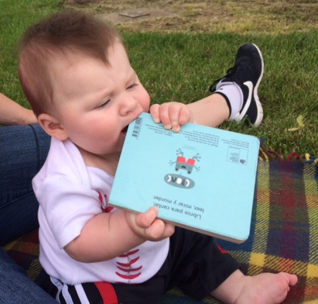

Slide 3
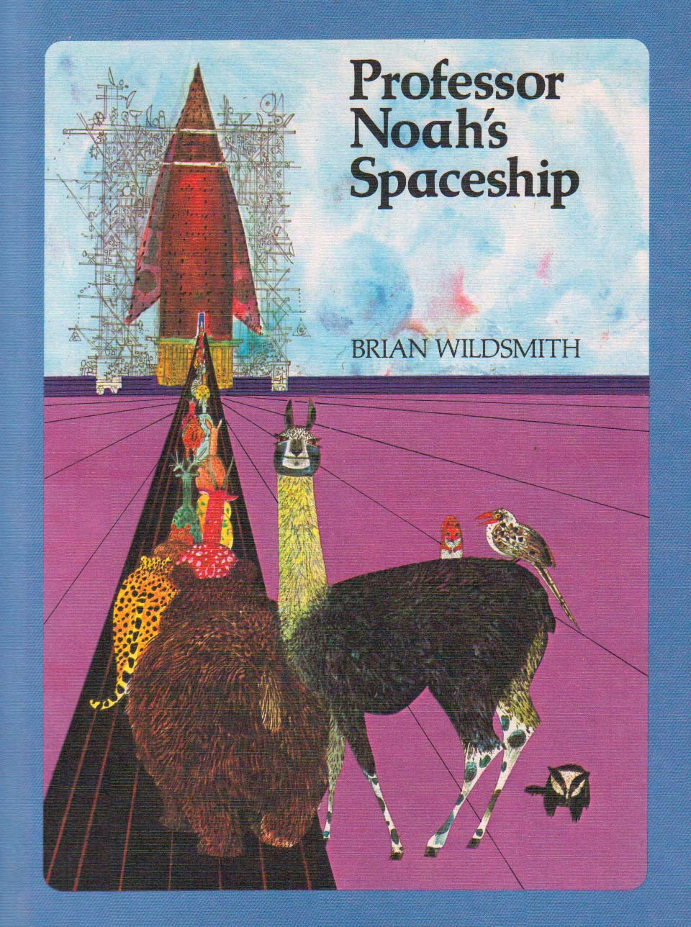
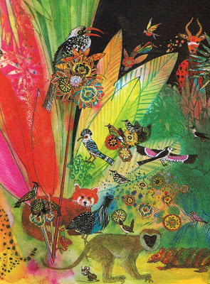
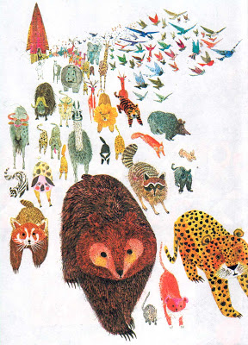
Notes:
When I was young, I was surrounded by beautiful books like Professor Noah’s Spaceship by Brian Wildsmith. I used to stare for hours at the illustrations. The bright colors sent my imagination into orbit.

Slide 4
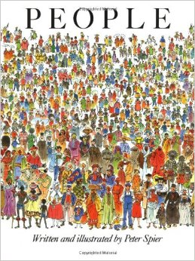
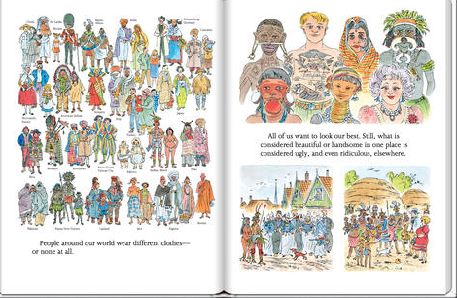
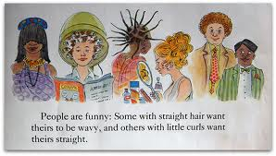
Notes:
When I was young, books helped me to understand the world around me. I would read and re-read Peter Spier’s People book to study the people that were different from me - how they dressed, how they lived, and what they liked.

Slide 5
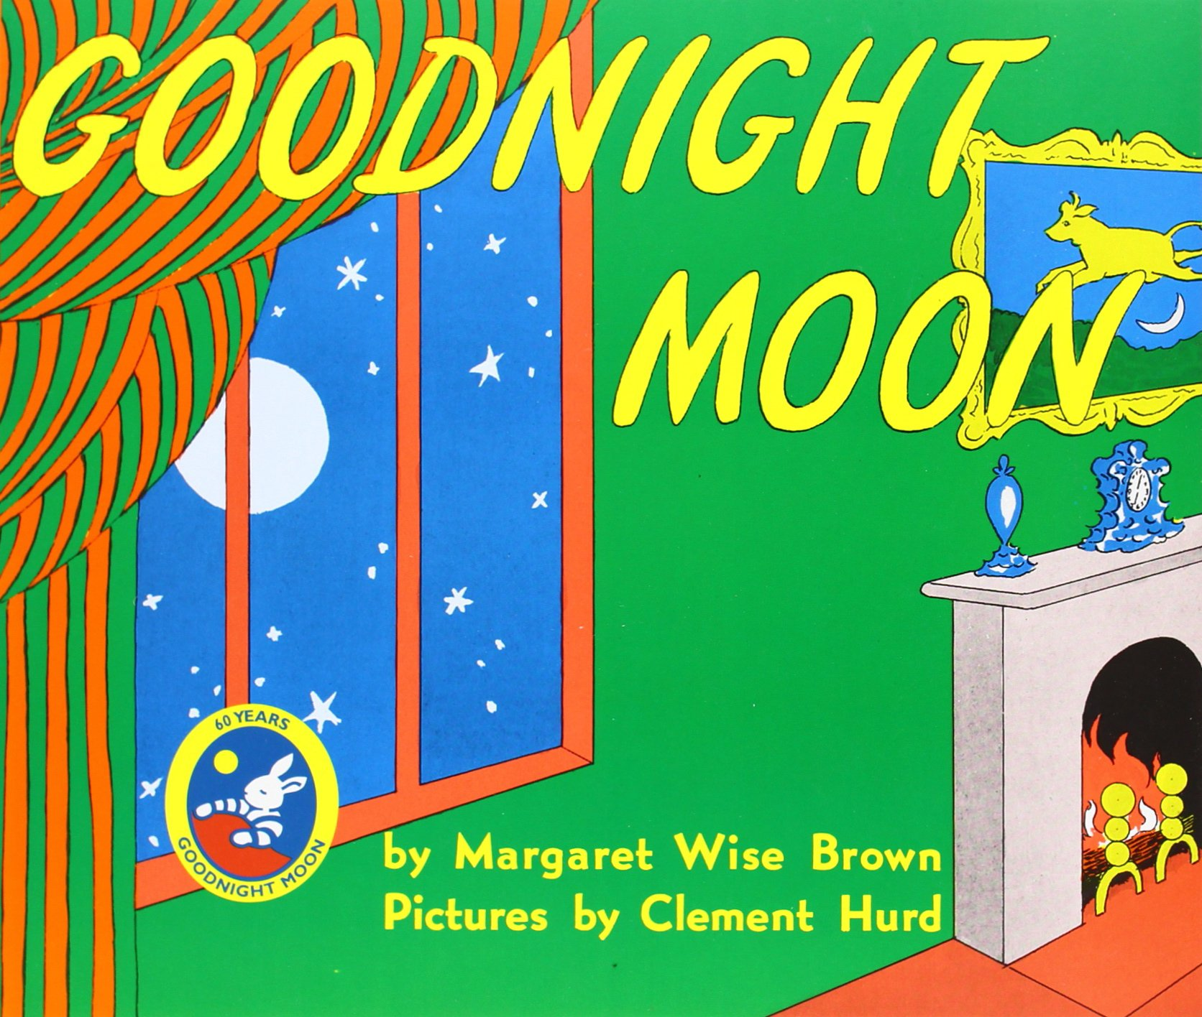
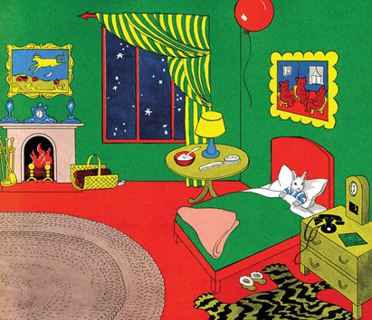
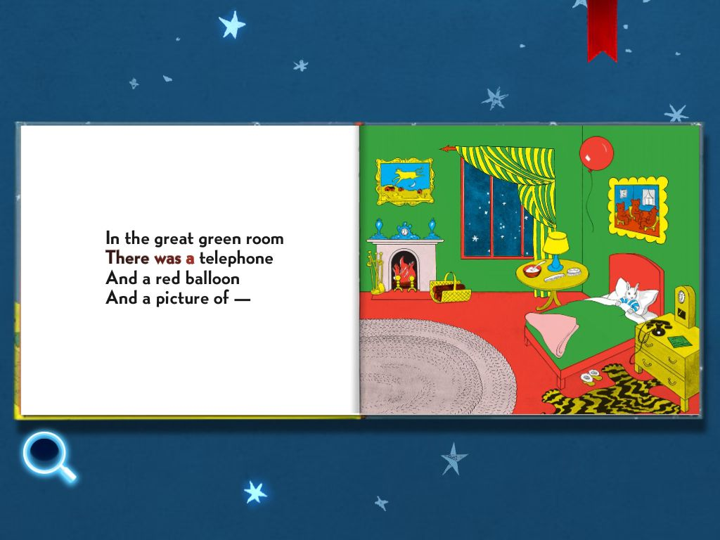
Notes:
When I was young, books were read to me over and over. This helped me develop the skills I needed to become a reader. I would look for the mouse on each page, which developed my understanding of using visuals to comprehend. I quickly learned the words in the story because the rhyme helped me to understand word families and word prediction. Read page…. Three bears….nope. Oh, yeah – everyone – a cow jumping over the moon.
It was books like these that made me love books. Books engaged me and motivated me. They fueled my curiosities.

Slide 6
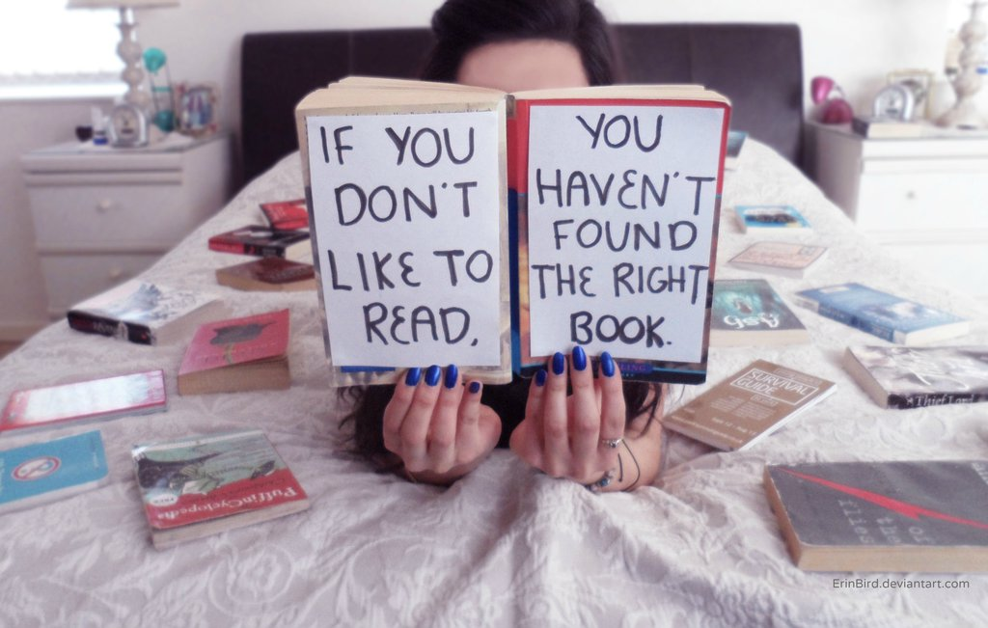
Notes:
As an adult, I’ve spent the last 15 years trying to get students to fall in love with books, or some people call it “teaching”

Slide 7

Soy de…
Una casa bilingue / A bilingual home
Una casa monolingue / A monolingual home
Una escuela primaria / An elementary school
Un centro de distrito / Administrative Offices
Una programa bilingue / a bilingual program
Una programa de immersion dual / Dual Immersion Program

Slide 8


Values & Philosophy
Student
Teacher
Federal, State & Local Mandates
Funds of Knowledge
Academic Skills
Learning Tools (books, web
Curriculum
Decision Making (Knowledge)
Common Core State Standards
NCLB Testing
Motivation & Engagement
Notes:
But TEACHING it’s not so simple right. I mean there are all these aspects of teaching.
There is the teacher – Elena, Monica, and me, Susan.
There is the student – you’ve got your Carmen’s, Your Paulo’s, Your Antonio’s, Your Lucia’s, Your Hannah’s – oh then you have people like Junot Diaz reminding you that you can’t just stereotype a kid based on his or her country of origin. Your student may be Dominican, gay, and like comic books.
Oh, then you also have Federal, State, and Local Mandates – PARC Testing, ACCESS Testing, Common Core State Standards, and now your district is telling you – write a BUF. Really?! It’s all a bit overwhelming is it not?!
So much of it is out of our control. Let’s focus on what is in our locus of control. You and your students.
While we need to do all of these things well – the key to this is to engage and motivate students. If you can do this then they will do the other things well.
And there is nothing that engages students like a good book.

Slide 9
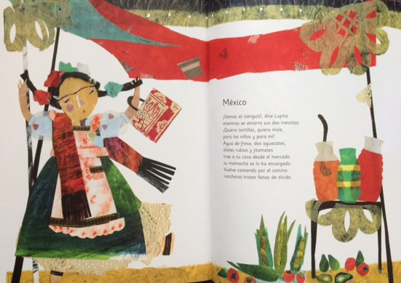

Slide 10
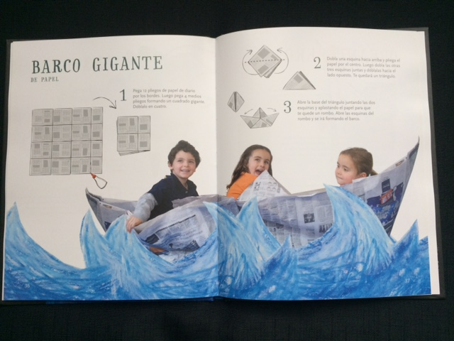

Slide 11
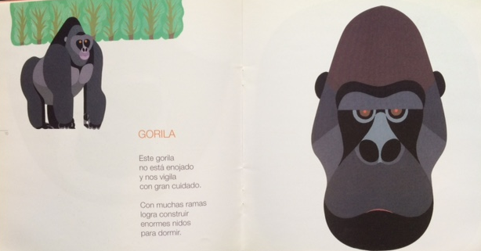

Slide 12
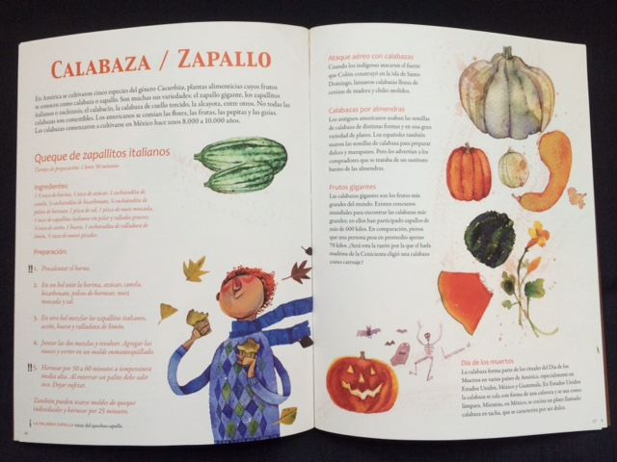

Slide 13
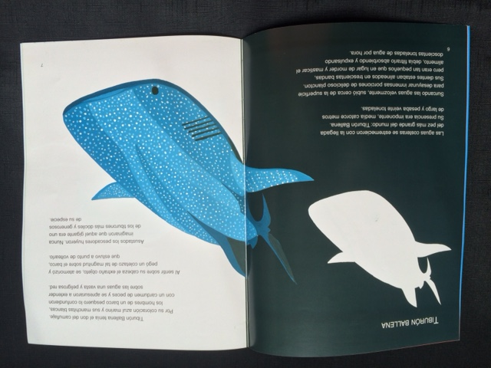

Slide 14
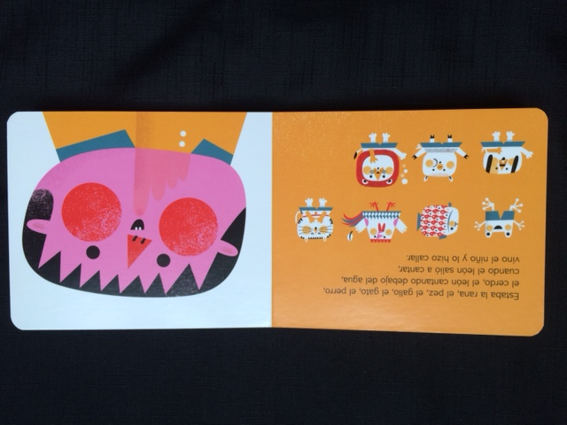

Slide 15
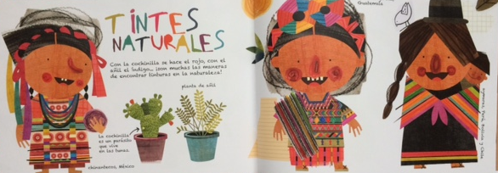
Notes:
Right? There is just something? It gets you in the gut, in the heart, and the mind….the mind. I have so many questions, connections, all those reading strategies that we teach they are in my mind. It is engaging instruction that brings them out.
So, are you tempted? Are you ready for me to put books in your hands?

Slide 16
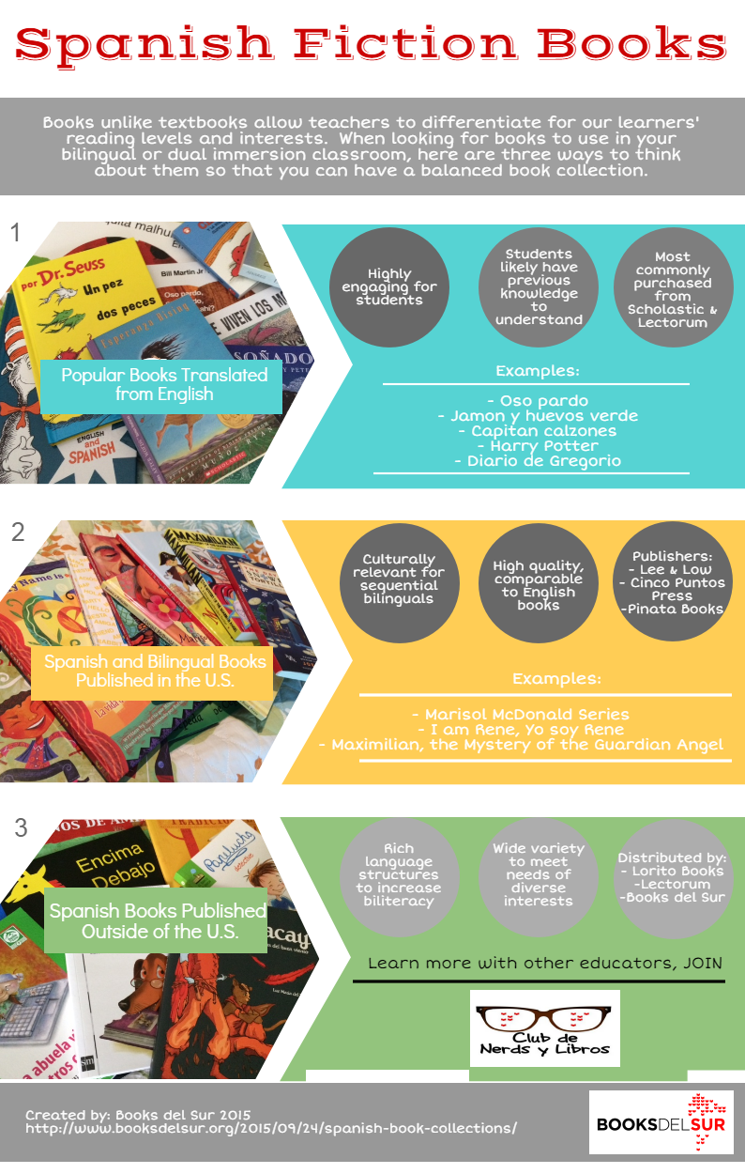

Slide 17
Why Have a Balanced Book Collection?
Psychosocial Uses for Literature
Provide characters and events with which readers can identify and through which they can consider their own actions, beliefs and emotions
Introduce readers to what the world may look like through others’ eyes and offer a chance to further construct their own views of self and the world
The mirror and the window (Sims Bishop)
Source: Temple, Charles A.; Martinez, Miriam; Yokota, Junko; & Naylor, Alice. (1998) Children’s Books in Children’s Hands. Boston: Allyn and Bacon.

Slide 18
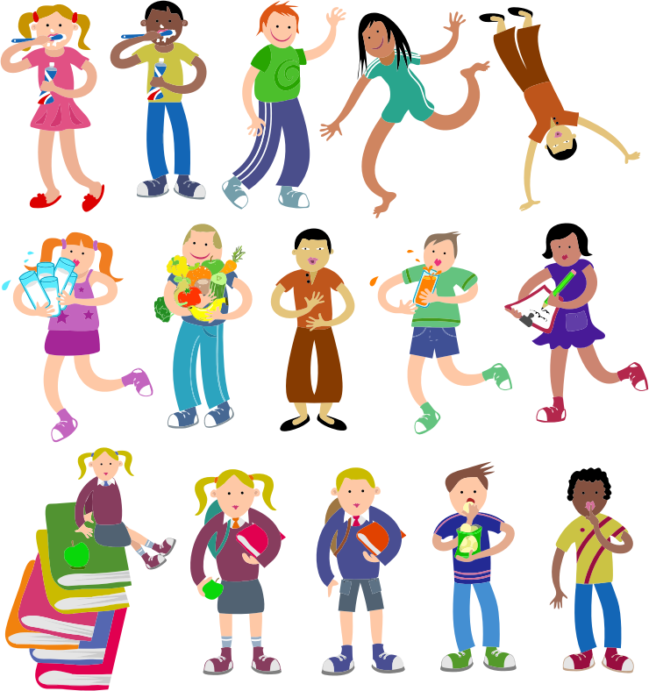

Slide 19
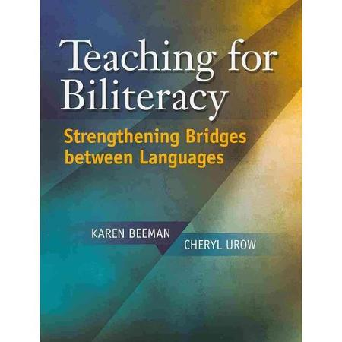
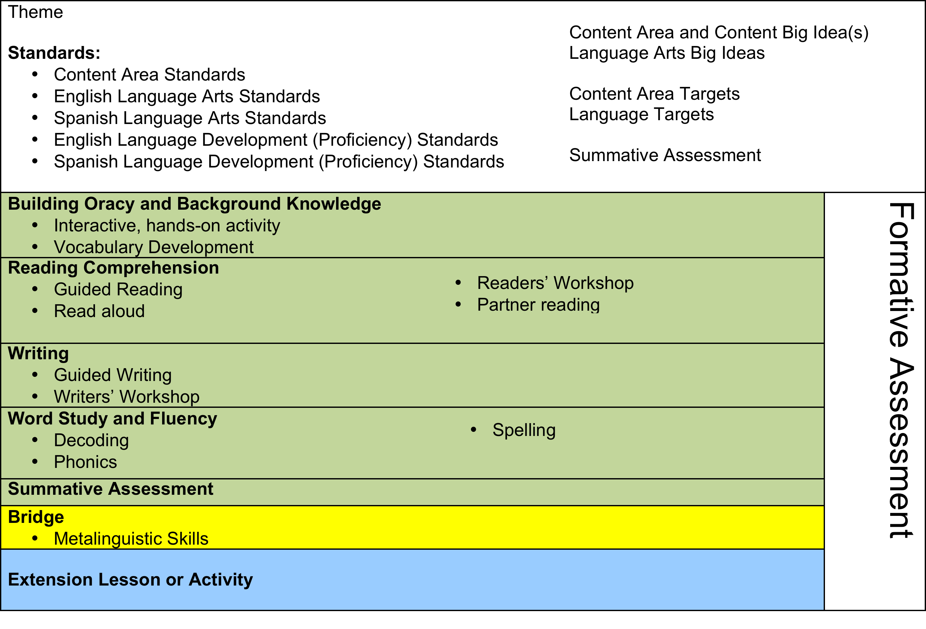
BILITERACY UNIT FRAMEWORK (BUF)
CHAPTER 7
Notes:
When to look for the book???
What to look for in a book? Content & Literacy is ideal.

Slide 20
Unifying your Biliteracy Unit Framework with a Book
What did all of those books I read when I was younger have?
Integrated content and literacy
Mirrors to my culture and windows to new cultures

Slide 21


Reading Comprehension
Read Aloud
Guided Reading Group

Slide 22
Reading Comprehension
Retell
¿Qué pasó en el libro? Incluye las personajes, el lugar y eventos. | Los personajes principales de libro son… Ellos (explicar un evento) en (dónde). (Repetirlo si es necesario.)
What happened in the book? Include persons, places and events. | The main characters are … They (explain an event) in (where). (Repeat if necessary.)

Slide 23
Reading Comprehension
Making Connections
¿Cómo sentiste acerca del libro? | Yo sentí …
How do you feel about the book? | I felt…
¿Qué tiene que ver con el tema comunidad? | Tiene que ver con el tema comunidad porque…
What does the book have to do with the theme community? | The book has to do with the theme community because …

Slide 24
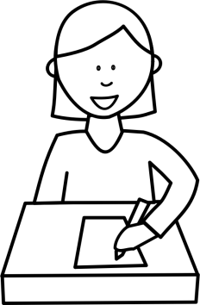
Examples of Books that
Unify Literacy & Content
K | El rabanito que volvió
1st Grade | De aquí de allá
2nd – 3rd Grade | ^{Amadeo va al colegio}

Slide 25

What are the examples of content and literacy evident in the texts?
What text features (if any) are unique about these examples of Authentic Spanish books?
What students would connect to this text?
Reflect & Discuss

Slide 26

Join the migration
www.booksdelsur.org
Notes:
Finally I hope that you will Join the Migration!
Books del Sur’s logo– a flock of books migrating from south to north– reflects not only what we strive to do but also tells the story of the children that we strive to provide equitable resources for.
Our logo represents our importation of books from Latin America to the United States as a way to make high-quality, authentic children’s literature in Spanish more accessible and to celebrate bilingualism and biliteracy. The logo also represents the experiences and cultural exchanges that inspired our company in the first place. The founders of Books del Sur, like so many of you, have migrated, too; through our travels, by immersing ourselves in great literature from around the world, by studying other languages, and by making deep connections with people across borders along the way.
As bilingual teachers, we know that it is imperative that all students feel their home cultures and first languages are valued and recognized in school. And we know how important it is for us to have access to high-quality literature as well as networks of support. By urging you to “join the migration” I’m inviting you to become part of a collaborative community of bilingual educators and librarians who share experiences and resources to better meet the needs of our students.
Thank you for your time today. I hope you’ll be in touch.

