Slide 1

Our Biliteracy Journey
Gurnee District 56
Karen Bromley and Lissette Quiñones
kbromley@d56.org, lquinones@d56.org
June 27, 2017

Slide 2
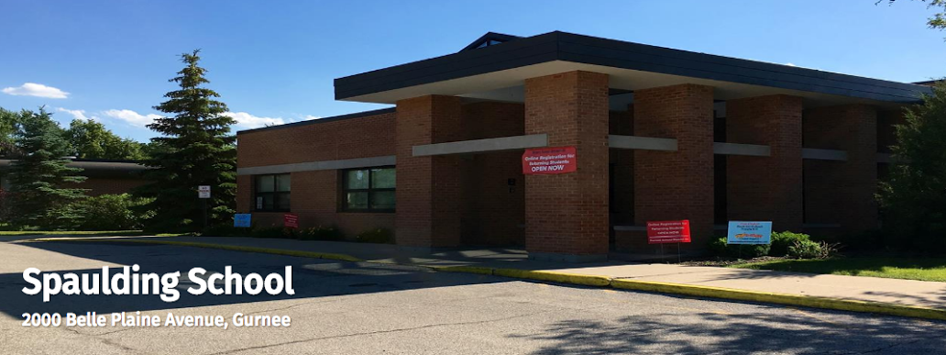
Who are we?
Spaulding School, Pre-K – 2
grades K & 2 OWDL
self-contained ESL classrooms

Slide 3
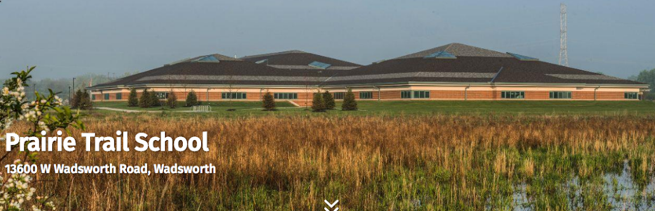
Who are we?
Prairie Trail School, 3-5
grade 4 OWDL
pull out ESL

Slide 4
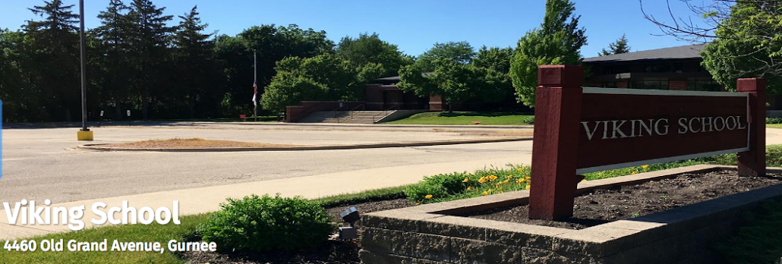
Who are we?
Viking School, 6-8
pull out services

Slide 5
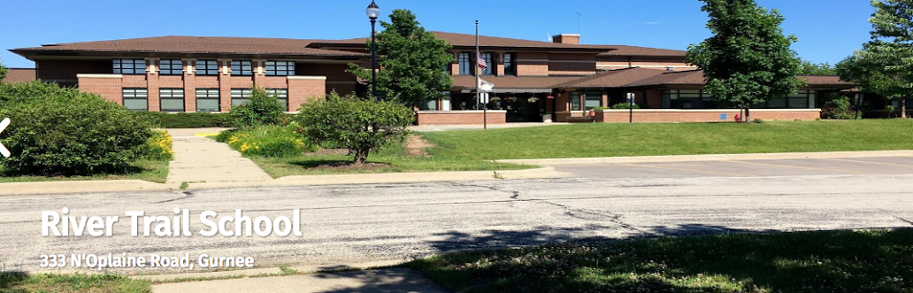
Who are we?
River Trail School, K-8
grades 1, 3, 5 OWDL
pull out ESL

Slide 6
Our Students
Students who qualify as ELLs and come from Spanish-speaking homes
ELL transfer students who have received instruction in Spanish
Will remain in the program through grade 5

Slide 7
Where We Were
TPI Program
TBE Program began in 2004
Late Exit Program in 2015

Slide 8
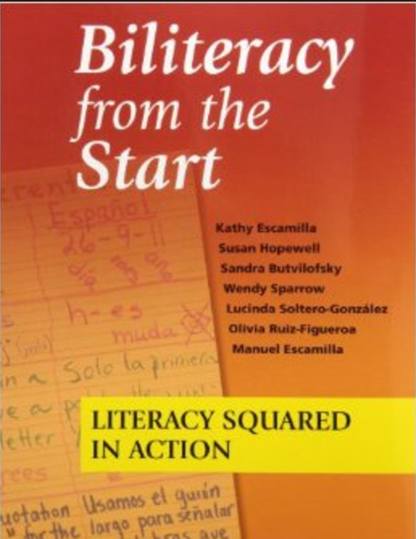
How did we begin?
Visited another district with different program models
A teacher and 2 administrators attended “Common Core and ELs: Pathways to Success” in April 2014
Began a book study of Biliteracy from the Start at River Trail School
A teacher and an administrator attended Cheryl Urow’s “Introduction to Biliteracy and the Bridge” workshop in May 2015

Slide 9

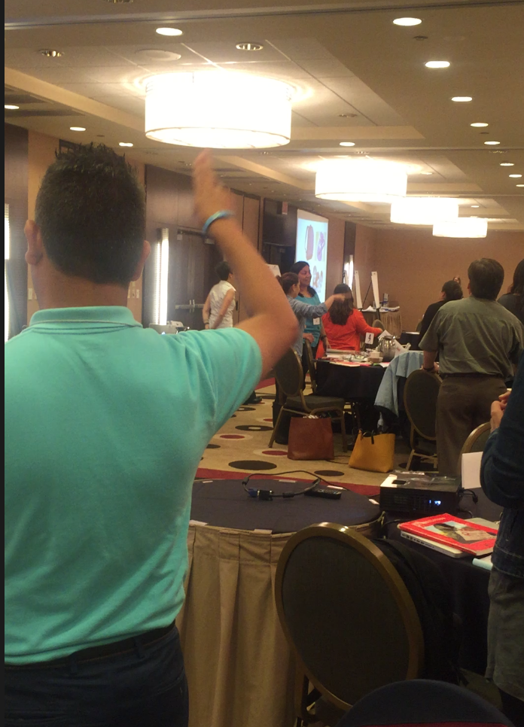
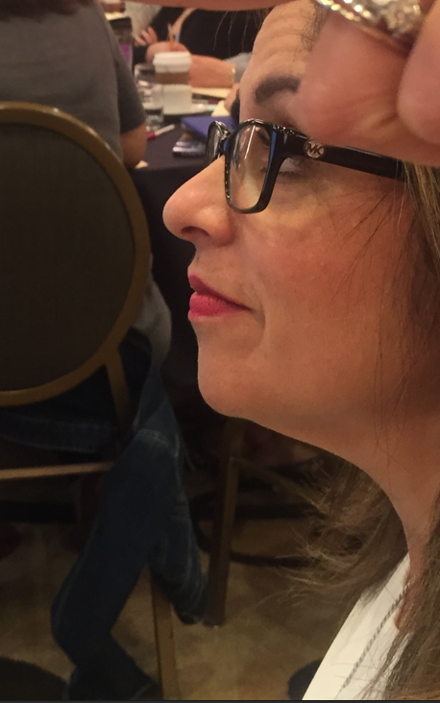
Teaching for Biliteracy Summer Institute All bilingual staff 2015

Slide 10
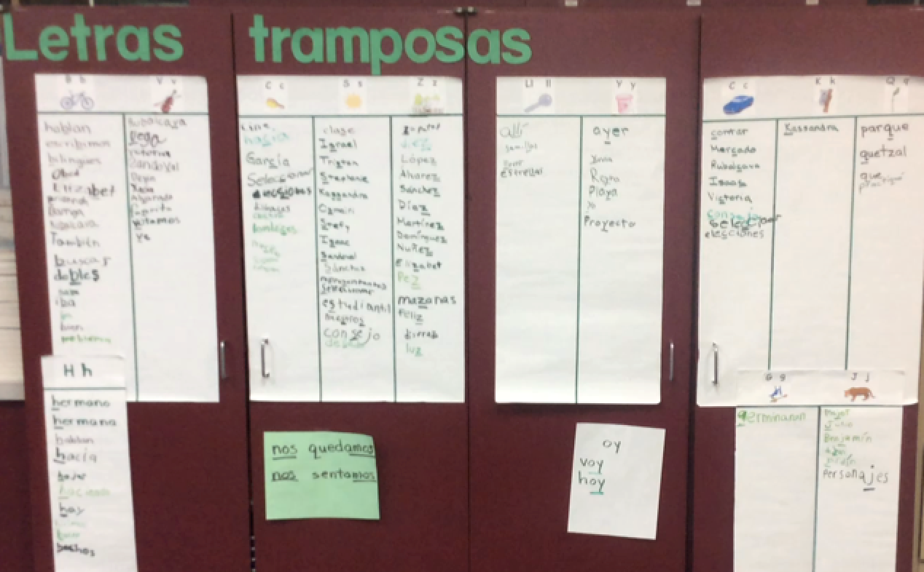
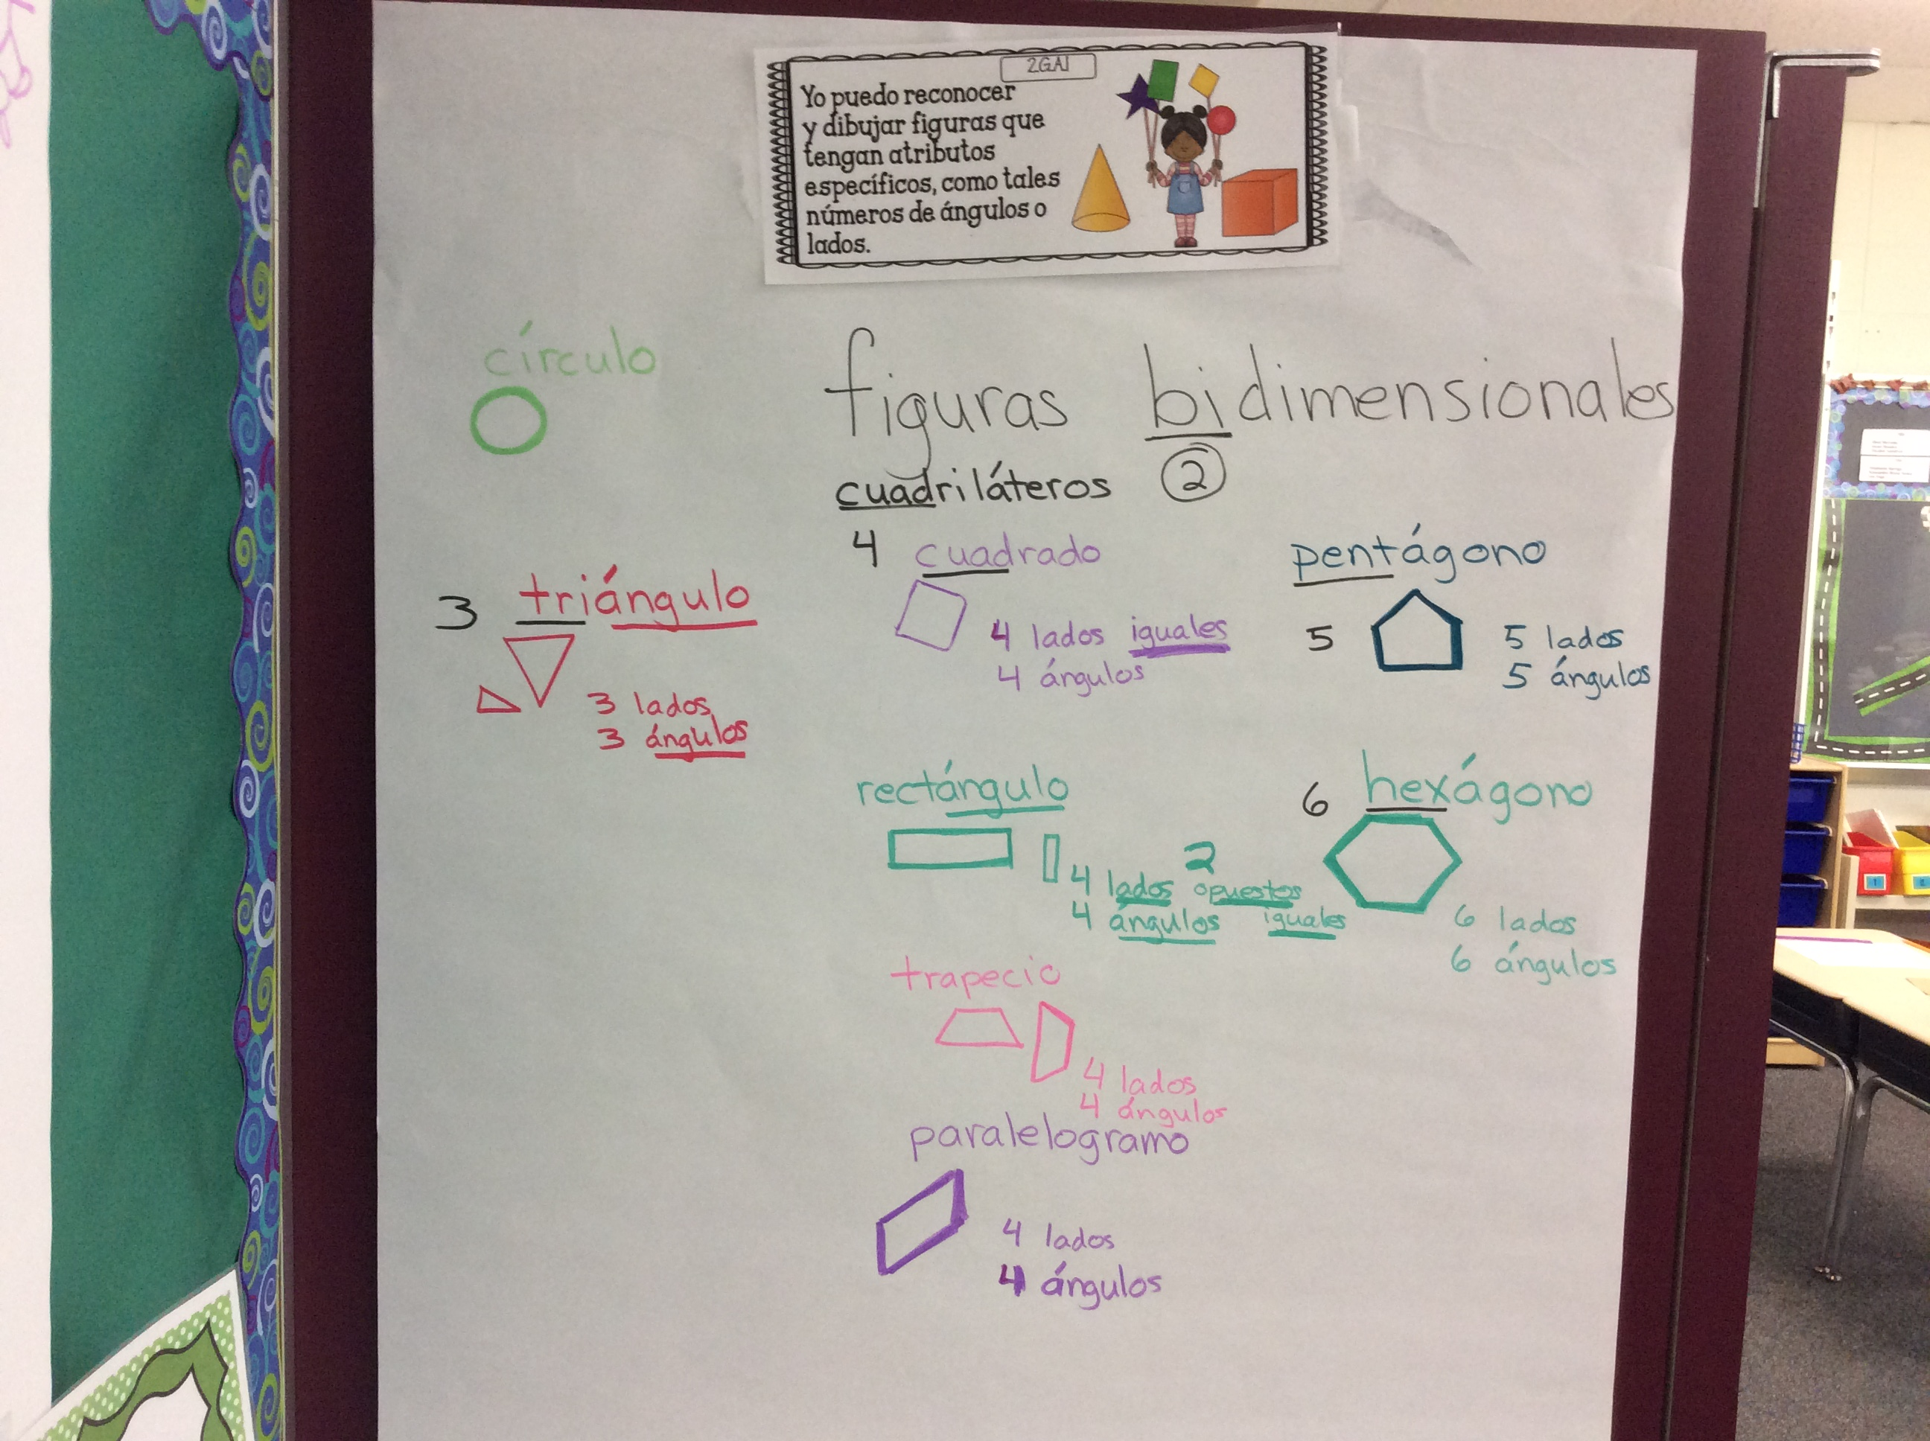
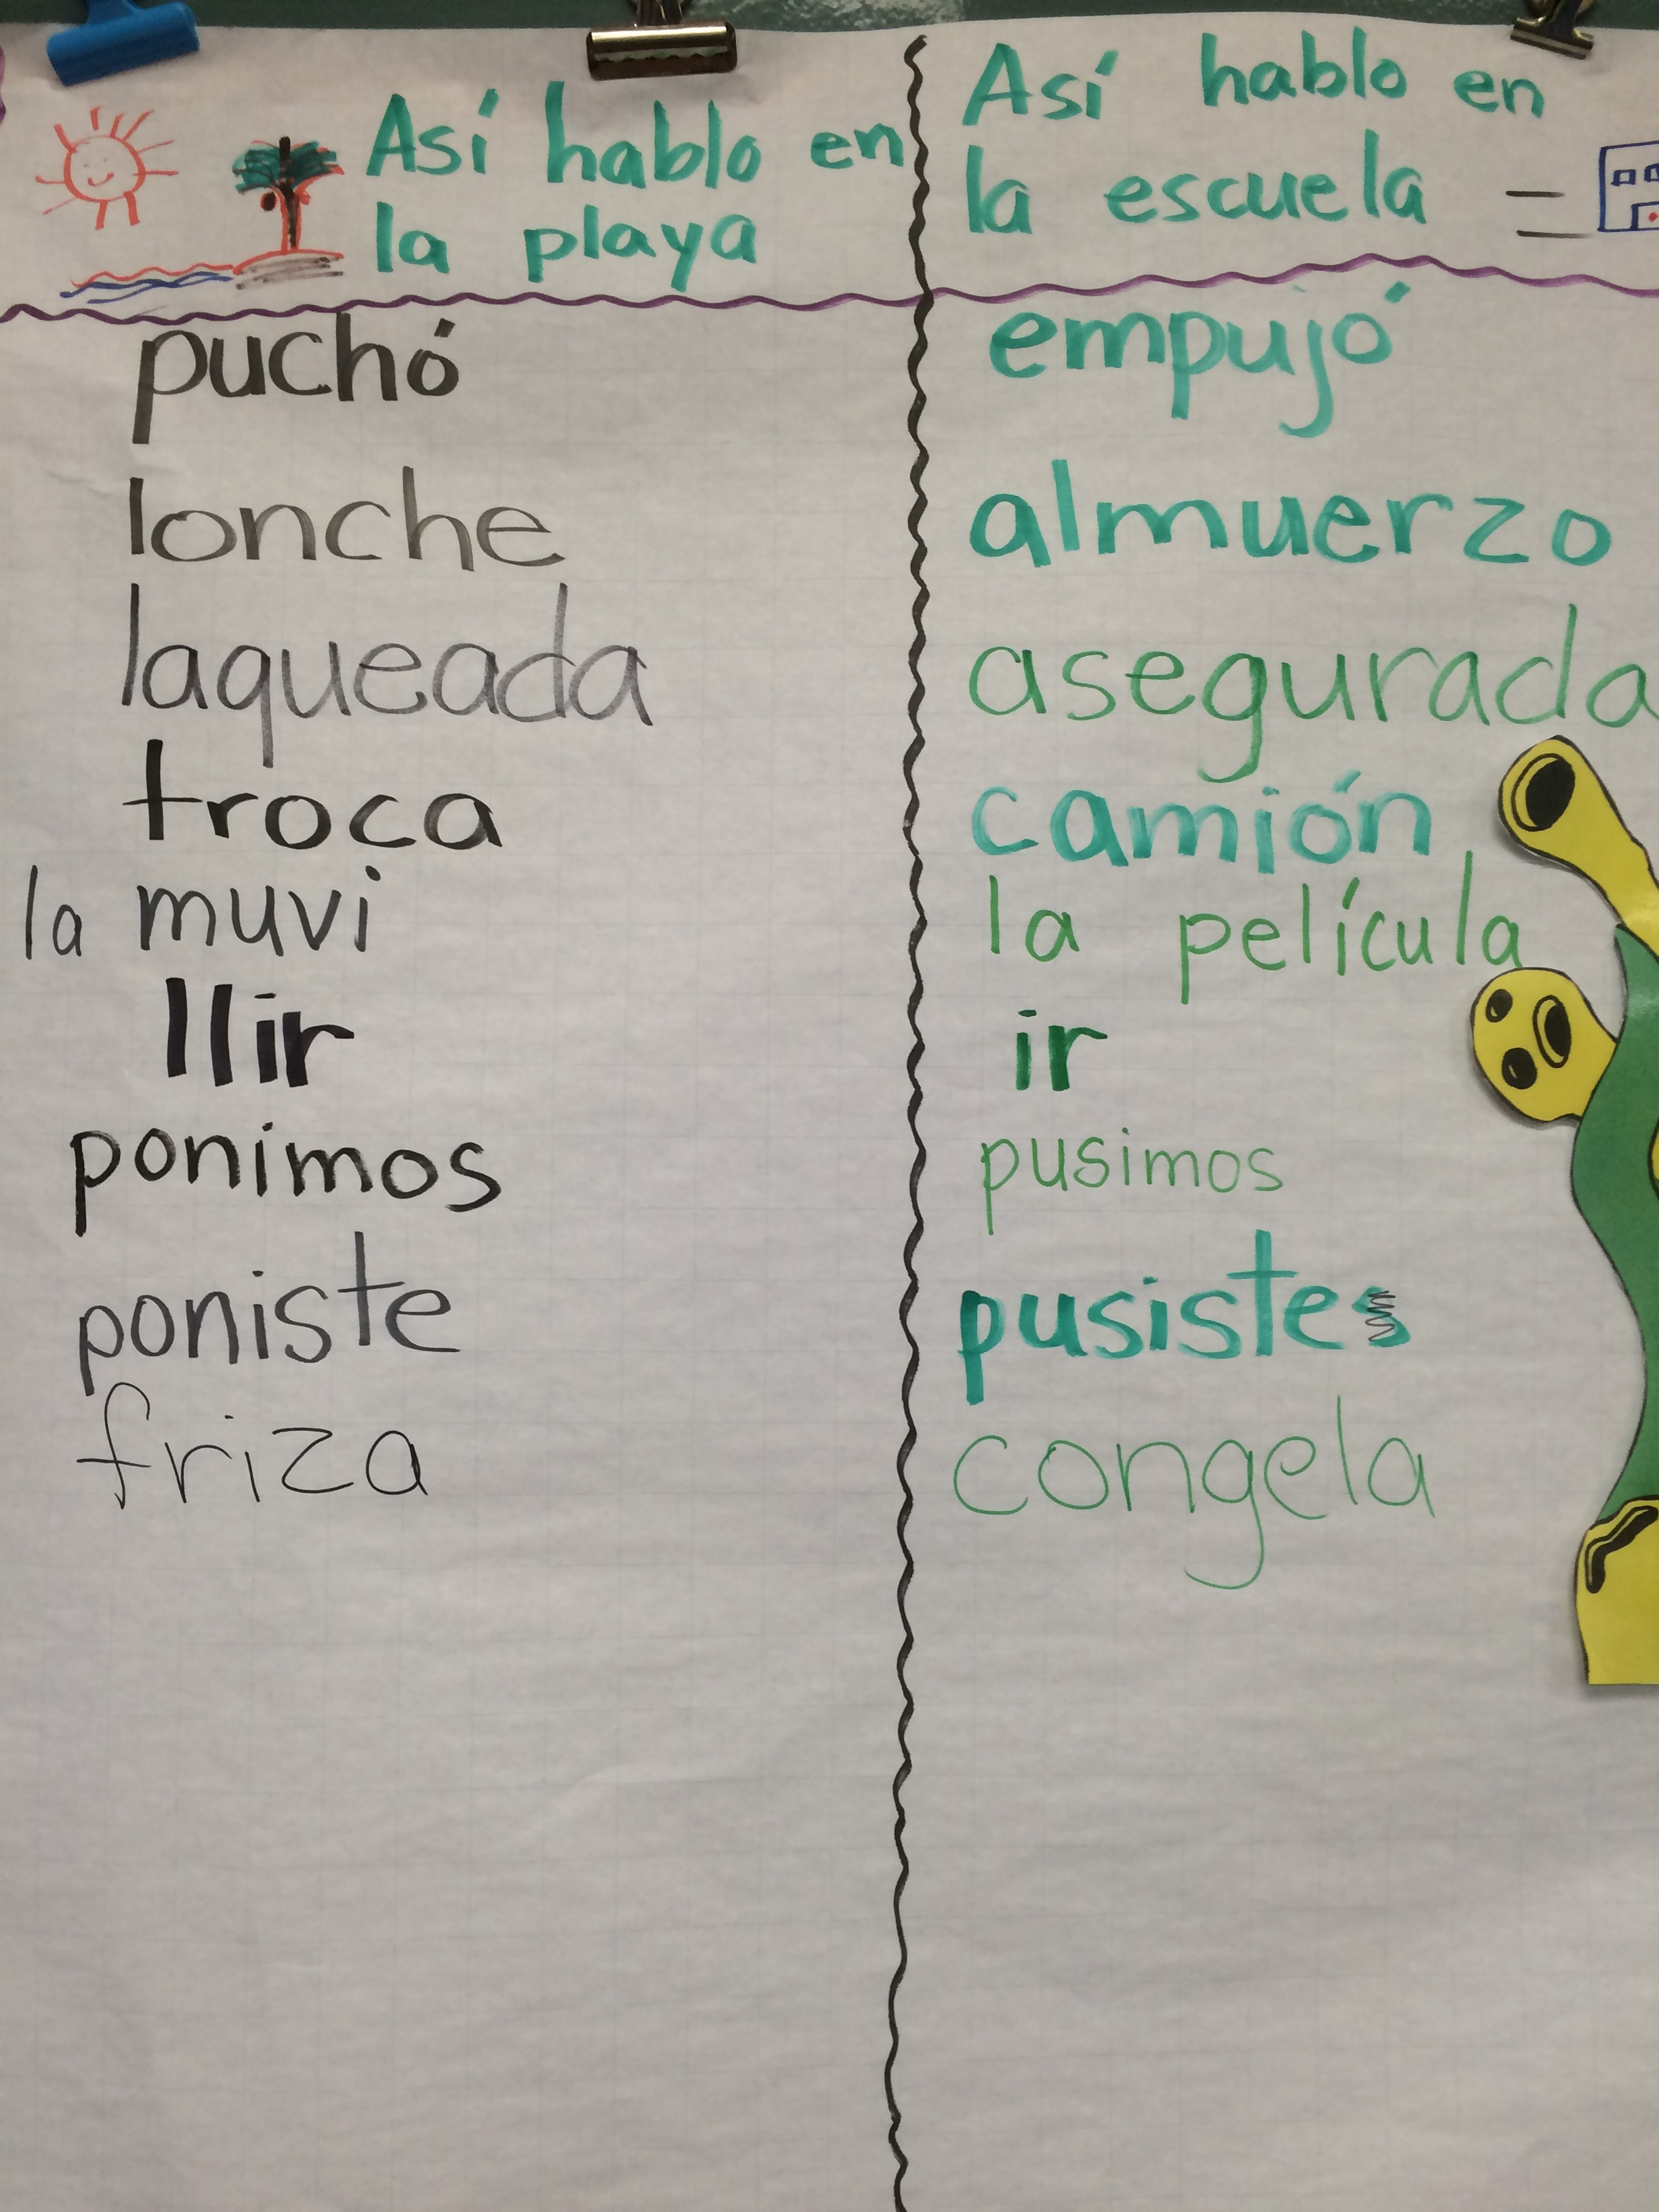
español

Slide 11
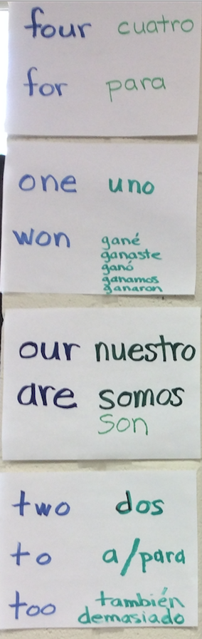
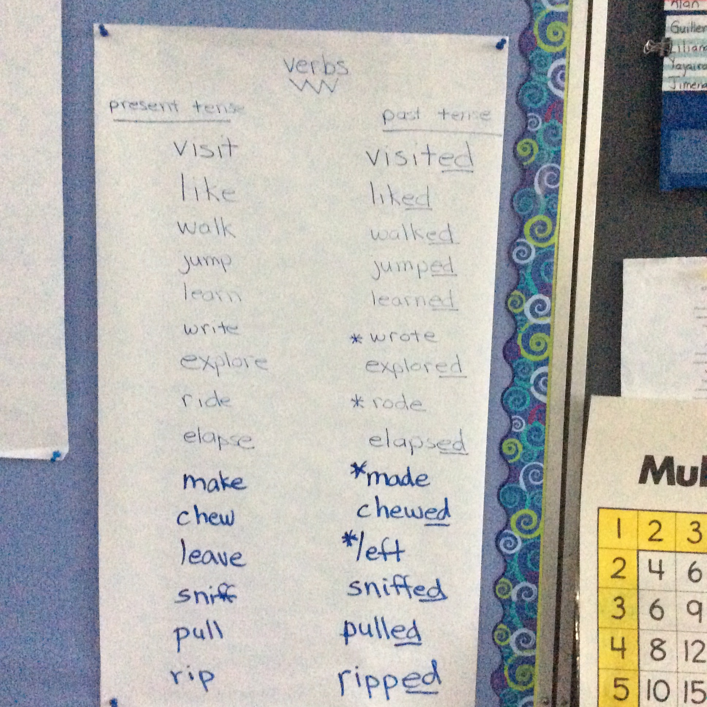
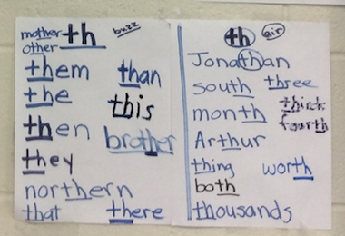
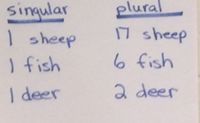
English

Slide 12
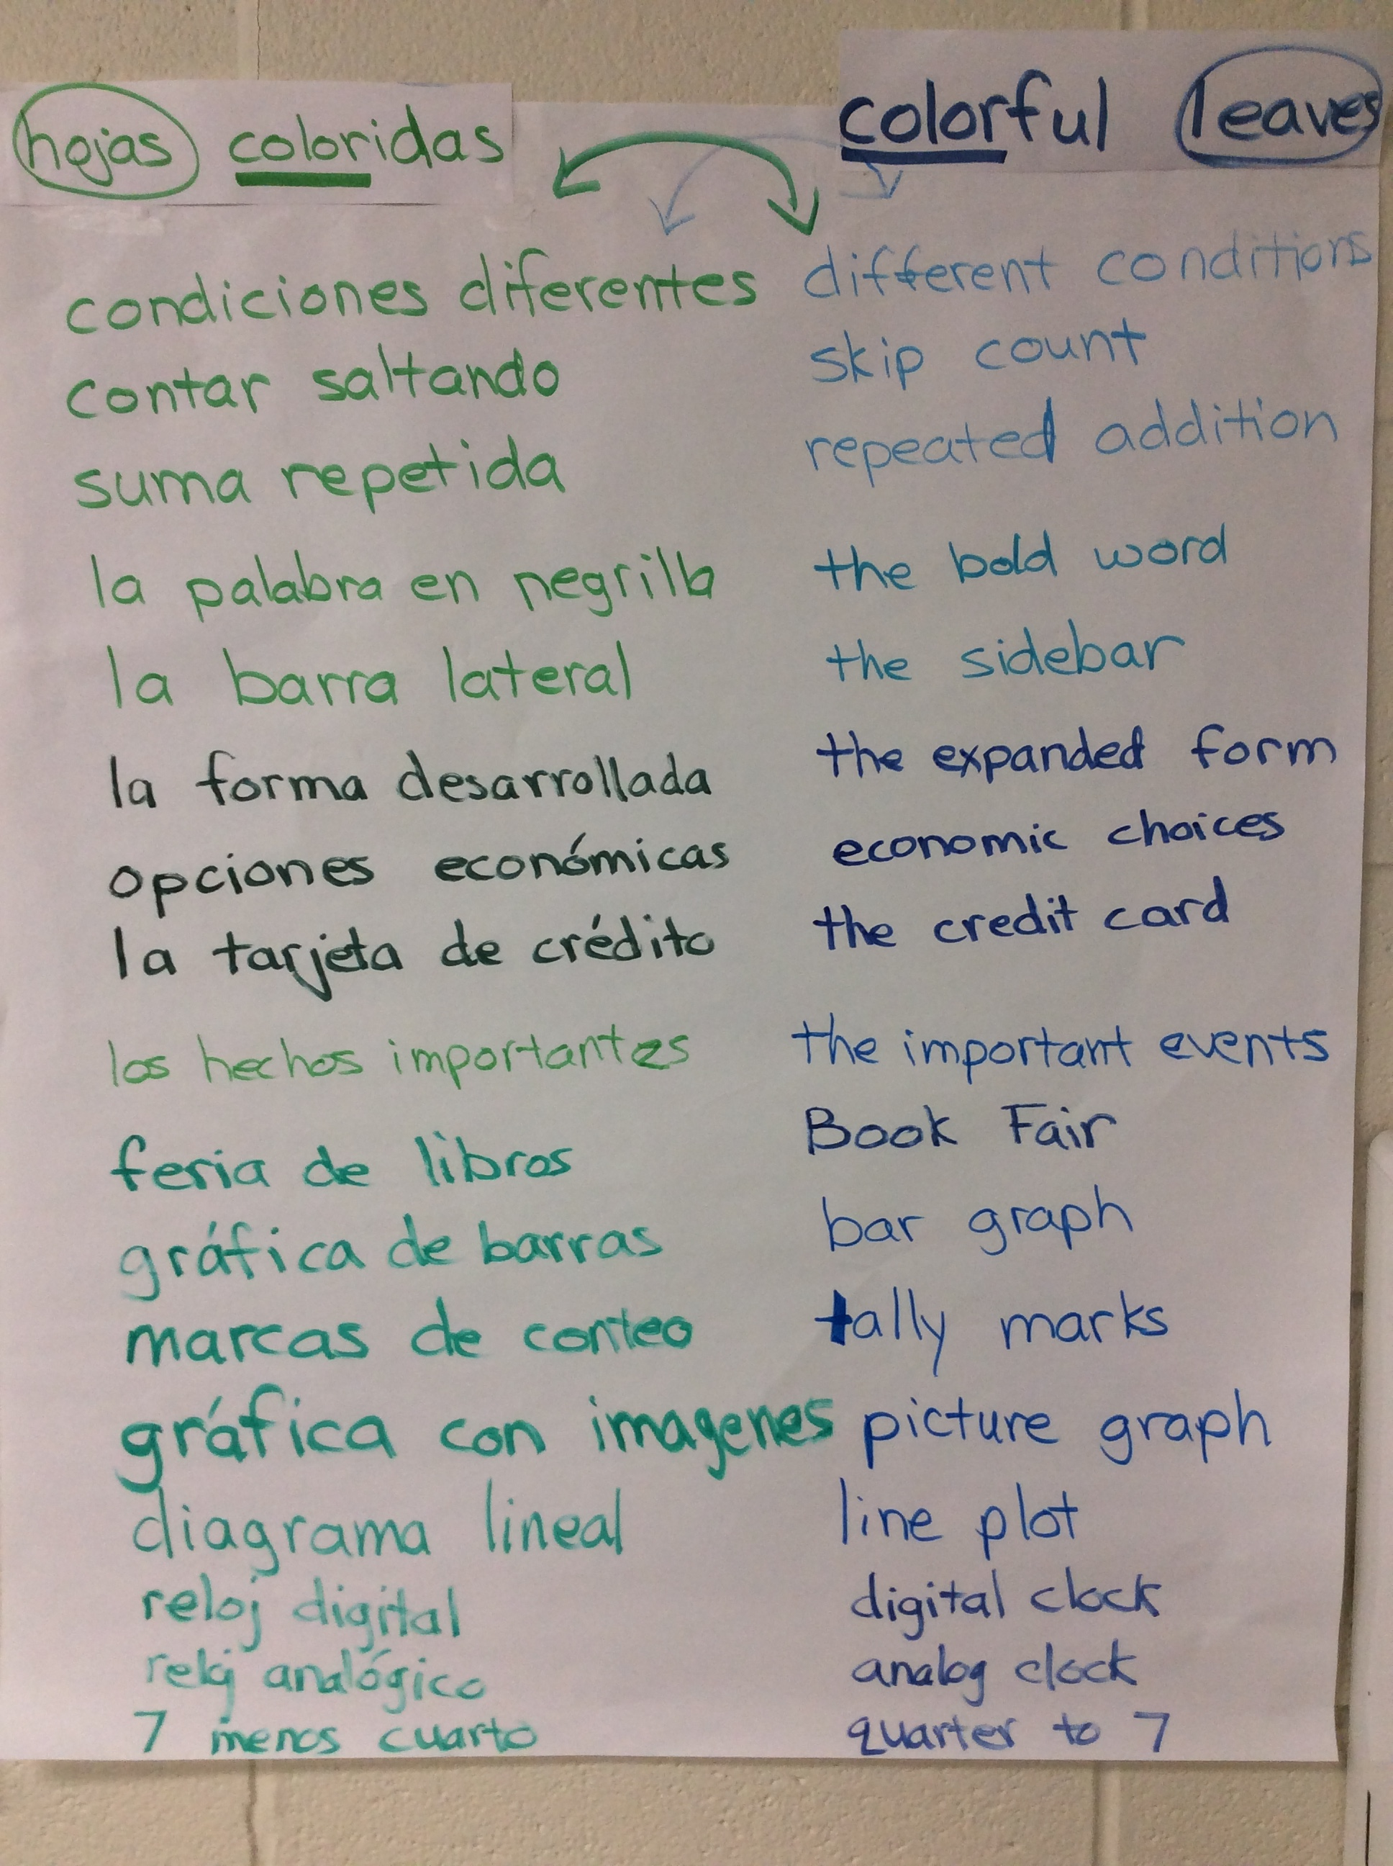
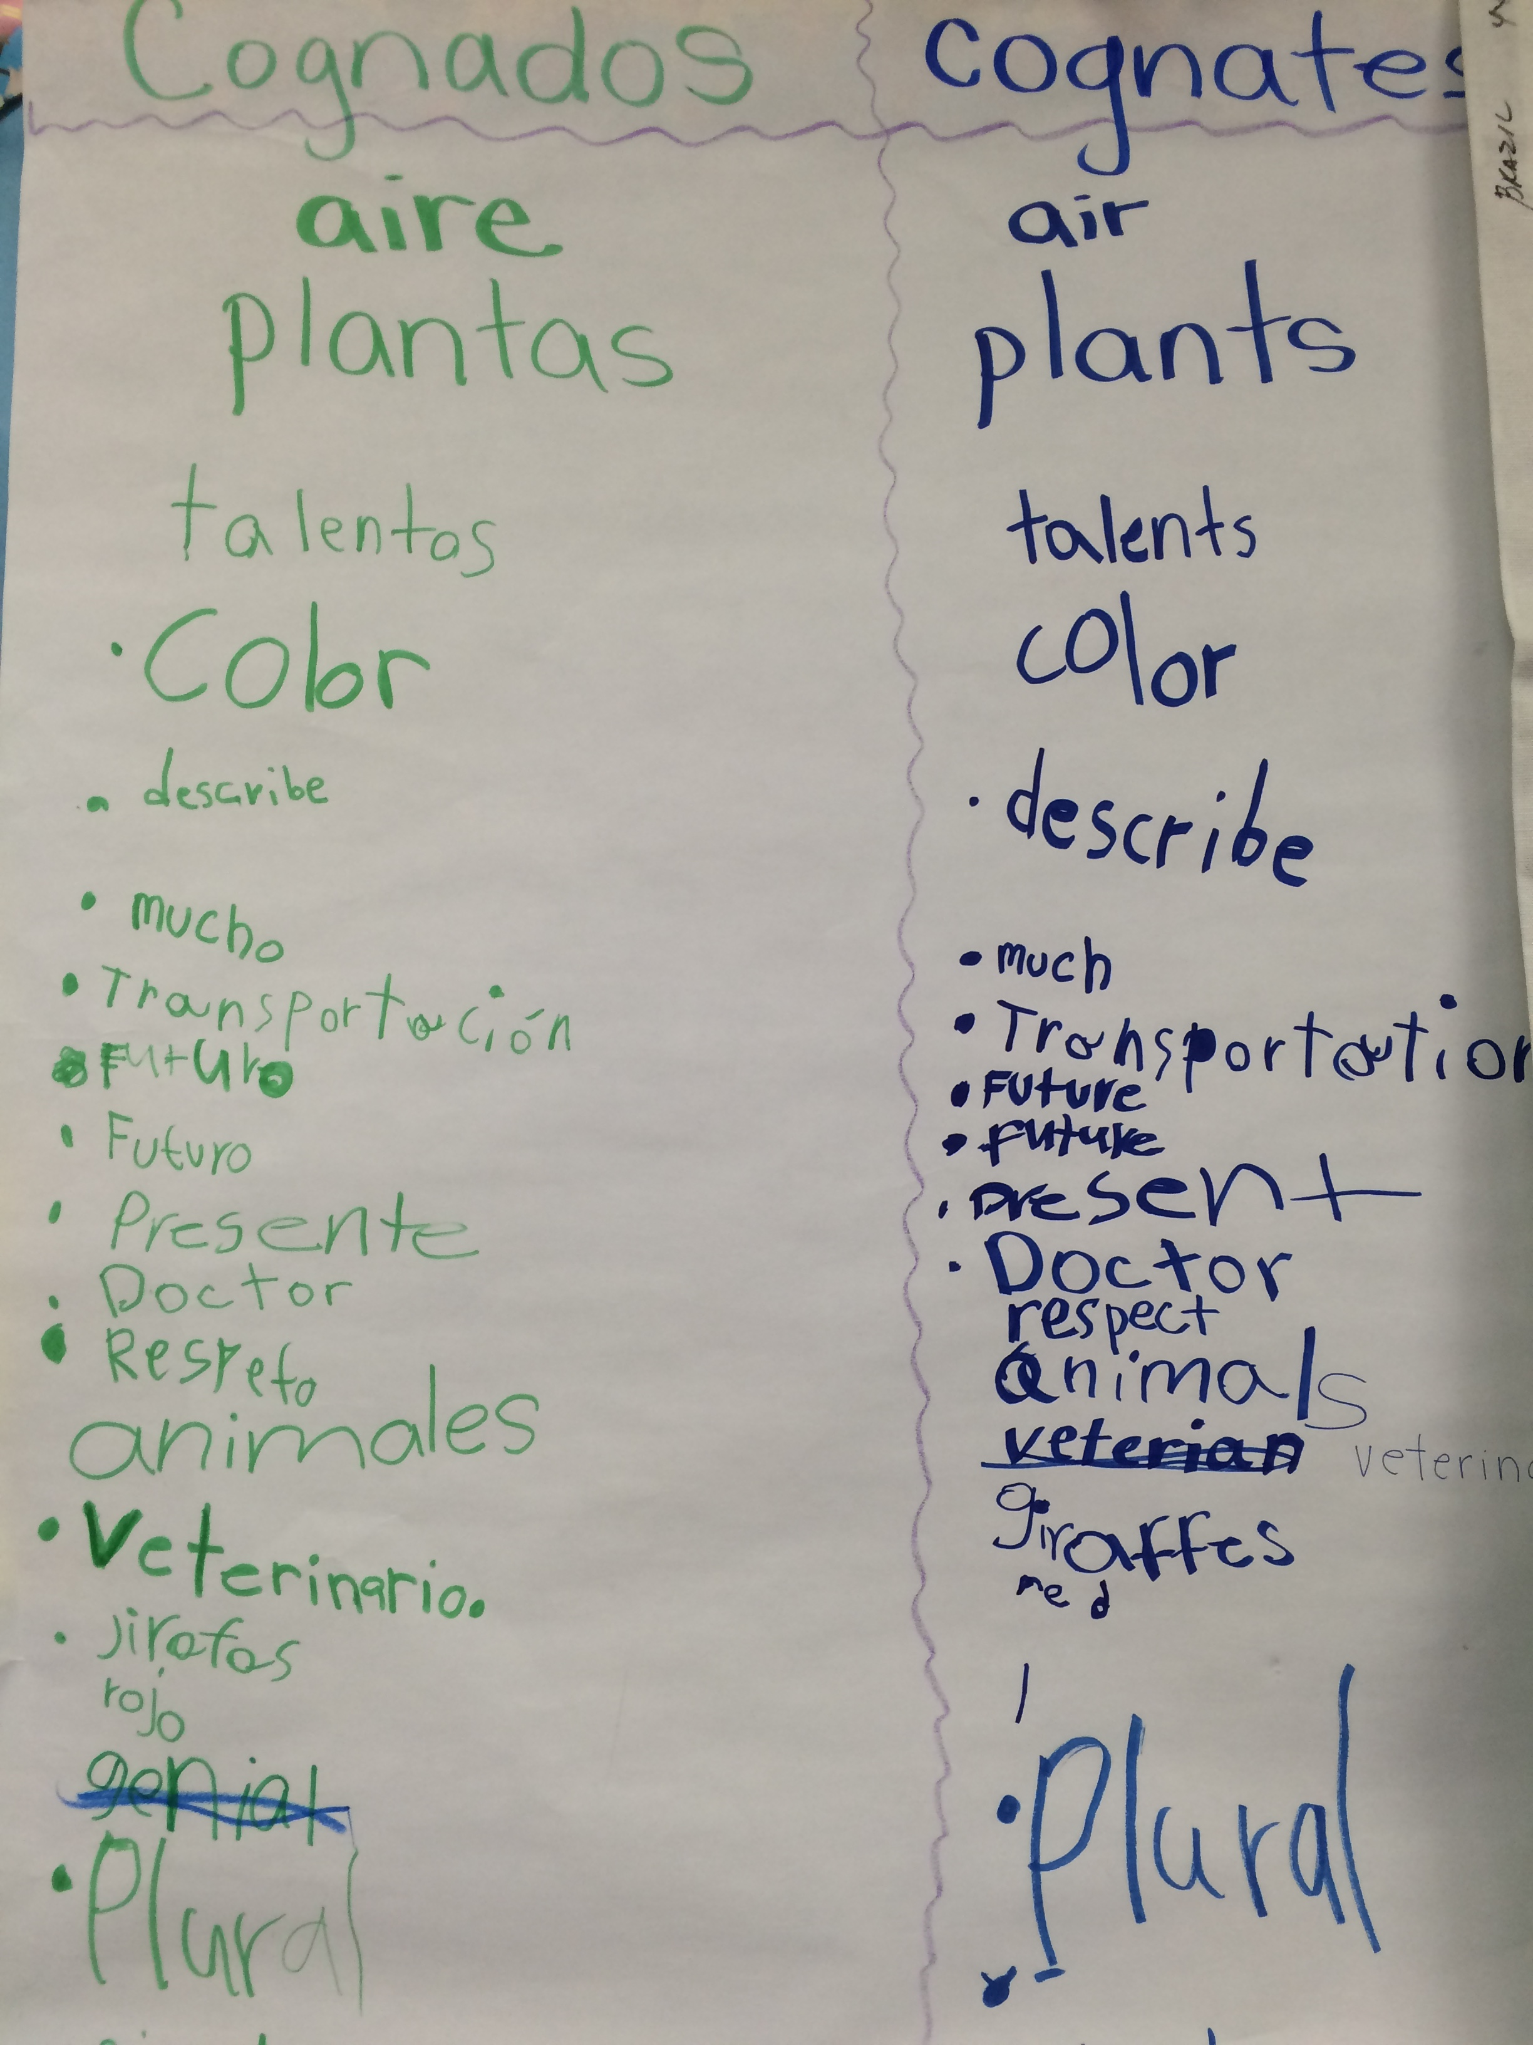
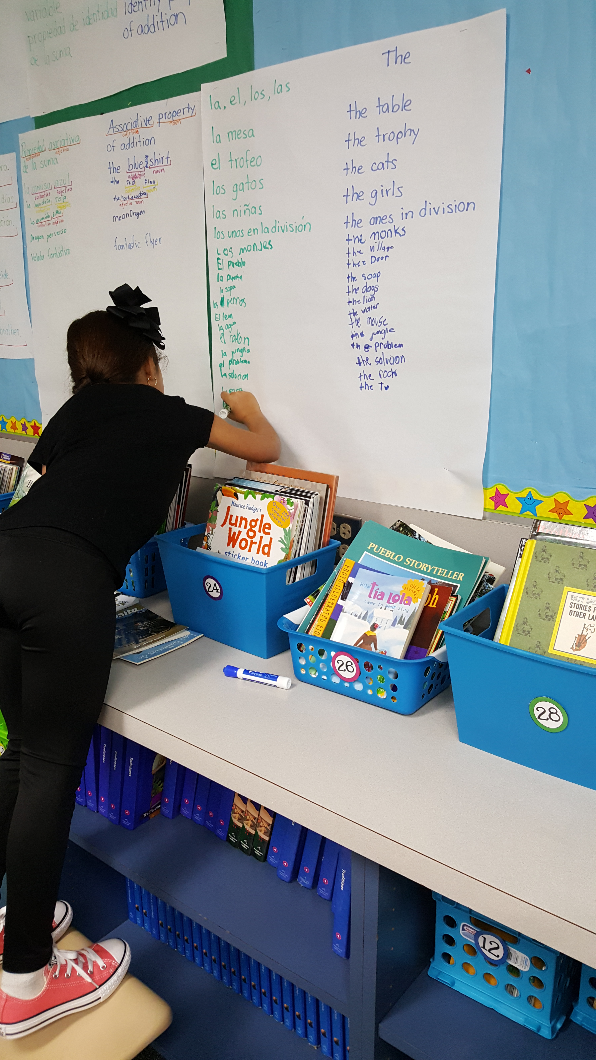
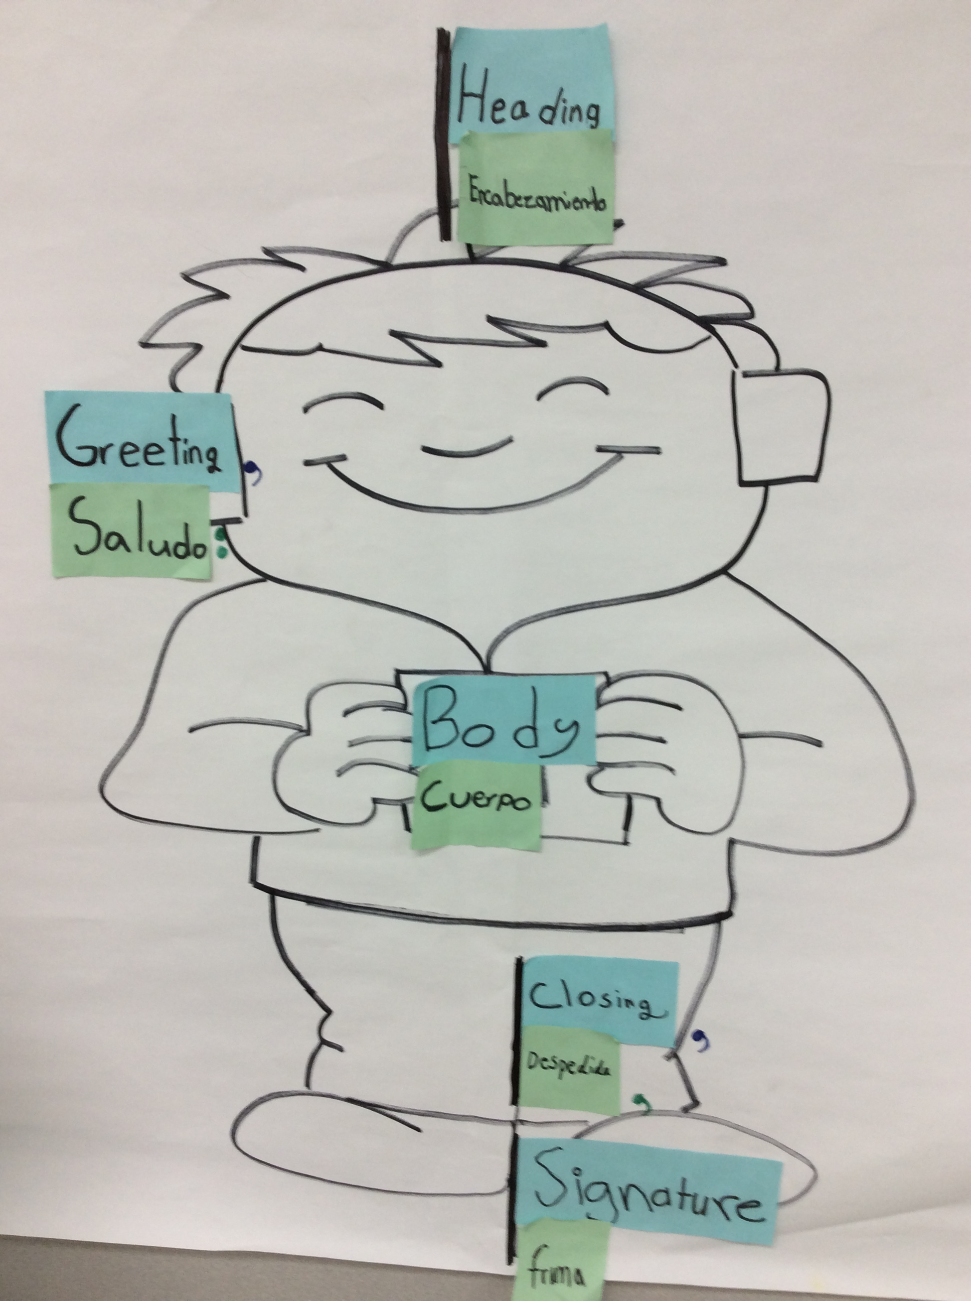
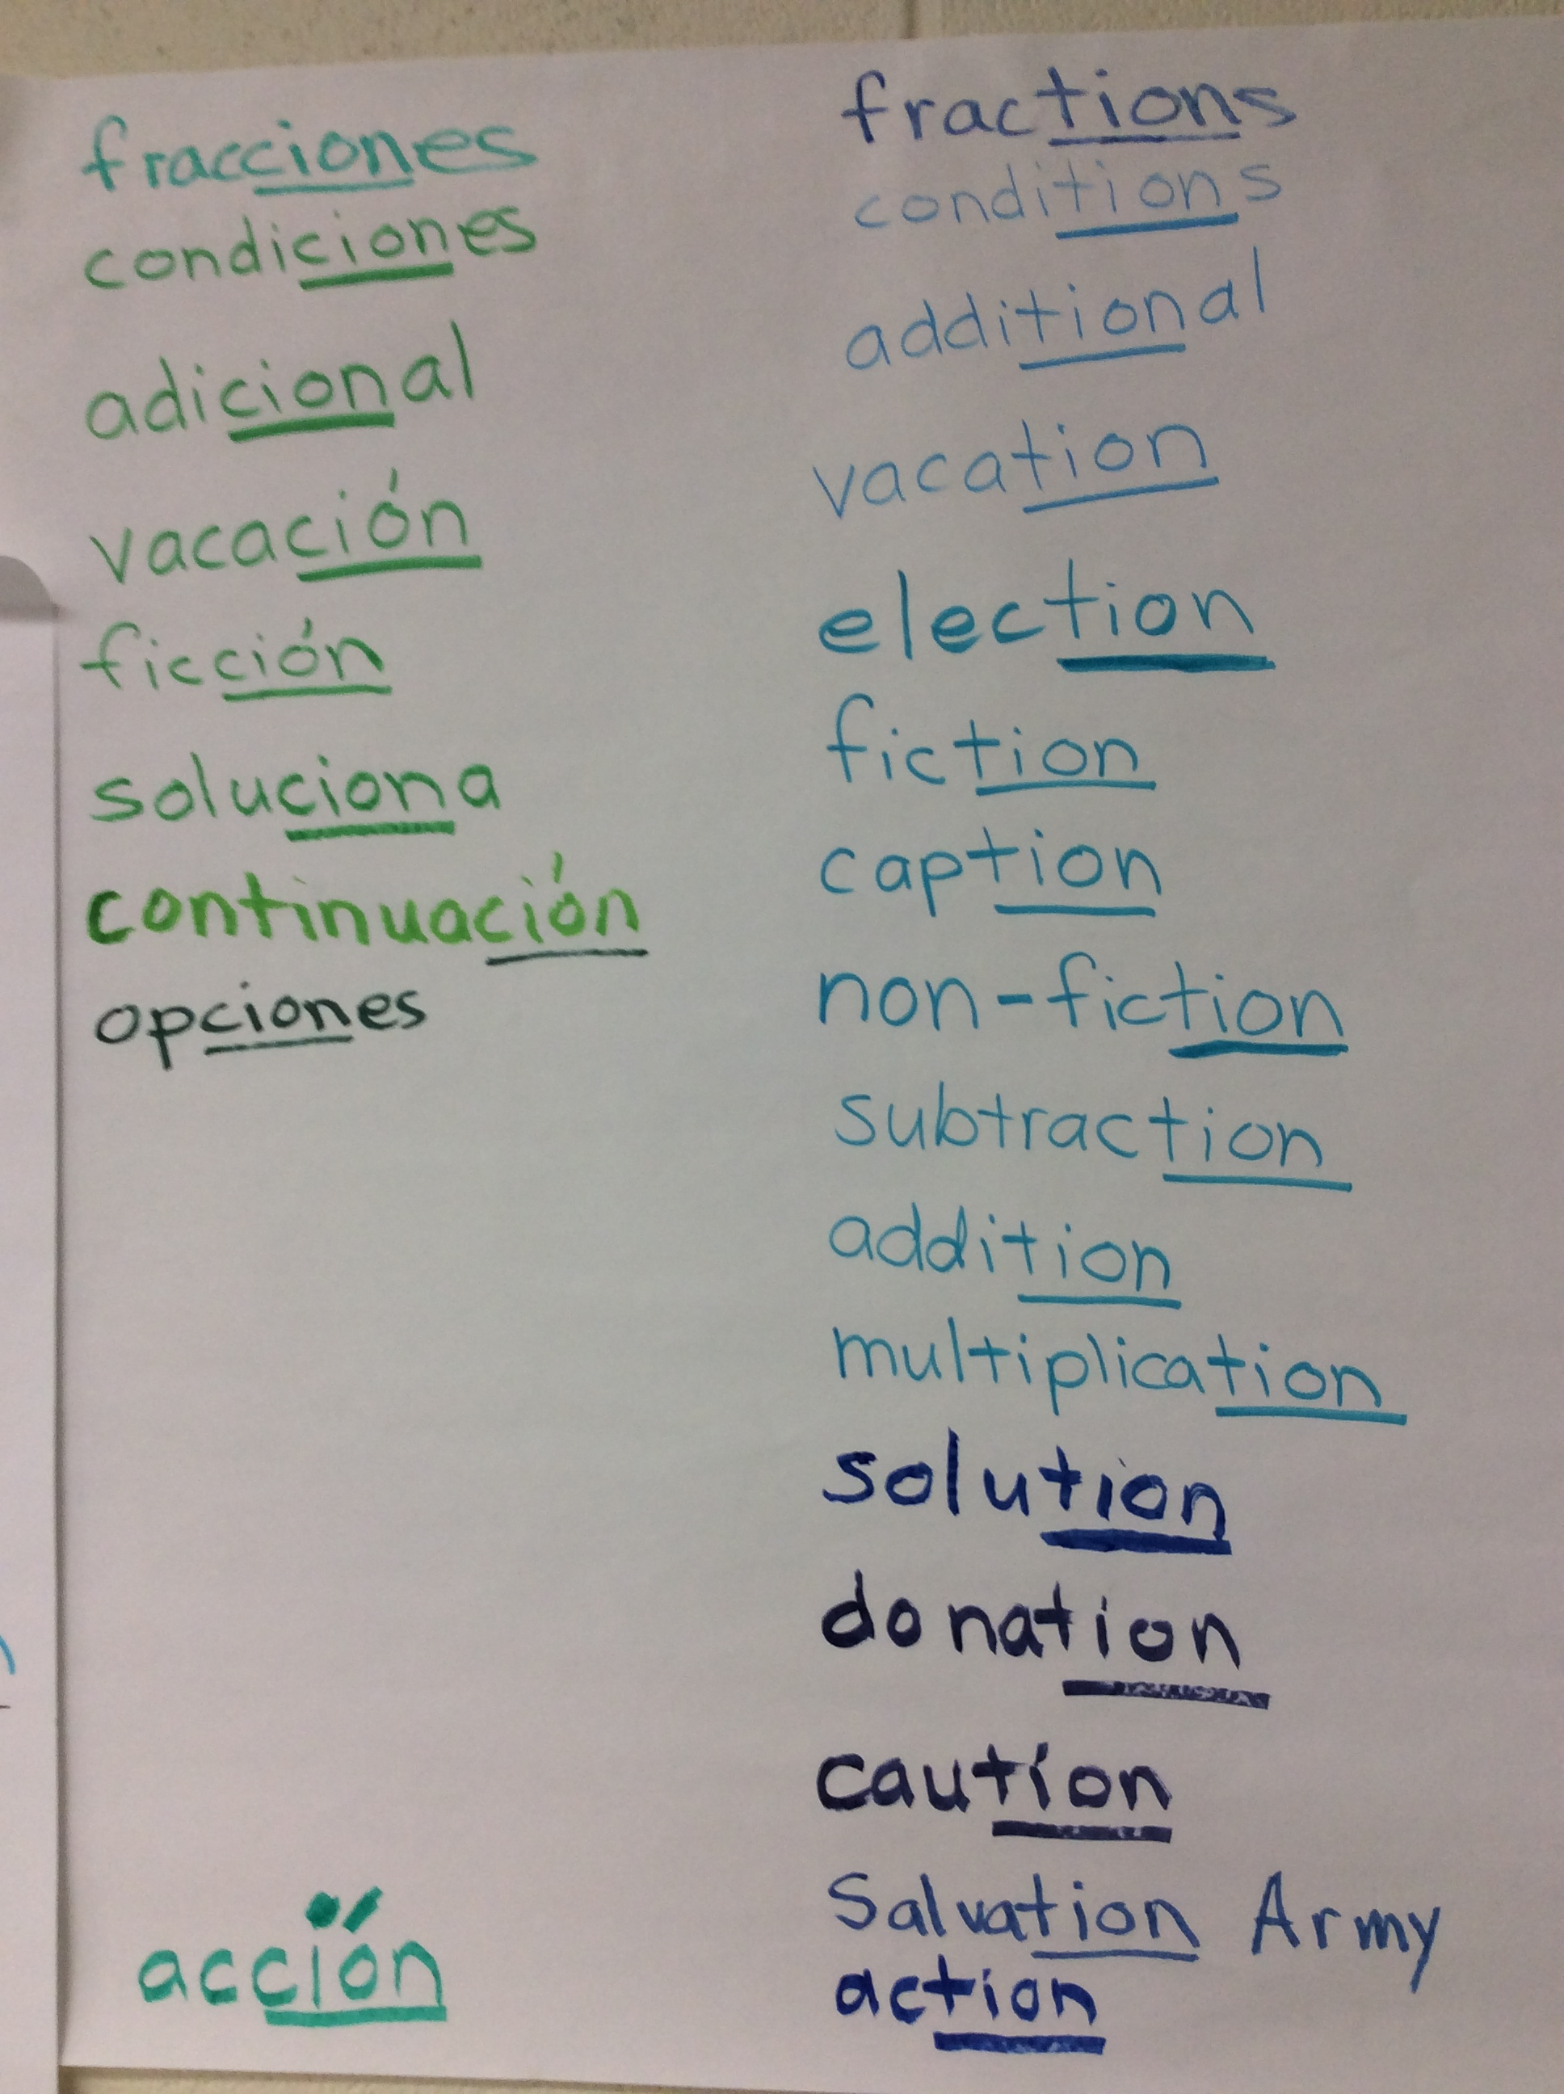
The Bridge

Slide 13
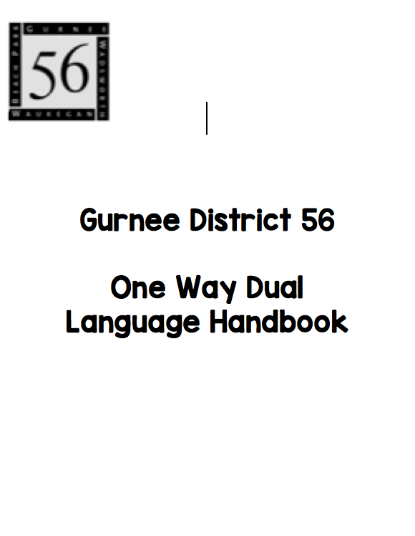
2015-16 Cheryl Urow all bilingual teachers

Slide 14
Content and Language Allocation Plan
Kindergarten: 80/20
Literacy and content area instruction, bridge, ELA extension activities
First Grade: 80/20
Literacy and content area instruction, bridge, ELA extension activities
Second Grade: 70/30
Literacy and content area instruction, bridge, ELA extension activities
Third Grade: 60/40
Literacy, science and math instruction & extension activities, bridge, social studies & ELA extension activities
Fourth Grade: 50/50
Literacy and math instruction & extension activities, bridge, science and social studies & ELA extension activities
Fifth Grade: 50/50
Literacy and math instruction & extension activities, bridge, science and social studies & ELA extension activities
Notes:
The language allocation was decided by teachers not taking into consideration the minutes per day

Slide 15
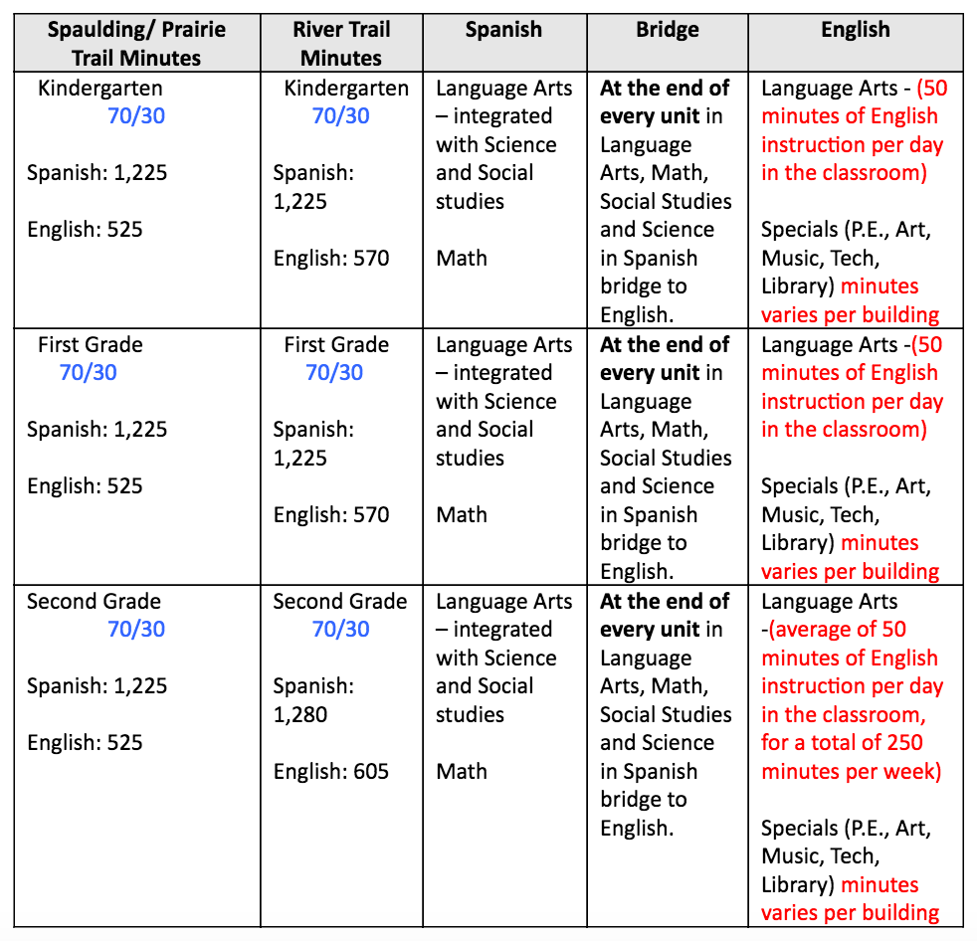
Language and Content Allocation Plan

Slide 16
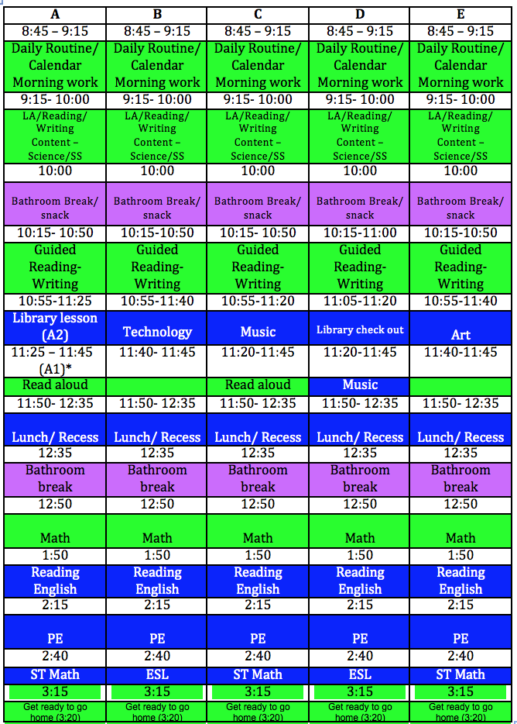
Grade 1 Schedule

Slide 17
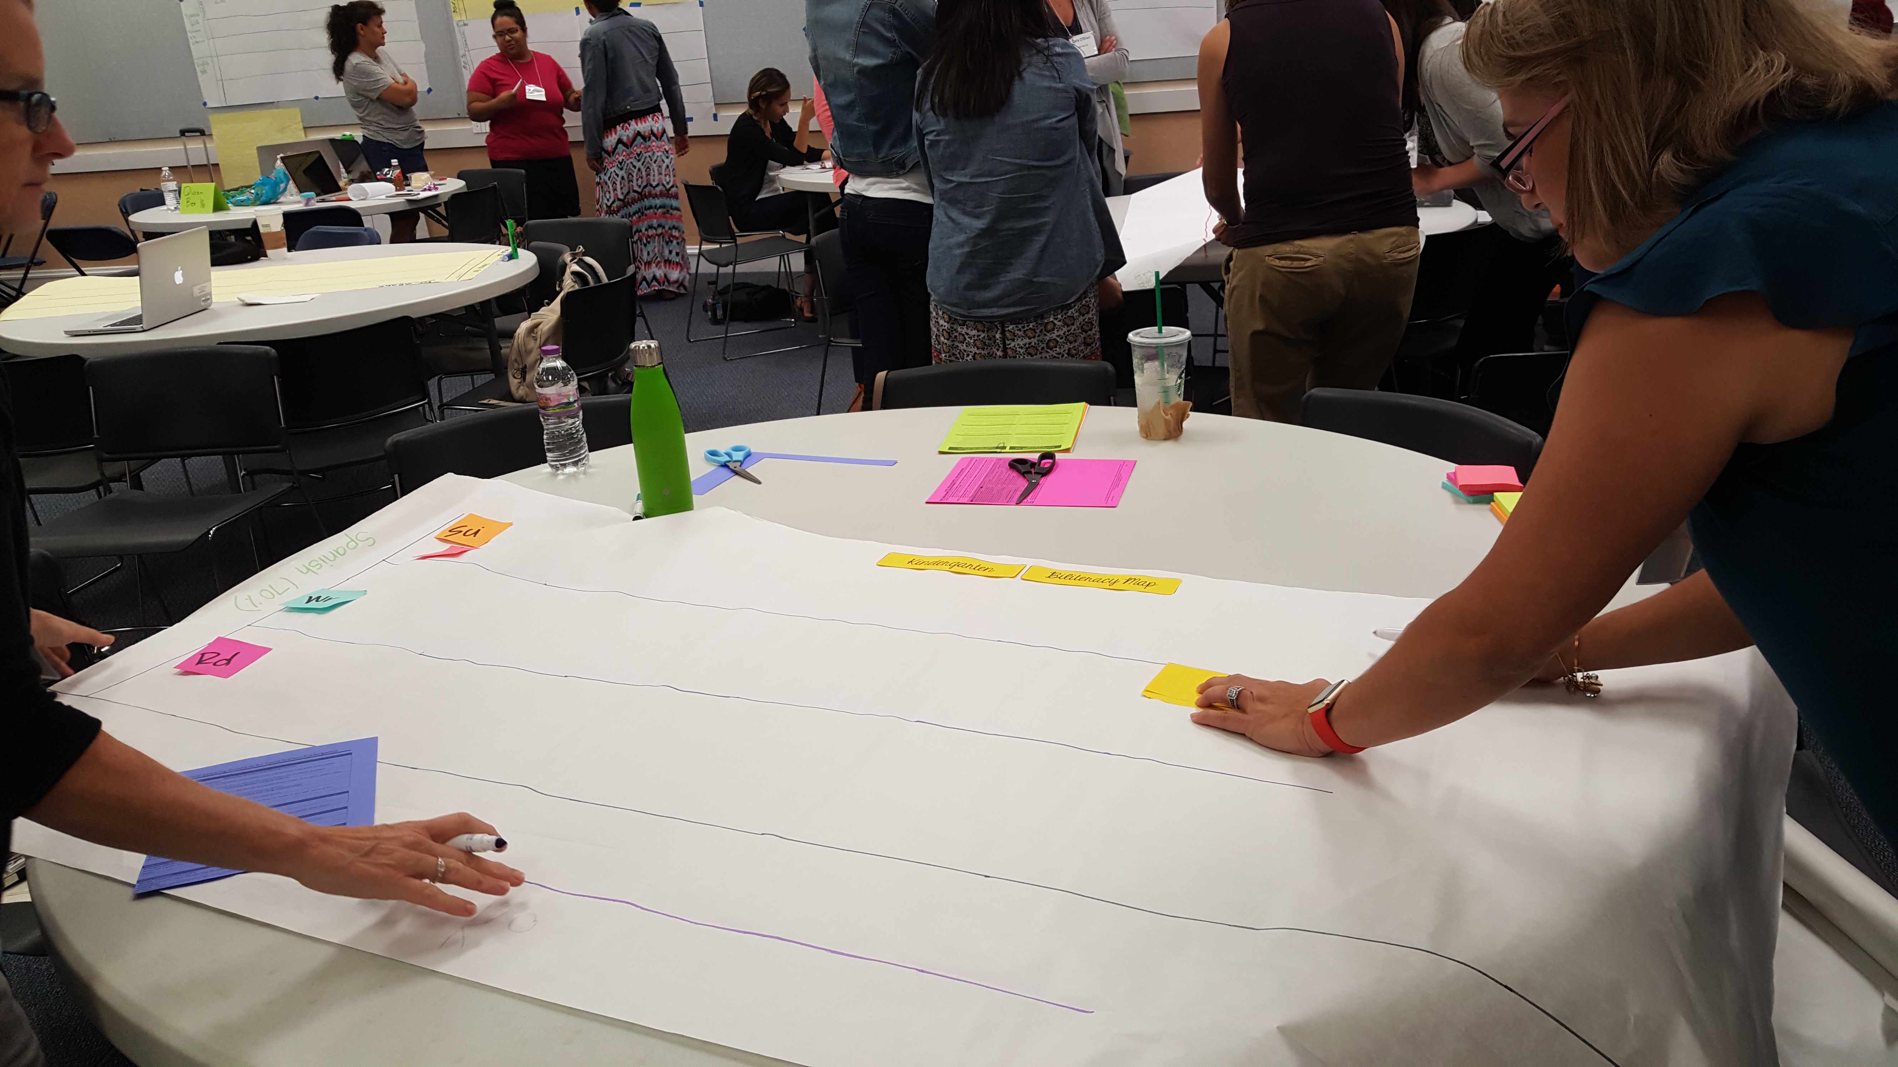
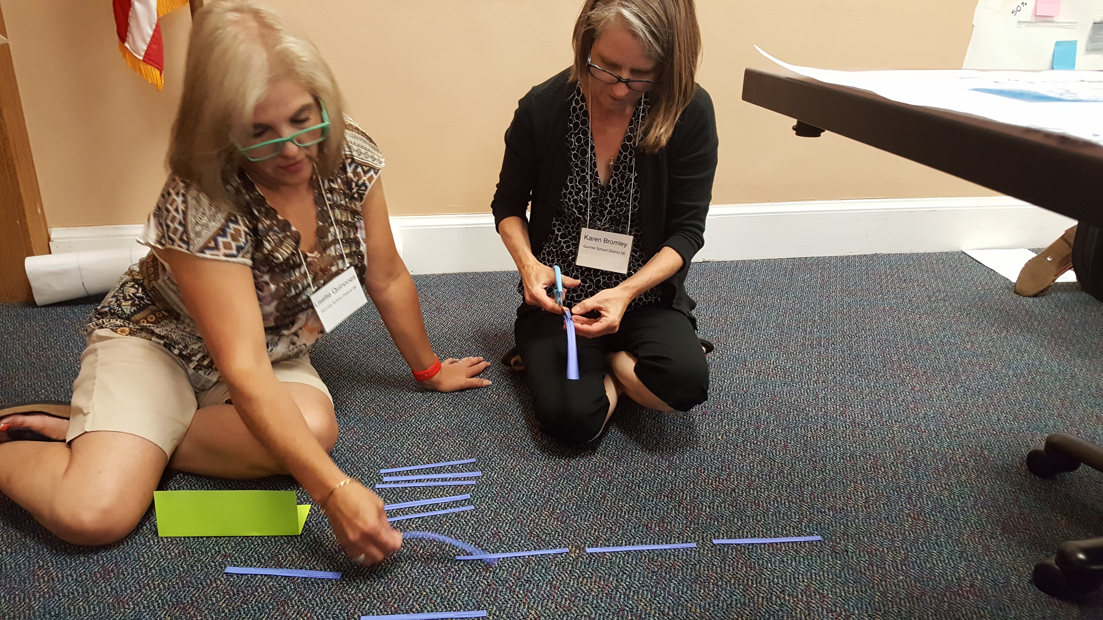
3 bilingual teachers attended BUF Writing Summit 2016

Slide 18
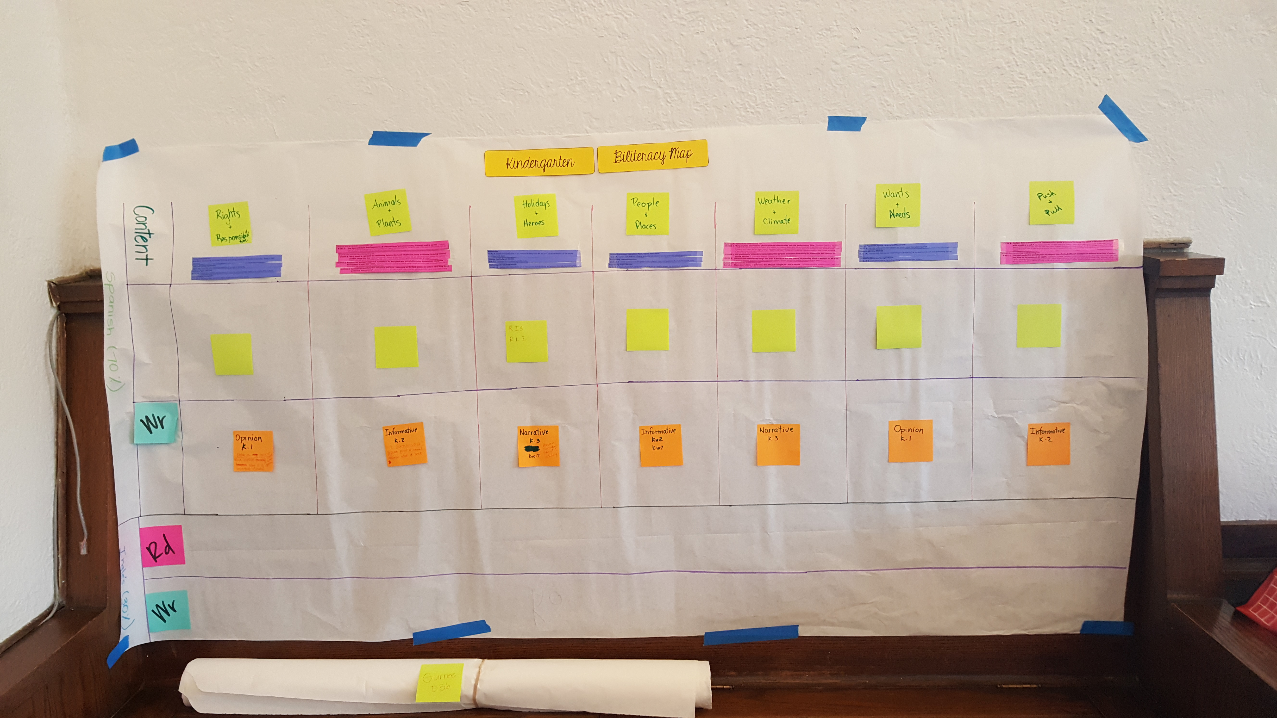
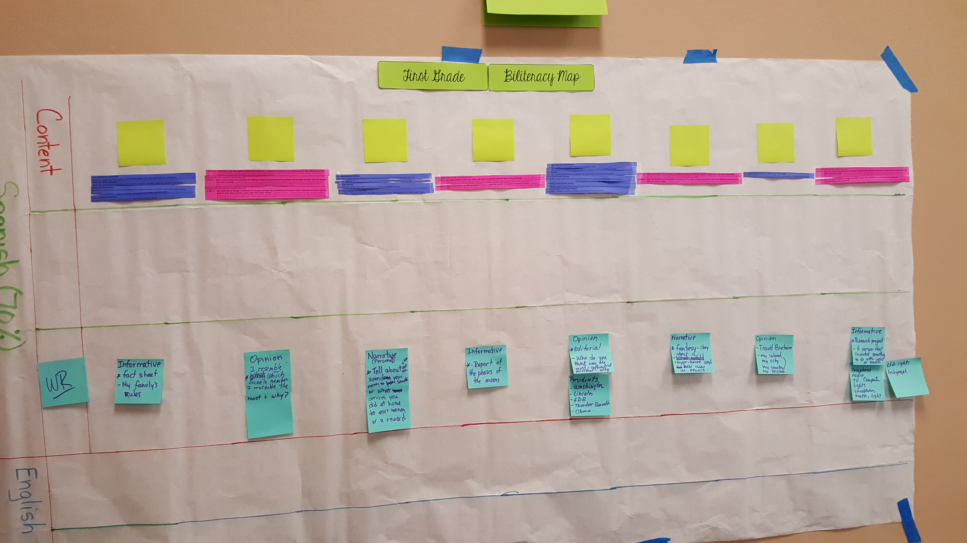
Biliteracy Maps

Slide 19
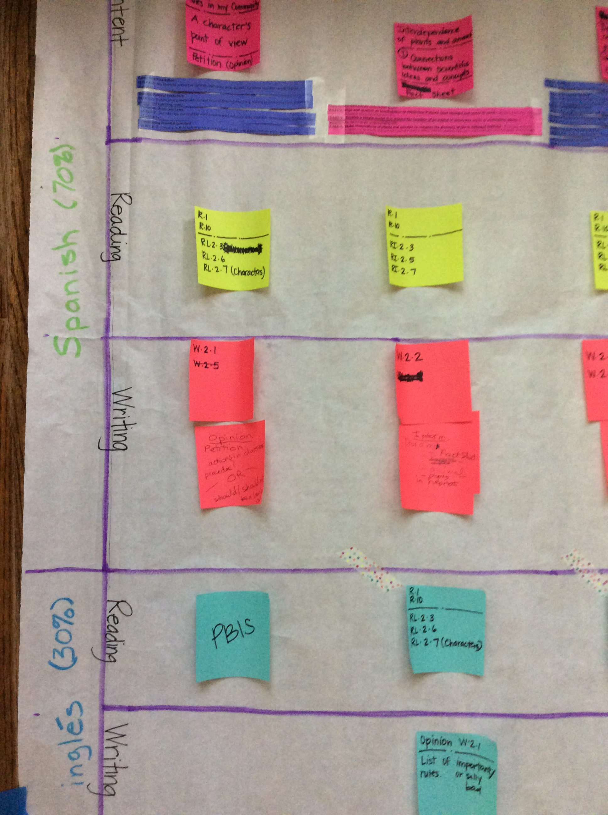

Slide 20
2016-17 Melody Wharton all bilingual teachers
Developed grades 3 & 4 biliteracy maps
Revised biliteracy maps after reviewing the NGSS and C3 Framework
Wanted to begin BUFs but glad we waited to have the groundwork set first

Slide 21
Our Struggles
Realizing that this is a process
Revising our maps because we did not understand the standards
Effectively communicating the program’s shifts with all stakeholders
Training new bilingual teachers
Writing our BUFs – hopefully this summer

Slide 22
The first steps in our journey
Mark the language of instruction
Create 3 linguistic spaces
green=Spanish
blue= English
purple=the Bridge
Teach the Bridge with intention
Dictado alternating English and Spanish
Share program shift with others

Slide 23
Our suggestions
Choose strategies you believe in and can implement now
Commit to the process
Involve as many stakeholders as possible and create a learning community

