Slide 2


Sample Unit of Instruction
The Primary Grades
Science and Spanish Language Arts
Patricia Núñez, M.Ed.
TeachingForBiliteracyPN@gmail.com
www.TeachingForBiliteracy.com
@T4Biliteracy
Teaching for Biliteracy
Notes:
Good afternoon- if you are looking for the primary grade Sample unit of instruction- in other words grades PK – 2nd, you are in the right place.

Slide 3

BILITERACY UNIT FRAMEWORK (BUF)
Spanish
PAGES 16 AND 17
What the planning looks like
English
Notes:
Here is the BUF, the document we use to plan a unit. From looking at this document, what are some things you know about teaching for biliteracy?
Talk to your elbow partner.

Slide 4
BILITERACY UNIT FRAMEWORK (BUF)
PAGES 16 AND 17
English
What the planning looks like
Spanish
Notes:
OK, now lets look at this one. What is the difference and what does it mean? What are the implications on instruction after looking at these two documents?

Slide 5
Content and Language Allocation Plan
What the DL program looks like
 | Chinese or Spanish | English
PK-2 | Math Social Studies Literacy | Science Literacy
3-5 | Math Science Literacy | Social Studies Literacy
Melody Wharton - Center for Teaching for Biliteracy
Notes:
That is right. We saw in the BUF that there is instruction planned in Spanish and instruction planned in English
But it is not random and not decided by themes, or what I like to teaching in what language. It is decided by my school’s Content and Language Allocation plan.
We are going to talk about this more during the week.

Slide 6
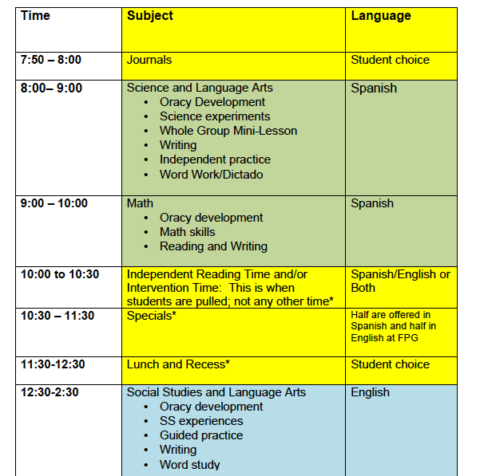
Teaching for Biliteracy Content and Language Allocation What is taught in Spanish/ Chinese?
What is taught in English?

Slide 7
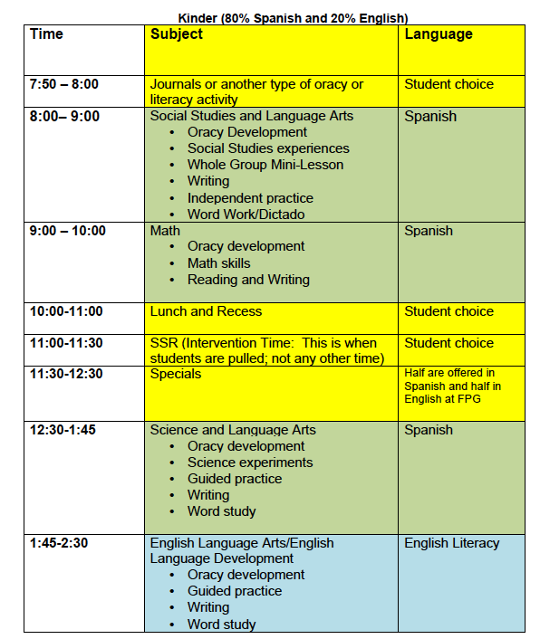
EVERYDAY
SPANISH
What does my day look like?
SPANISH
ENGLISH

Slide 8
BILITERACY UNIT FRAMEWORK (BUF)
Spanish
PAGES 16 AND 17
What the planning looks like
English
Notes:
Here is the BUF, the document we use to plan a unit. From looking at this document, what are some things you know about teaching for biliteracy?
Talk to your elbow partner.

Slide 9
Spanish Literacy Unit of Instruction

Slide 10

The purpose of Oracy is …
..to prepare ALL students for literacy success with
grade level texts and academic content.
www.TeachingForBiliteracy.com

Slide 11

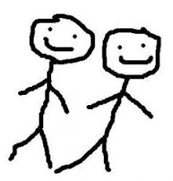
Strategic Pairing and Grouping
Marking the Language

Slide 12
As students engage in biliteracy they
ALL become developing bilinguals
Notes:
Although right you you can fit in the extremes, after the first week of kindergarten, you no longer have blue faces, orange faces, green faces and stripey faces. All you have is varying degrees of stripey. All students become stripey.

Slide 13
“Bilingual” does not mean “balanced”.
=
Wharton, teachingforbiliteracyMW@gmail.com, 2017
Notes:
Now that does not mean the students will be balanced bilingual

Slide 14
Sample Biliteracy Instruction
Spanish Literacy Unit of Instruction

Slide 15
Day 1
Science – with integrated language and literacy and content
ORACY BUILDING – language building in anticipation of literacy and content instruction
Notes:
oracy – oral language – receptive and productive oral language – directly tied to content and literacy. Rather than the way I began the unit (KWL or read aloud) Biliteracy begins with oracy building. And this is critical to a successful Bridge.

Slide 16

JJULIO
JULIO 2018
Empezar la unidad

Slide 17
Strategic Pairing and Grouping
Marking the Language

Slide 18
Day 2
Science – with integrated language and literacy and content
MORE ORACY BUILDING

Slide 19
Also on Day 2
Science – with integrated language and literacy and content
Experiments and investigations with weather reports and instruments of
measurement

Slide 20
JJULIO
JULIO 2018
Empezar la unidad

Slide 21
Day 3
Science – with integrated language and literacy and content
Moving from oracy to literacy – writing and phonics
More experiments and investigations
Notes:
Now do LEA – and then focus on word study – mariposa – ma, me , mi, mo, mu – make a chart and everything.

Slide 22
JULIO 2018
Empezar la unidad

Slide 24
Partner A:
1. ¿Cuál será la temperatura de mañana?
Partner B:
2. La temperatura de mañana será ___ grados centigrados. Anótalo por favor.
Partner A:
3. ¿Cuál será la velocidad del viento de mañana?
Partner B:
4. La velociad del viento mañana será ___ kilómetros por hora (k/h). Anótalo por favor.
Partner A:
5. ¿Va estar nublado mañana?
Partner B:
6. _________ va estar nublado mañana. Anótalo por favor.
Notes:
Partner A:
¿Qué dice el pronóstico del _(día)__?
Partner B:
El pronóstico del __dice que la temperatura
será __ grados.
Partner A:
Anotaré que dice que la temperatura será ___ grados.
Partner B:
También dice que la velocidad del viento será ____km/h

Slide 25
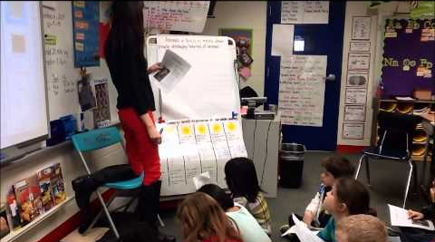
LEA: Language Experience Approach
And Oracy Development
Notes:
Ahora vamos a hacer un resumen de lo que nos dice el pronóstico de tiempo.
Toquen dedos con su pareja. ¿qué es un bueno titulo para nuestro resumne?
Platicquen con su pareja.

Slide 26
Days 4, 5, 6, 7…
Science – with integrated language and literacy and content
Reading
Continued experiments and investigations
Notes:
maybe skip to the read aloud.

Slide 27
The purpose of Oracy is …
..to prepare ALL students for literacy success with
grade level texts and academic content.
www.TeachingForBiliteracy.com

Slide 28


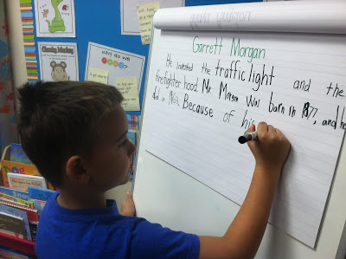
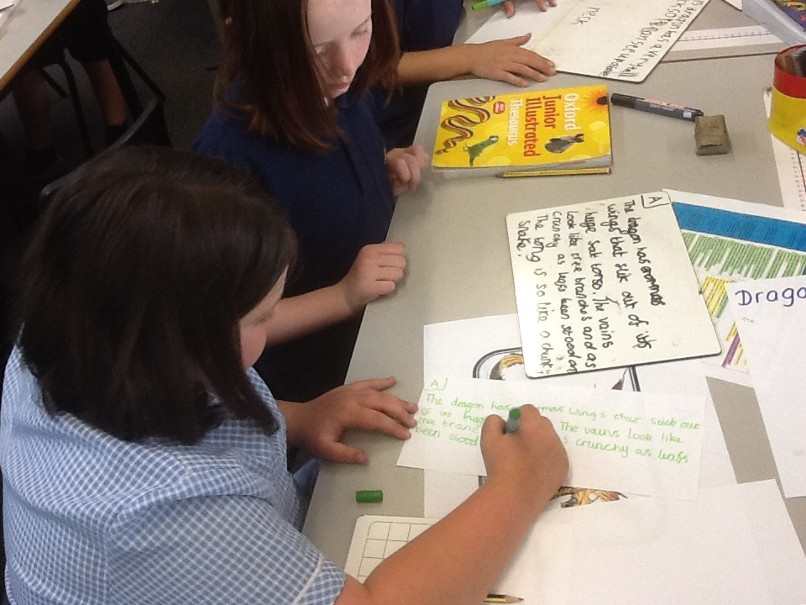
Throughout the unit we….

Slide 29
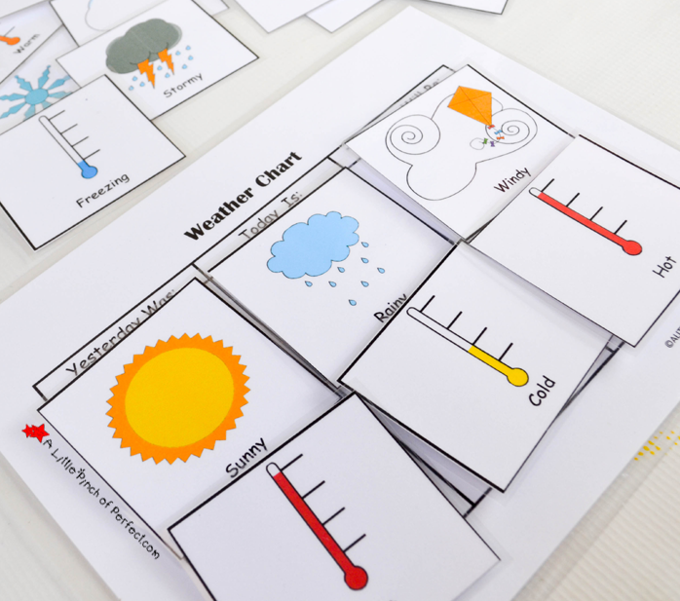
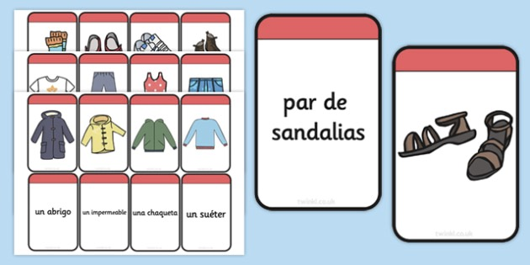
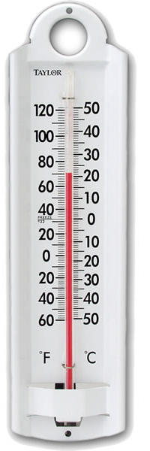
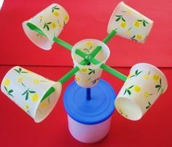
Pronóstico del tiempo

Slide 30
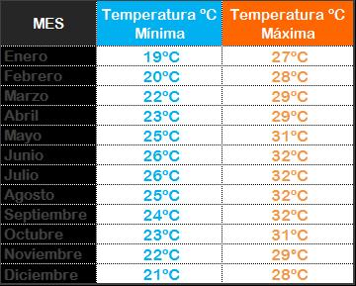
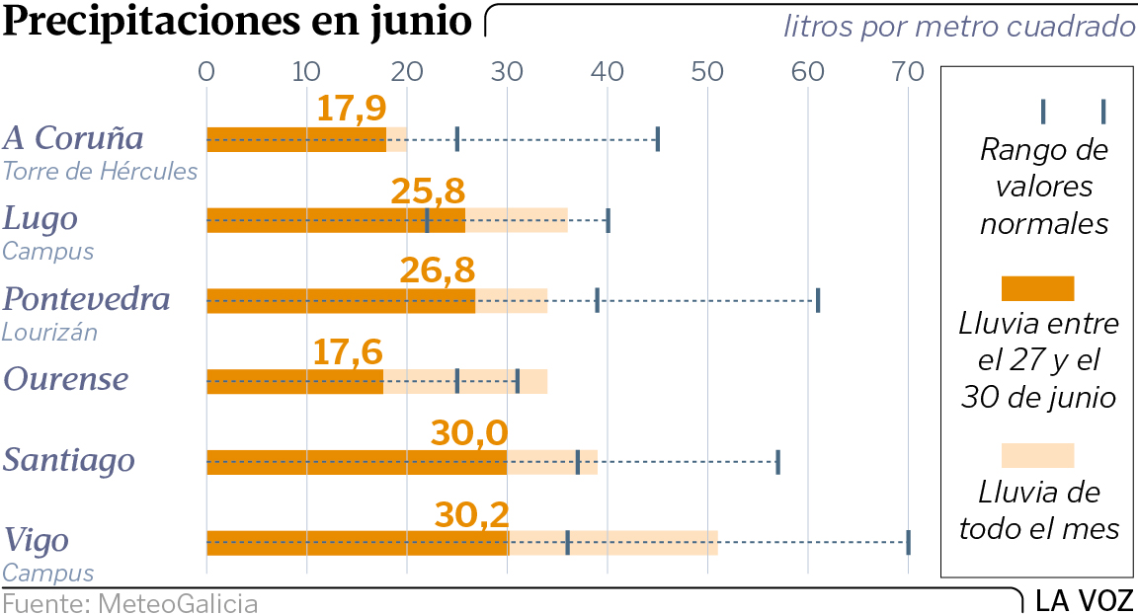

Slide 31
JULIO 2018
Empezar la unidad

Slide 32
LEA: Language Experience Approach
And Oracy Development
Notes:
Hemos estado leyendo muchas graficas y haciendo muchos reportes sobre el cambio de clima y como afecta las actvidades de la gente.
¿Comó podemos explicar este proceso de leer las graficas para poder hacer una lista de instructiones para que alguien sepa hacer su propia grafica?

Slide 33
About Day 14…
Science – with integrated language and literacy and content
Final project on weather (summative assessment)

Slide 34
JULIO 2018
Empezar la unidad

Slide 35
Pronóstico del tiempo

Slide 36
Throughout the unit we….

Slide 37
About Day 15…
The Bridge and
Content Focus

Slide 38

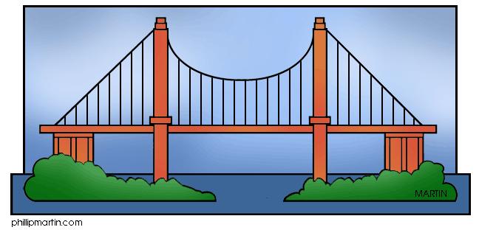
JULIO 2018
Empezar la unidad

Slide 39


Slide 40
clima
el pronóstico del tiempo
la temperatura
nublado
velocidad del viento
como vestirse
que hacer
weather
the weather forecast
the temperature
cloud coverage
wind speed
to dress
activities to do
Notes:
Bridge Metalinguistic Focus
While the teacher plans a specific metalinguistic teaching point in advance of the Bridge, the teacher also accepts and highlights other areas of
Metalinguistic Skills
Syntax and Grammar
SIDE BY SIDE
vestirse
To dress
hacer
To do
pararse
To stand

Slide 41
About Day 16…
The Bridge and Metalinguistic Focus

Slide 42
JULIO 2018
Empezar la unidad

Slide 43
The Bridge

Slide 44

Strategic Pairing and Grouping
Marking the Language

Slide 45
JULIO 2018
Empezar la unidad

Slide 46
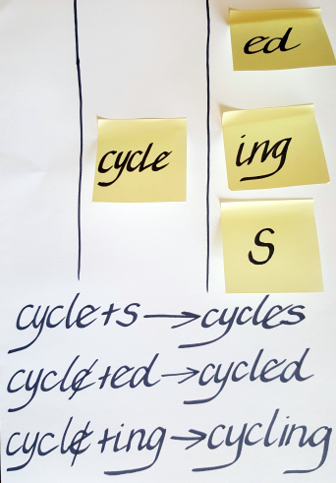
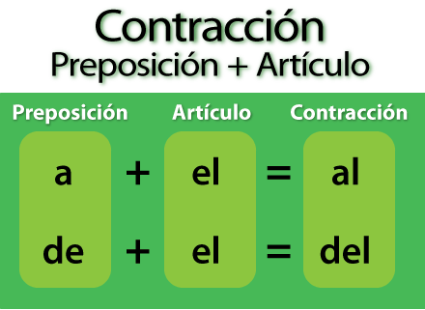
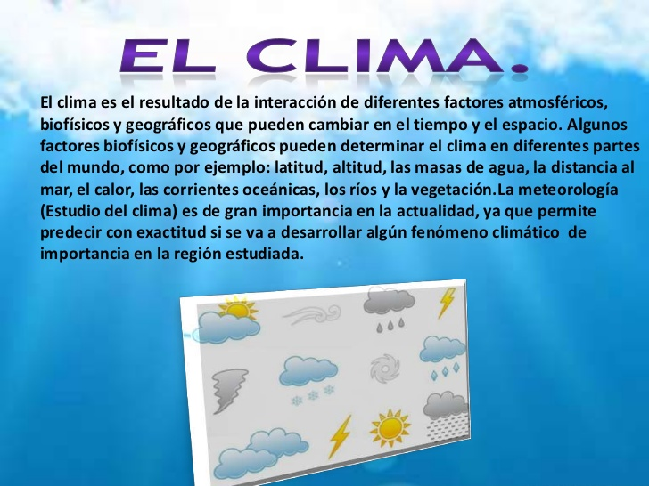
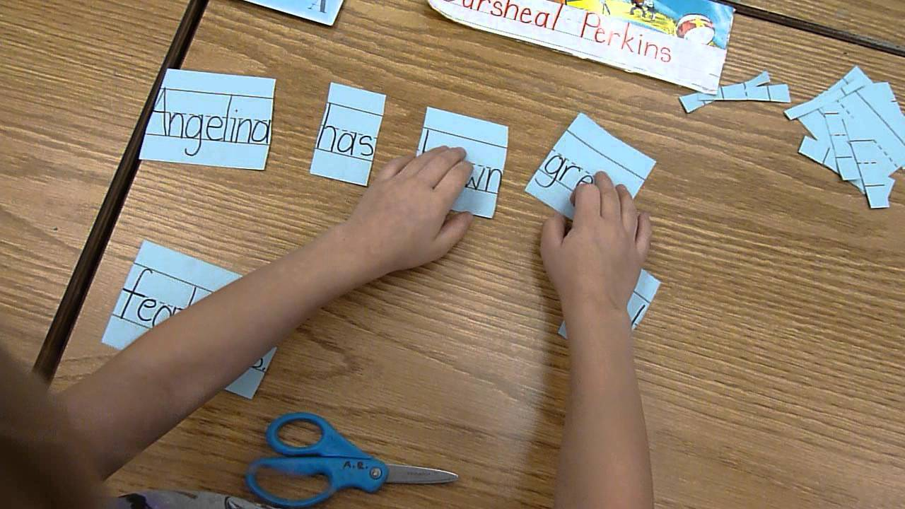
Throughout the unit we….

Slide 47
CREATED THREE LINGUSTIC SPACES
Spanish
English
The Bridge
Notes:
Here is the BUF, the document we use to plan a unit. From looking at this document, what are some things you know about teaching for biliteracy?
Talk to your elbow partner.

Slide 48

How did you feel as a learner?
I felt _____________.
What did you learn about biliteracy instruction?
One thing I learned about biliteracy instruction is ______________________.

Slide 49

What does it look like in Prekindergarten?

Slide 50
The Three Circles Times in Prekindergarten
Building Oracy and
Background Knowledge
Center with students and teacher
Activities such as
Fish Bowl and Picture Sort
Oracy and
Center work with Student Roles
Oracy with
Reading and Writing

Slide 51

Sample Biliteracy Instruction
Biliteracy is for ALL developing bilinguals – all students participate actively and meaningfully
Explicitly builds receptive and productive oral language in anticipation of content and literacy instruction
Teaching for Biliteracy
Strategically plans for the three linguistic spaces: Spanish, the Bridge, and English
Integrates literacy and content
Notes:
51
So there doesn’t have to be translation

Slide 52
In other words, …rather than asking,
“Which language…, we ask…
“What strategies are we using to consistently build and develop language, literacy, and content and to compare and contrast languages?”
“What structures are in place to support this kind of instruction?”
Notes:
h

Slide 53
Teaching for Biliteracy means always teaching
language
literacy
and
content
Wharton, teachingforbiliteracyMW@gmail.com, 2016
Notes:
Because teaching for biliteracy is 3 – NOT 2!! Which is the most important???
Teaching for biliteracy – 3 fingers; always teaching lang, literacy, content –
and NOT just teaching Spanish OR English – but teaching Spanish, English, and the bridge.

Slide 54
Sample Biliteracy Instruction
Biliteracy is for ALL developing bilinguals – all students participate actively and meaningfully
Explicitly builds receptive and productive oral language in anticipation of content and literacy instruction
Teaching for Biliteracy
Strategically plans for the three linguistic spaces: Spanish, the Bridge, and English
Integrates literacy and content
Notes:
54
So there doesn’t have to be translation

Slide 55
TEKS based integrated instructional units
Segundo grado- Ciencias
2. 8 La Tierra y el espacio. El estudiante entiende que hay patrones reconocibles en la naturaleza y entre los objetos en el cielo. Se espera que el estudiante:
(A) mida, anote y haga gráficas sobre la información del estado del tiempo, incluyendo la temperatura, las condiciones del viento, precipitación y nubosidad, para identificar los patrones en esa información;
(B) identifique la importancia de la información sobre el estado del tiempo y la que es de temporada para tomar decisiones relacionadas con qué ropa usar, actividades diarias y el transporte;

Slide 56
TEKS based integrated instructional units
Segundo: Escritura –
(20) Escritura/textos persuasivos. Los estudiantes escriben textos persuasivos para influenciar las actitudes o acciones de un público específico sobre temas específicos. Se espera que los estudiantes escriban ensayos persuasivos para el público apropiado en la escuela, casa o comunidad sobre temas que sean importantes para el estudiante.
Notes:
Latest research – I will show it in first part = not second

Slide 57
TEKS based integrated instructional units
Segundo: Lectura –
(14) Lectura/comprensión de textos informativos/textos expositivos. Los estudiantes analizan, infieren y sacan conclusiones sobre el texto expositivo y proporcionan evidencia del texto para apoyar su comprensión. Se espera que los estudiantes:
(A) identifiquen la idea principal de un texto y la distingan del tema;
(B) localicen los hechos que están claramente especificados en el texto;
Notes:
Latest research – I will show it in first part = not second

Slide 58
TEKS based integrated instructional units
Segundo Grado- Lectura
(5) Lectura/desarrollo del vocabulario. Los estudiantes comprenden vocabulario nuevo y lo utilizan al leer y al escribir. Se espera que los estudiantes:
(A) usen prefijos y sufijos para determinar el significado de las palabras (ej., componer/ descomponer; obedecer/desobedecer);
(B) usen el contexto para determinar el significado relevante de palabras poco comunes o palabras con significados múltiples;
(C) identifiquen y usen palabras comunes con distinto significado
Notes:
Latest research – I will show it in first part = not second

Slide 59
The strategies and structures of biliteracy instruction reflect and support the developing bilingual.
Biliteracy instruction is different from monoliteracy instruction.
Biliteracy instruction is different from two monoliteracy instructions.
Biliteracy instruction creates three linguistic spaces.
Notes:
B

Slide 60

Research Connection
Bilinguals who learn about how their
languages are similar and different (in
other words, students with high levels of
metalinguistic awareness) achieve higher
levels of academic achievement in both
their languages.
Jimenez, García, and Pearson,1996,
Dressler et al, 2011, de Jong 2011
Notes:
https://www.ncbi.nlm.nih.gov/pmc/articles/PMC3322418/

