Slide 1
Sample Dual Language Instruction: Part 3
June 11, 2026 – Lloyd Elementary
Karen Beeman

Slide 2
Professional Learning Expectations
Participate actively and meaningfully
Avoid side conversations
Place cell phones on vibrate
Be present
Ensure everyone has a voice
Flexible mind – be open to new ideas- Growth mindset
© Center for Teaching for Biliteracy, LLC

Slide 3
Agenda:
Sample Instruction Part 2: Foundational Skills and Writing
Sample Instruction: Part 3 – The Bridge
The Multilingual Perspective of Language
Biliteracy Assessment
Planning for Sustainability: Creating the Lloyd Vision and Pedagogy –create “DL Look Fors
Closure

Slide 4
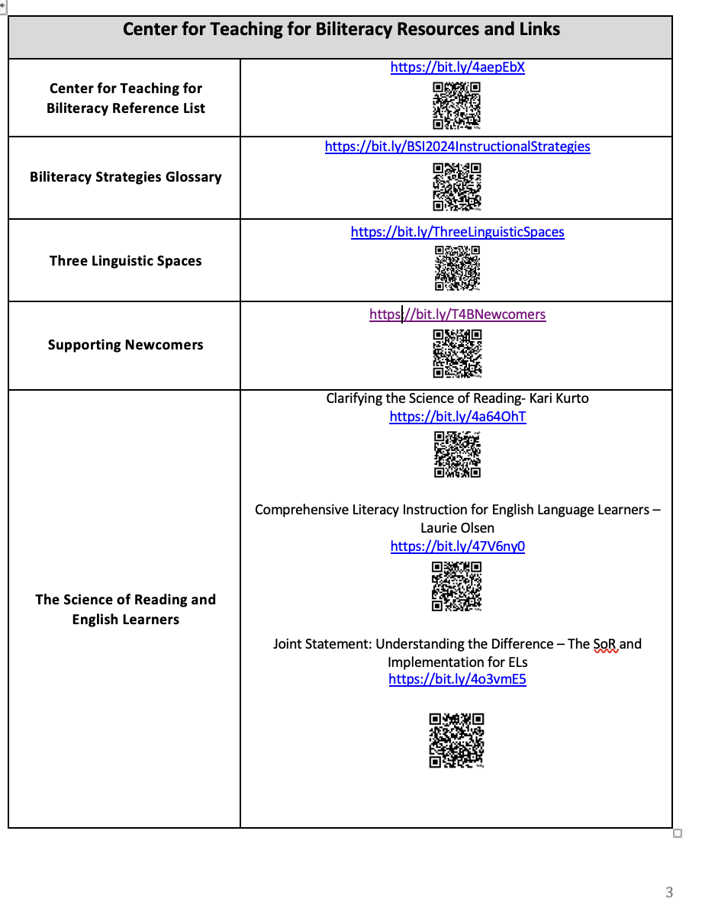

Slide 5
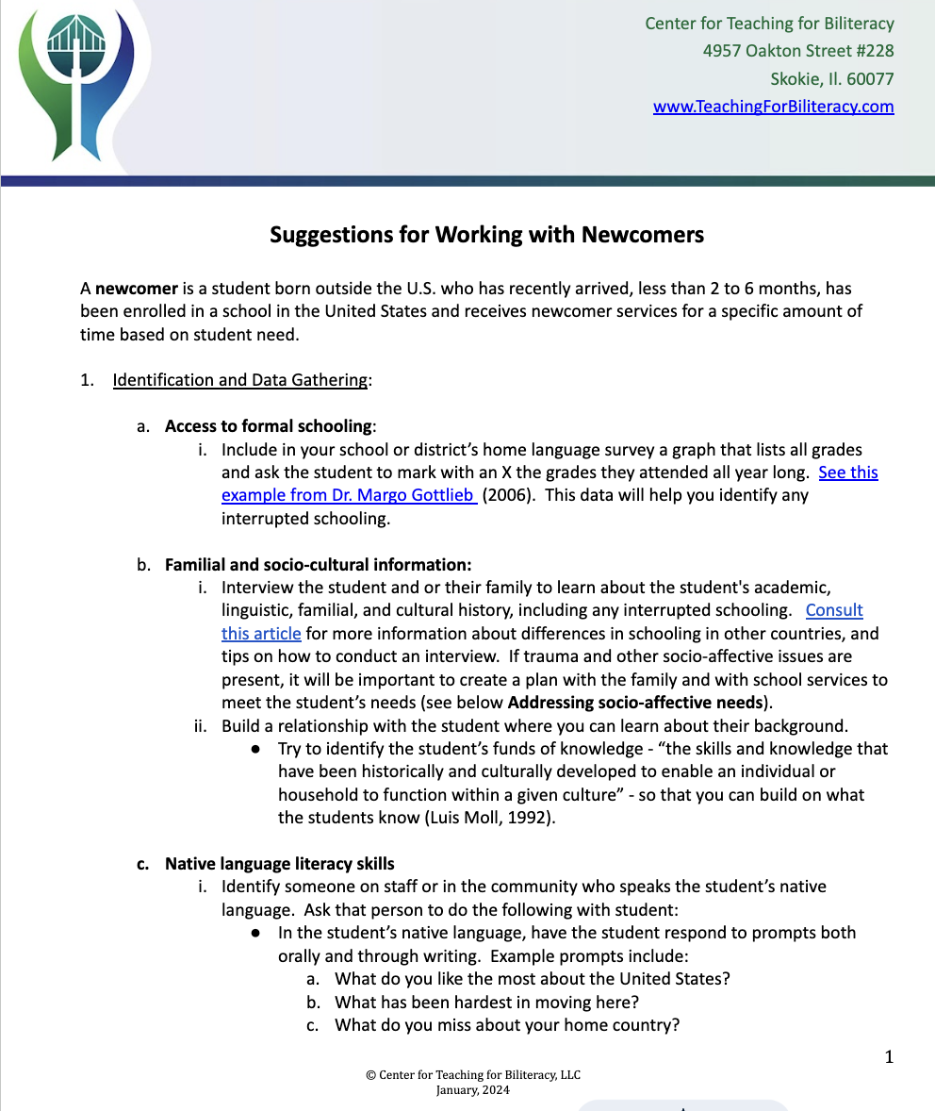

Slide 6
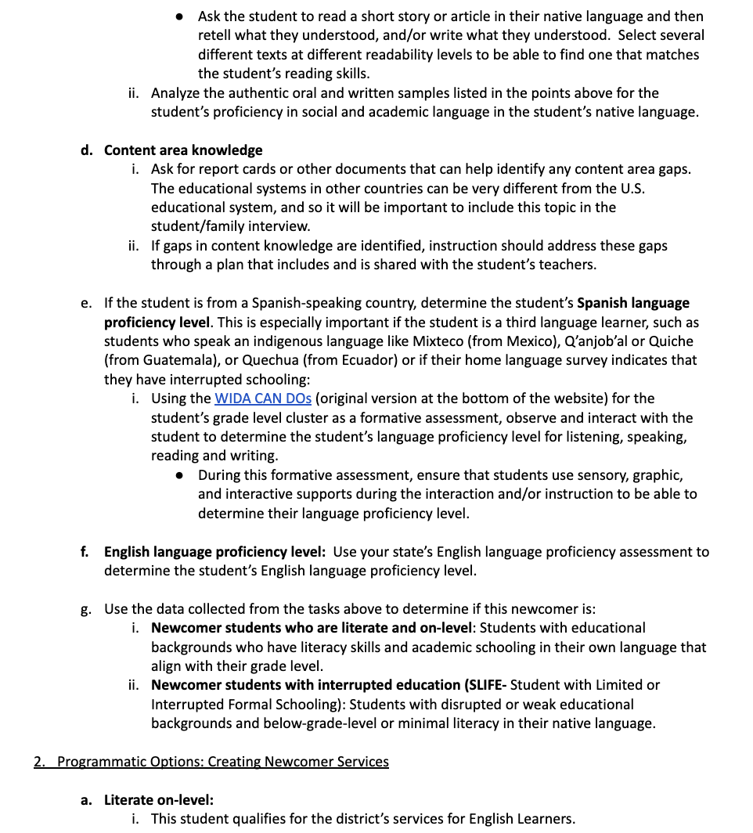

Slide 7
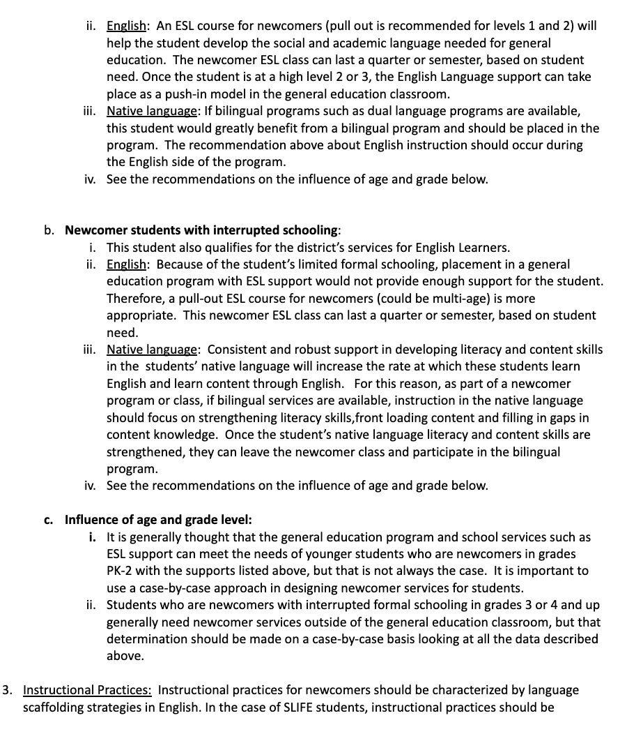

Slide 8
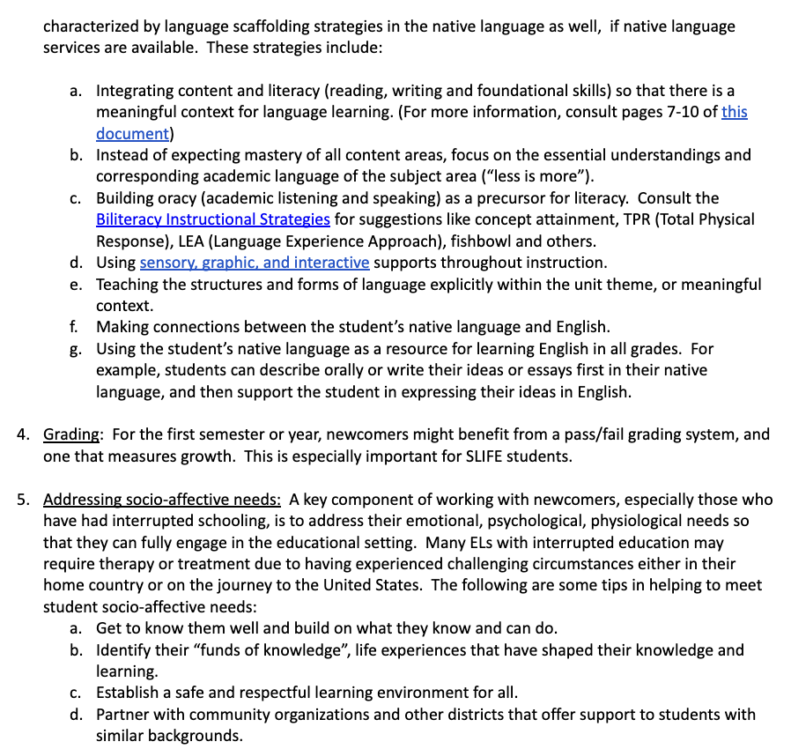

Slide 9
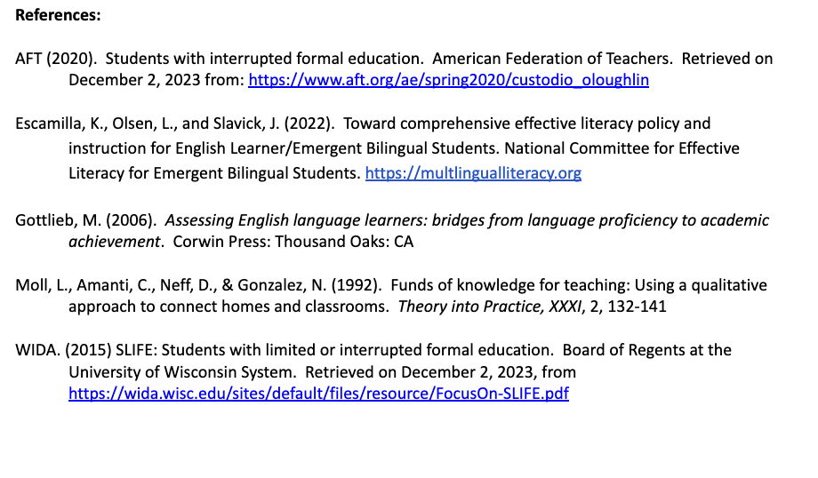

Slide 10

www.teachingforbiliteracy.com

Slide 11
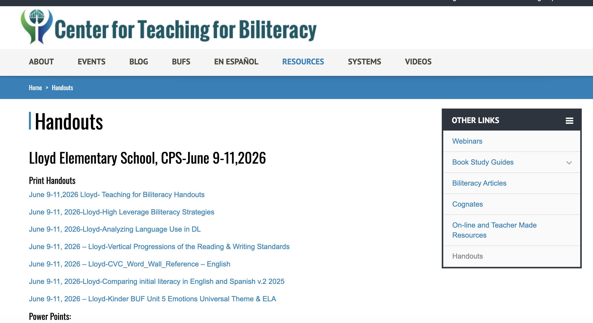

Slide 12
Agenda:
Sample Instruction Parts 2 & 3: The Bridge
Debrief Sample Instruction
The Multilingual Perspective of Language
Biliteracy Assessment
Planning for Sustainability: Creating the Lloyd Vision and Pedagogy –create “DL Look Fors
Closure

Slide 13
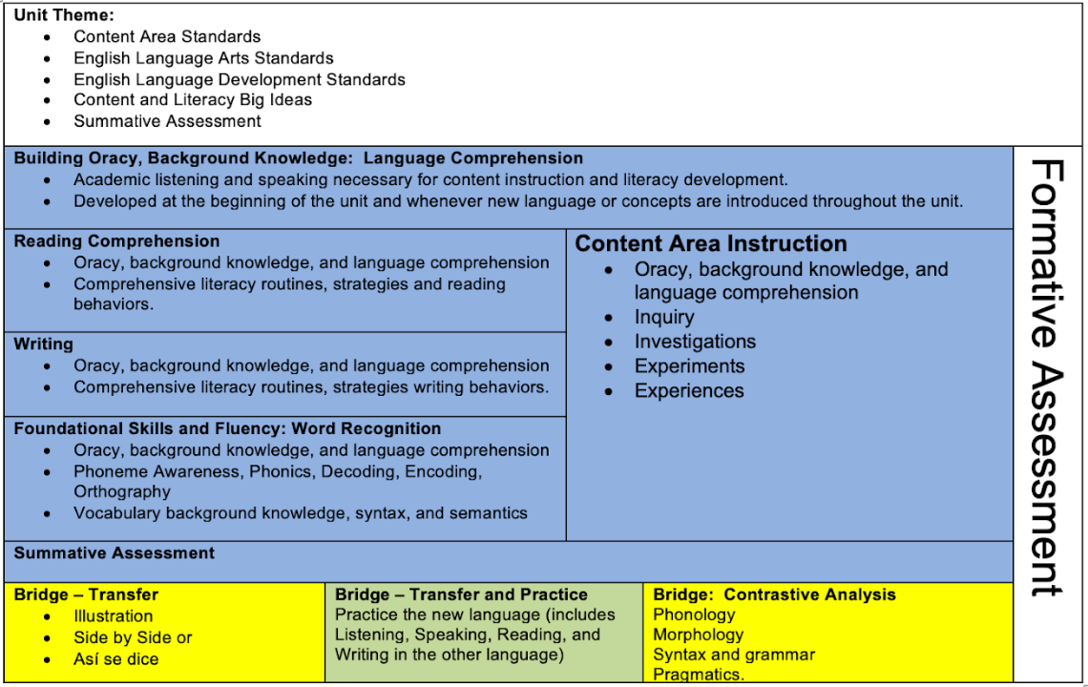

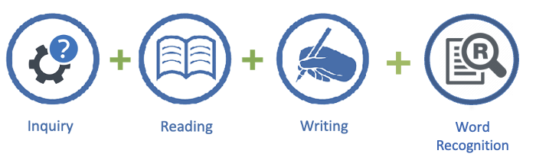
Biliteracy Unit Framework
Notes:
As we see here in the BUF, we developed oracy first! CLICK This is in anticipation of explicit content and literacy instruction. CLICK x 2
We will unpack the BUF tomorrow to see what other instructional experiences students would encounter as a result of their experience to prepare them to complete the summative assessment.
On Thursday you will see the Bridge.

Slide 14
Development of Oracy and background knowledge
Receptive
Listening: Participate and understand the academic language
Productive
Speaking: Use the academic language
Reading: Understand academic language (receptive)
Writing: Use academic
Language (productive)

Slide 15
Development of background knowledge
Concrete: Introduction of concepts
Understand through the use of
realia, images, experiences, etc.
Apply and practice the concepts
More abstract: Increase rigor
Understand, apply and practice through inquiry, Reading and writing

Slide 16
Oracy
Receptive (listening)
Productive (speaking)
Receptive (reading)
Productive (writing)
Background Knowledge
Concrete: understanding
Apply and practice
Level of rigor increases:
More abstract
Understanding, appplying and demonstrating knowledge

Slide 17
Oracy
Receptive (listening)
Productive (speaking)
Receptive (reading)
Productive (writing)
Background Knowledge
Concrete: understanding
Apply and practice
Level of rigor increases:
More abstract
Understanding, appplying and demonstrating knowledge
As the unit progresses, the language and concepts become more complex.

Slide 18

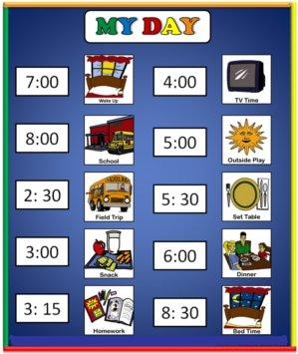





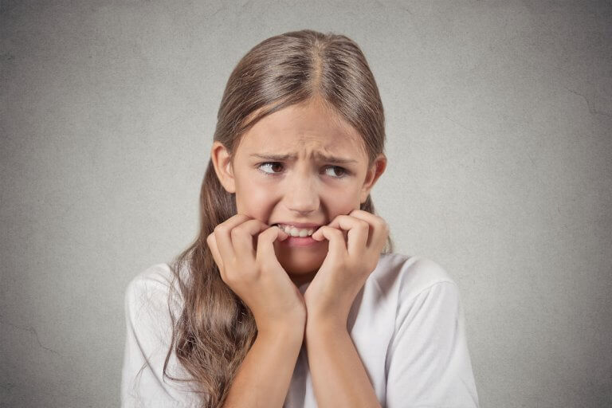
Notes:
Show me:
Scared or afraid
Events
Different
Body
Emotion
Glad or happy
Mad or angry
confused

Slide 19

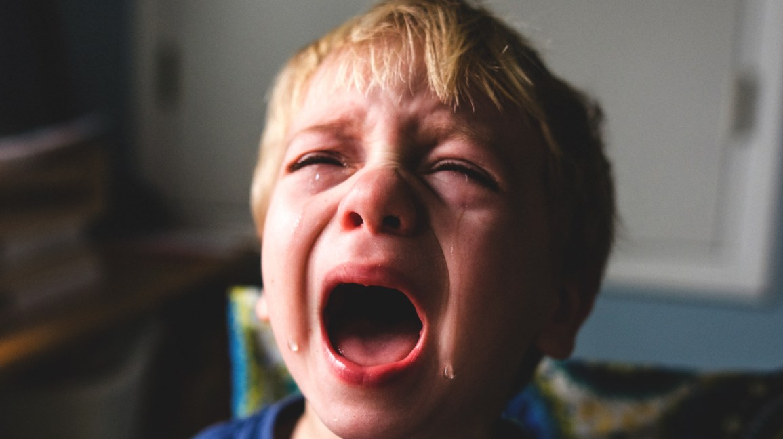

short a, long a
a
a
Notes:
Dictation or foundational skills
In English, the letter a can have many sounds, and usually the sound is either short a, that says /a/ CLICK Say that /a/
And other times it is long a that says aaaaaa CLICK. Long a says aaaaaa.
Look at our pictures do you hear any words that have /a/ or aaaaa?

Slide 20
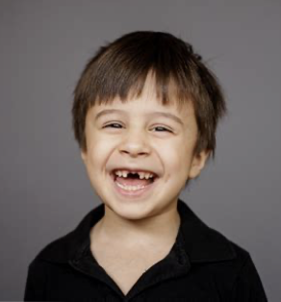
short a, long a
a
a
happy
glad
afraid
sad
face
James
mad
Notes:
We can also add our names, if they fit. Who has a name that has a short a in English? How about a long a? James! CLICK

Slide 21
short a, long a
a
a
happy
glad
afraid
sad
face
James
mad
Notes:
Let’s look at our LEA – do you hear any words in our LEA that have a a a or aaaaaaa in them? Let’s circle them!

Slide 22
Dictation/Dictado
I
a
m
m
a
d
.
Notes:
Talk through this?
Now that we are in week 4, I am confident that my students have the oracy from this unit to engage with foundational skills and language study.

Slide 23
Dictation/Dictado
I
a
m
m
a
d
.
Notes:
Let's see what sound our a is making in these words. Circle the a and say the sound. That's short a!
BEADS OFF

Slide 24
Dictation/Dictado
I
a
m
m
a
d
.
J
a
m
e
s
h
a
s
a
h
a
p
p
y
f
a
c
e
.
Notes:
BEADS OFF With my students who are ready for more, I may take a small group into an extension of the whole group activity and have them write more, including some of those long a sounds, then circling or highlighting to show what sounds each of the a’s is making.

Slide 26

Writing Standards
Melody Wharton - Center for Teaching for Biliteracy
Notes:
Melody

Slide 27
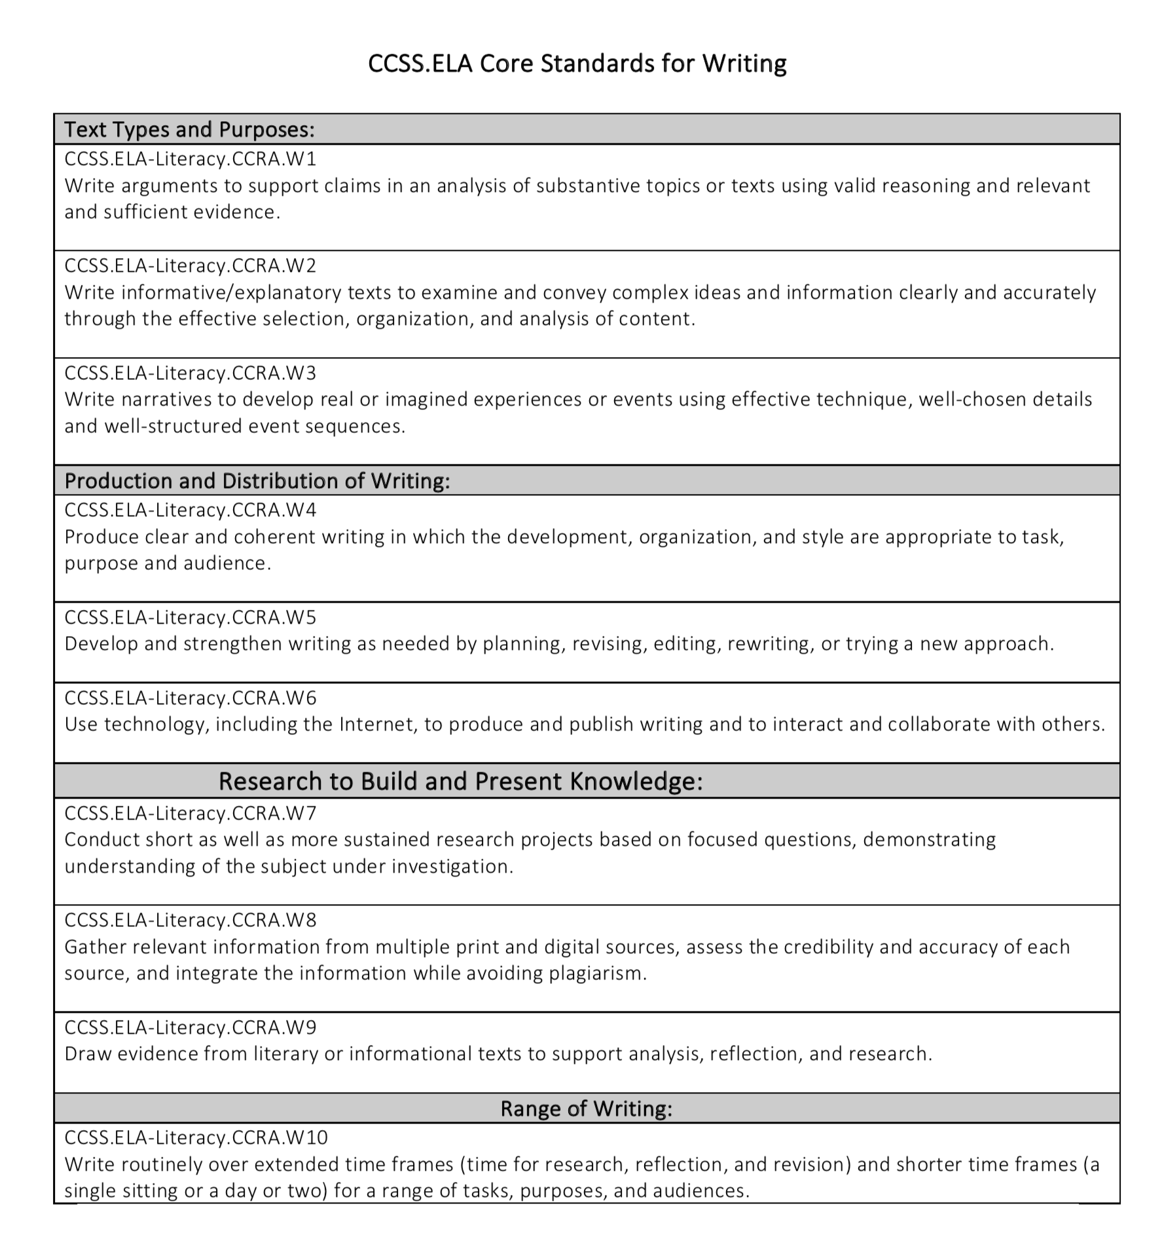
Organization of Writing Standards:
10 anchor standards
Anchor standards for Writing
Notes:
goal – K-12 – each grade's standard is scaffolded developmentally to get here by 12th grade.

Slide 28
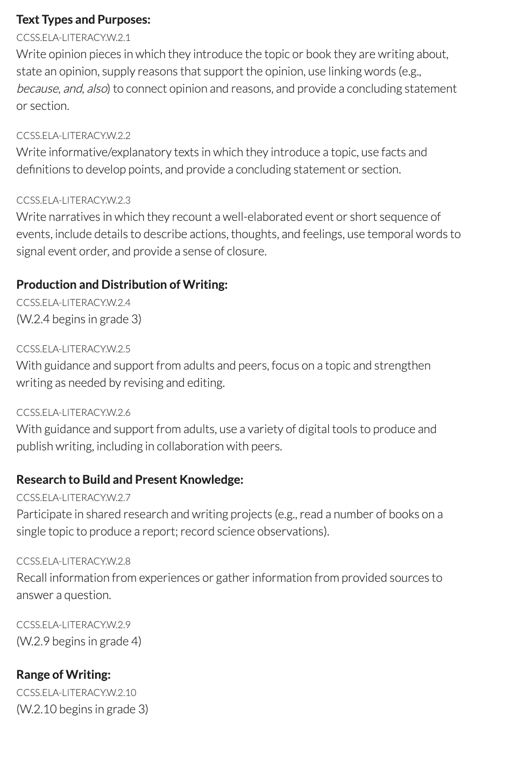
Notes:
Lets look at K – looks like a list – just go down the list

Slide 29


Sample
When you are sad
your eyes can cry.
You can frown.
Notes:
Throughout the unit we are also working on authentic writing. This might be a student's response. Of course, student work would have phonetic spelling

Slide 30
Notes:
Lets look at K – looks like a list – just go down the list

Slide 31
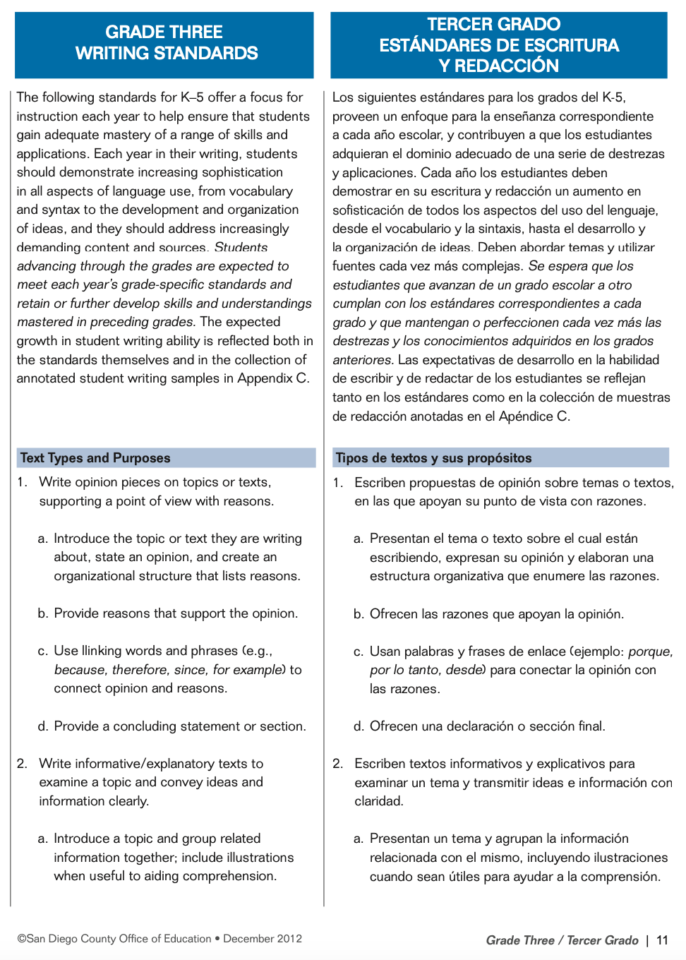
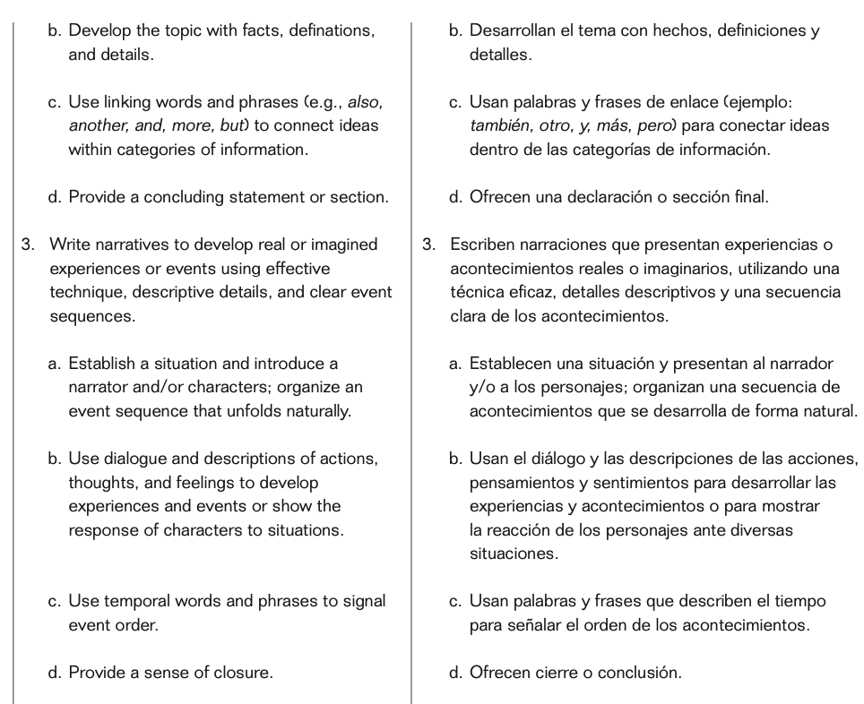
Notes:
Here are the writing standards in teh CCSS en Espanol
For those of you who have heard of priority standards, that was for a different set of standards that were much more plentiful. With these, the guidance is that these 10 ARE the priority.

Slide 32
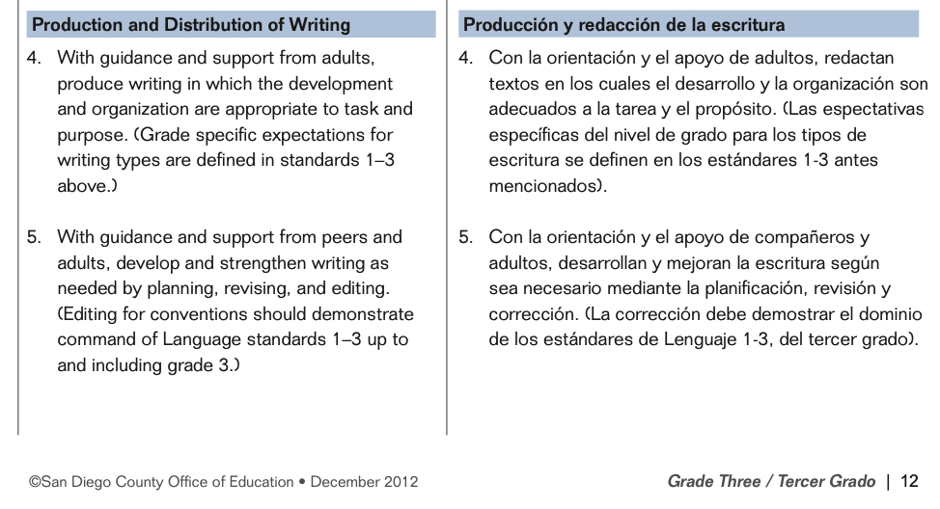
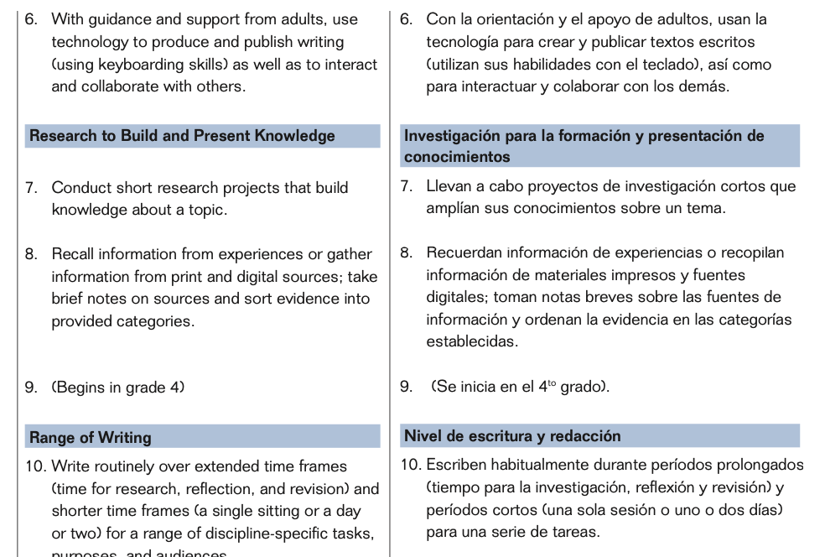

Slide 33
Notes:
Here are the writing standards in teh CCSS en Espanol

Slide 34
Organization of the CCSS Writing Standards
Opinion
Informative
Narrative
Melody Wharton - Center for Teaching for Biliteracy

Slide 35
Notes:
Lets look at K – looks like a list – just go down the list

Slide 36
Organization of the CCSS Writing Standards
Opinion
Informative
Narrative
Standard 1
Standard 2
Standard 3
Standard 4 – For purpose, task, and audience
Standard 10 – Write routinely
Melody Wharton - Center for Teaching for Biliteracy
Notes:
standards 4 & 10 begin in grade 3 – but not really

Slide 37
Genres within each bucket
(Source: Pathways to the Common Core)
Persuasive/Opinion/ Argument | Informational/ Functional/Procedural | Narrative Writing
Persuasive Letter Review Personal Essay Literary Essay Historical essay Petition Editorial Op-Ed Column | Fact Sheet News Article Feature Article Blog Website Report Analytic Memo Research Report Nonfiction book How-to-book Directions Recipe Lab Report | Personal Narrative Fiction Historical Fiction Fantasy Narrative Memoir Biography Narrative Nonfiction
Notes:
As you map, to think about the genre within each bucket - how boring that every time they write an opinion piece it is a persuasive paper – they can also do an op ed column – or personal essay sharing their opinion

Slide 38
Organization of the CCSS Writing Standards
Opinion
Informative
Narrative
Standard 1
Standard 2
Standard 3
Standard 4 – For purpose, task, and audience
Standard 10 – Write routinely
Melody Wharton - Center for Teaching for Biliteracy

Slide 39
Organization of the CCSS Writing Standards
8
6
6
7
7
5
5
5
Opinion
Informative
Narrative
Standard 1
Standard 2
Standard 3
Standard 4 – For purpose, task, and audience
Standard 10 – Write routinely
Melody Wharton - Center for Teaching for Biliteracy
Notes:
Within each bucket go the bucket fillers - the standards that help students to achieve quality writing pieces. This may differe from unit to unit depending on the purpose of the writing. But all must be covered across the year and within each langauge according to the nuances of writing in each respective langauge.

Slide 40

5
6
7
8

Slide 41
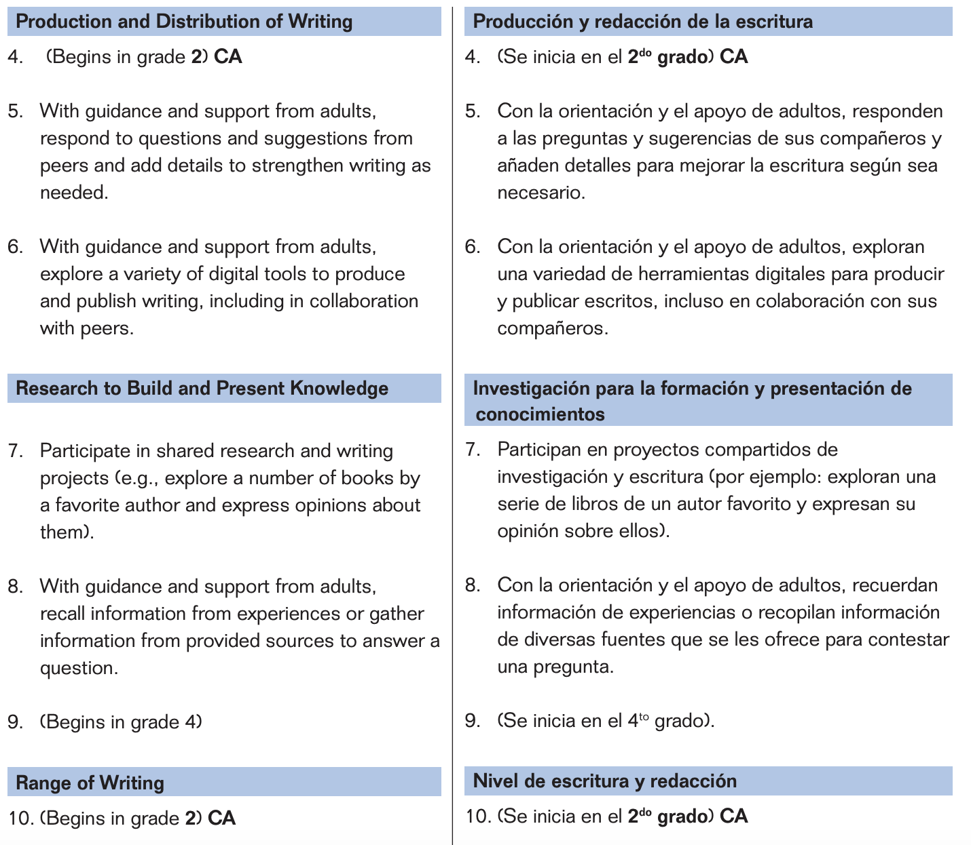
5
6
7
8

Slide 42
Organization of the CCSS Writing Standards
8
6
7
7
5
5
5
Opinion
Informative
Narrative
Standard 1
Standard 2
Standard 3
Standard 4 – For purpose, task, and audience
Standard 10 – Write routinely
Melody Wharton - Center for Teaching for Biliteracy
Notes:
Within each bucket go the bucket fillers - the standards that help students to achieve quality writing pieces. This may differe from unit to unit depending on the purpose of the writing. But all must be covered across the year and within each langauge according to the nuances of writing in each respective langauge.

Slide 43
Anchor Standard W.2
W.CCR.2: Write informative/
explanatory texts to examine and convey complex ideas and
information clearly & accurately
through the effective selection,
organization, and analysis of
content.

Slide 44
W. K.2 Informational / Explanatory
Informative Book
W.K.2. Use a combination of drawing, dictating, and writing to compose informative/explanatory texts in which they name what they are writing about and supply some information about the topic.

Slide 45
W.K.2 Use a combination of drawing, dictating, and writing to compose informative/explanatory texts in which they name what they are writing about and supply some information about the topic.
W.1.2. Write informative/explanatory texts in which they name a topic, supply some facts about the topic, and provide some sense of closure
W.2.2 : Write informative/explanatory texts in which they introduce a topic, use facts and definitions to develop points, and provide a concluding statement or section.

Slide 46
W.K.2 Use a combination of drawing, dictating, and writing to compose informative/explanatory texts in which they name what they are writing about and supply some information about the topic.
W.1.2. Write informative/explanatory texts in which they name a topic, supply some facts about the topic, and provide some sense of closure
W.2.2 : Write informative/explanatory texts in which they introduce a topic, use facts and definitions to develop points, and provide a concluding statement or section.

Slide 47
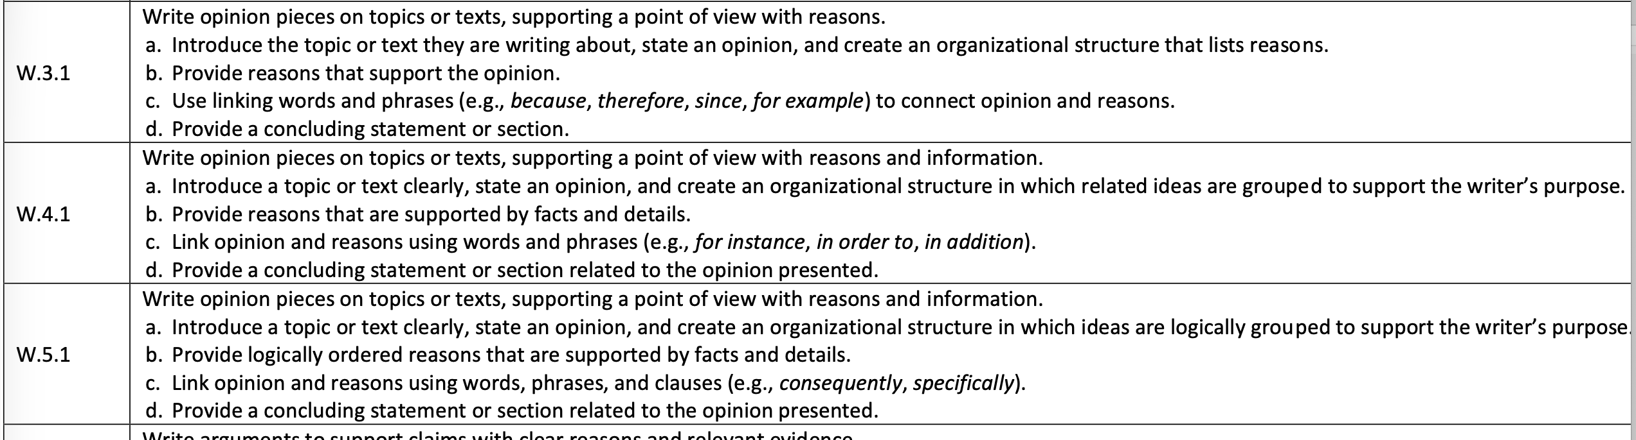

Slide 48
W. K.2 Informational / Explanatory
Informative Book
W.K.2. Use a combination of drawing, dictating, and writing to compose informative/explanatory texts in which they name what they are writing about and supply some information about the topic.

Slide 49
Notes:
Carmen was given a picture and asked to write about it.
”The kids playing in the park. The mom waiting for the kids. And the father is waiting for the kids too. Oh the grandmother waiting for the kids too.”
She knows what she is saying! She is using all her linguistics resources (especially Spanish phonology)

Slide 50
Frogs
frogs hav bgliz. thay lve in pnz. thay cn jmp hie. Thayetbgs
Teacher dictation:
FROGS Frogs have big eyes. They live in ponds. They can jump high. They eat bugs.

Slide 51
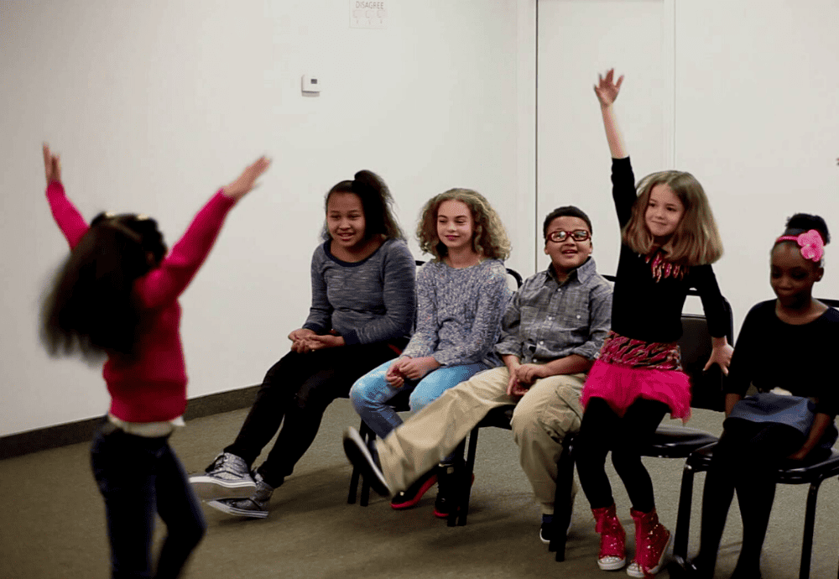
Summative Assessment:
Emotion Charades
Notes:
Summative assessment- As the unit's culmination, the class engages in charades, where they act out various emotions and justify their guesses by what they see their classmates doing. For example:
You are sad! I can tell because you have a frown and are pretending to cry!

Slide 52
Performance-Based Summative Assessment
For the summative assessment of Unit 5 students demonstrate their knowledge of emotions as they answer the unit’s essential question: How do we show emotions? The class will participate in a game of emotion charades, where a student selects an emotion that was previously discussed through inquiry, reading, and writing. They act out that emotion without saying the actual name, and classmates take turns guessing what emotion the actor is expressing. When the class guesses the emotion correctly, the student can then elaborate and verbally share one or two examples of when they have experienced (or would potentially experience) the emotion they acted out.

Slide 53
Biliteracy Unit Framework
Notes:
The Bridge comes last - AFTER the summative assesmsent

Slide 54
Biliteracy Unit Framework
Notes:
The Bridge comes last - AFTER the summative assesmsent

Slide 55
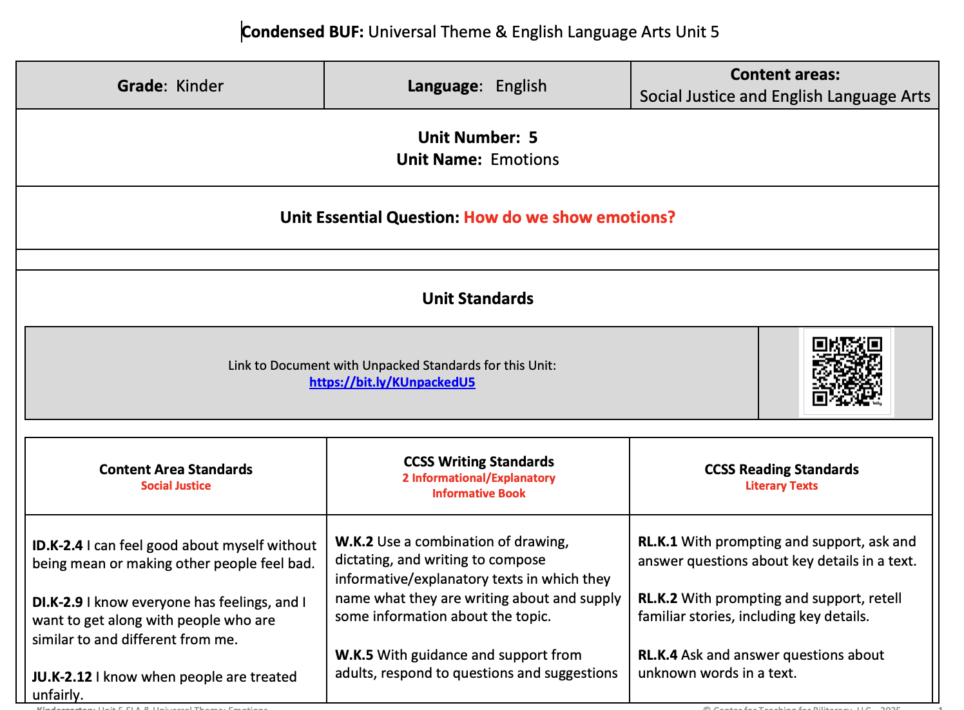

Slide 56
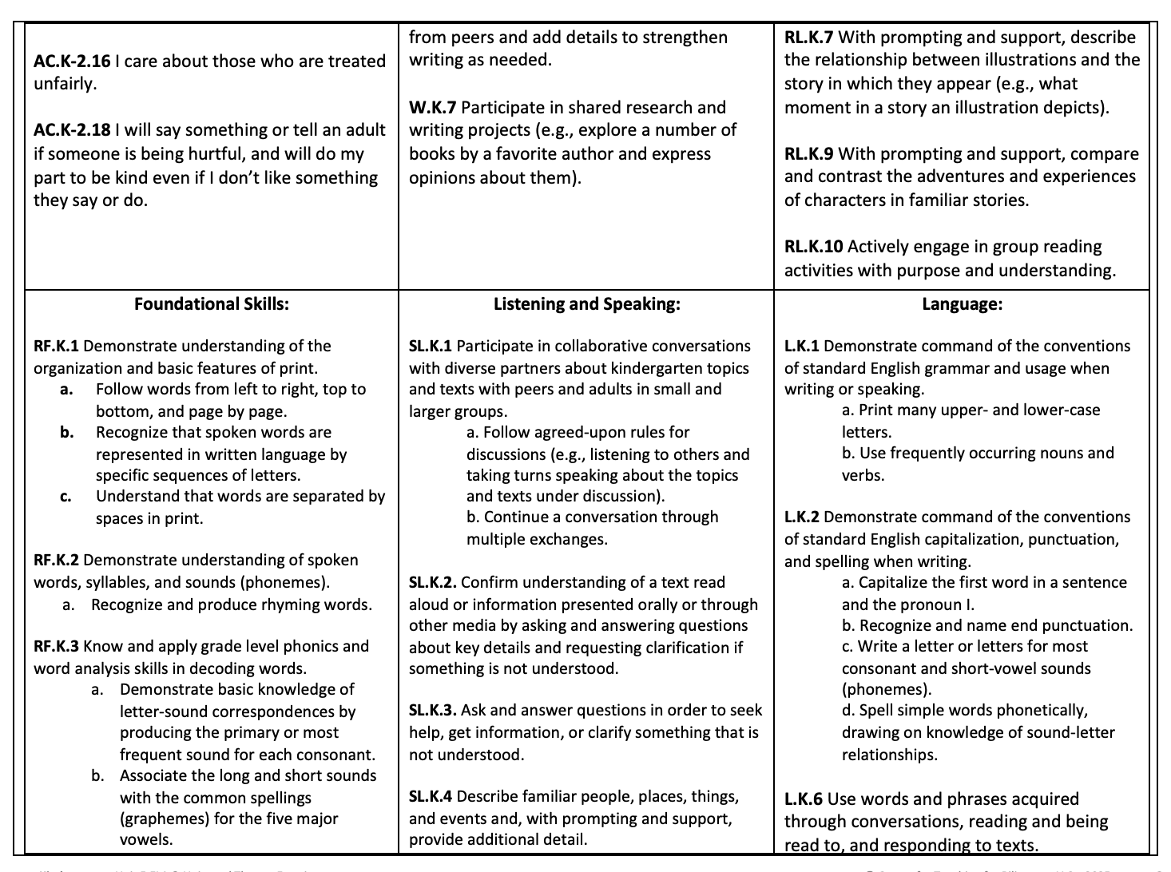

Slide 57
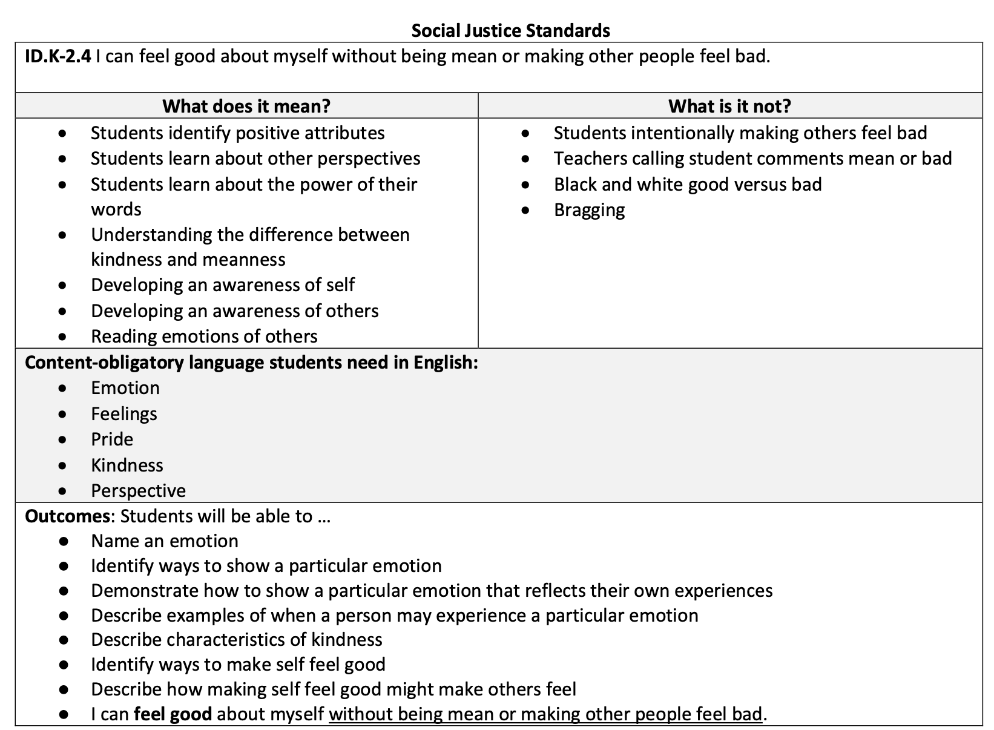

Slide 58
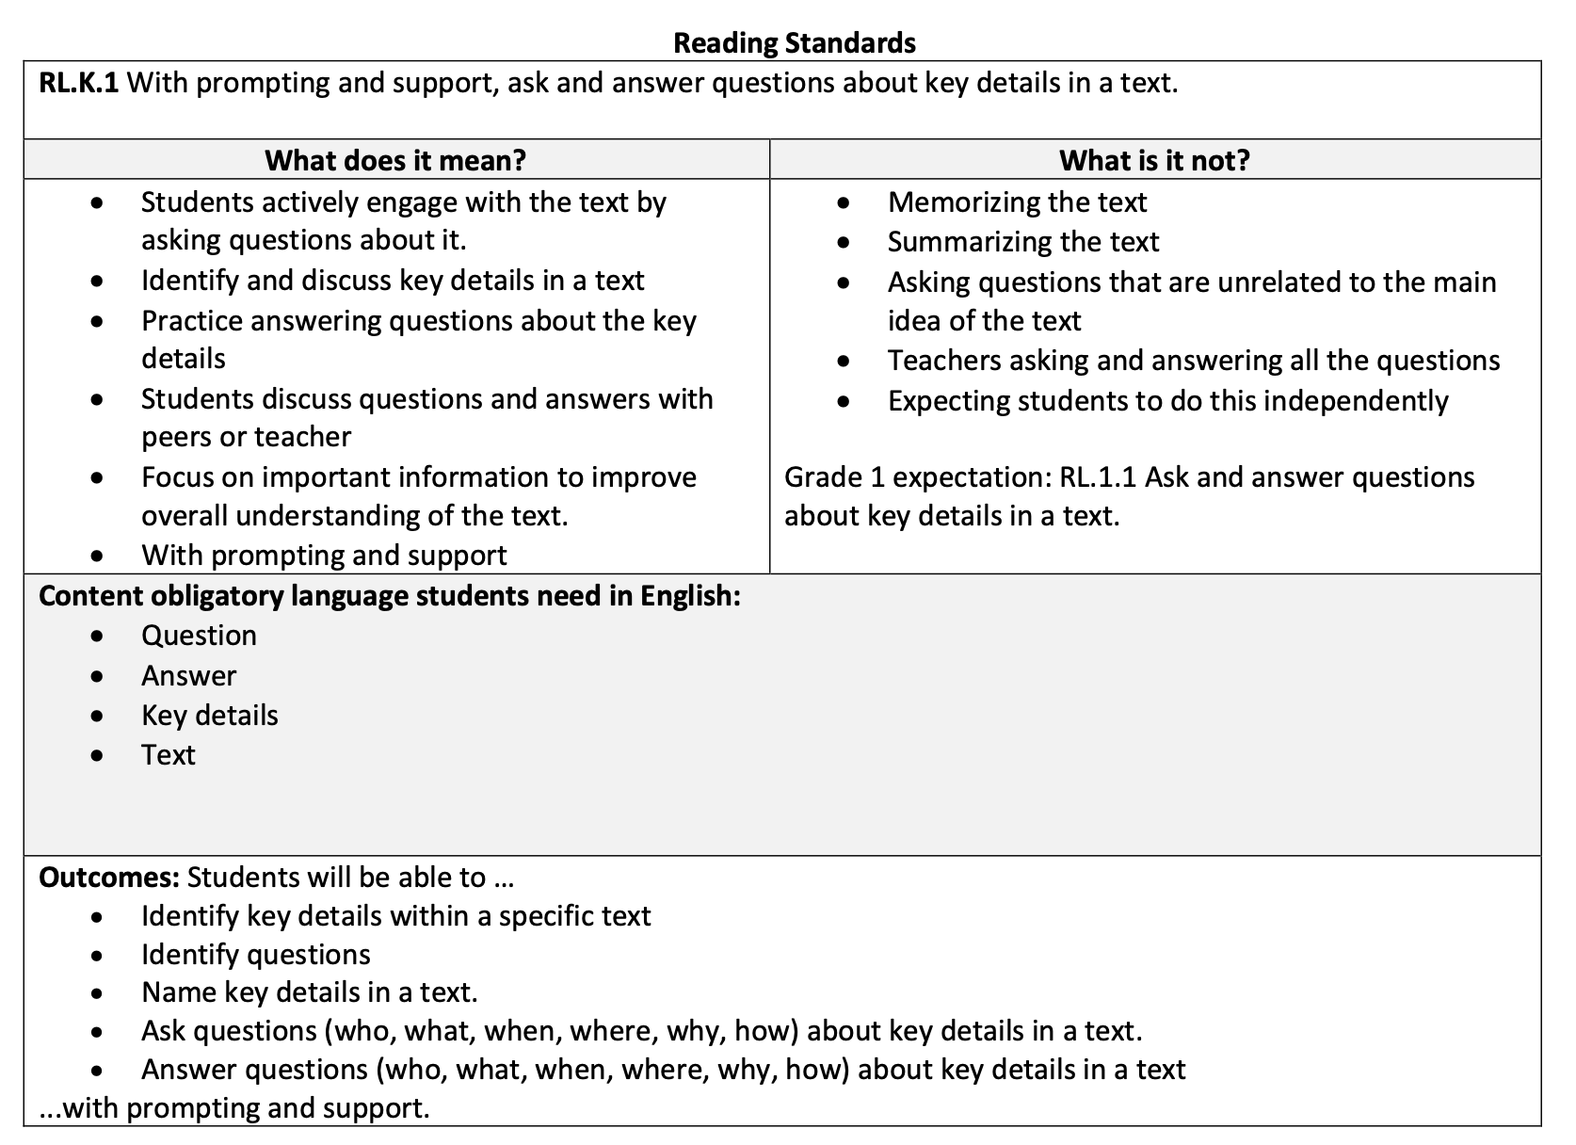

Slide 59
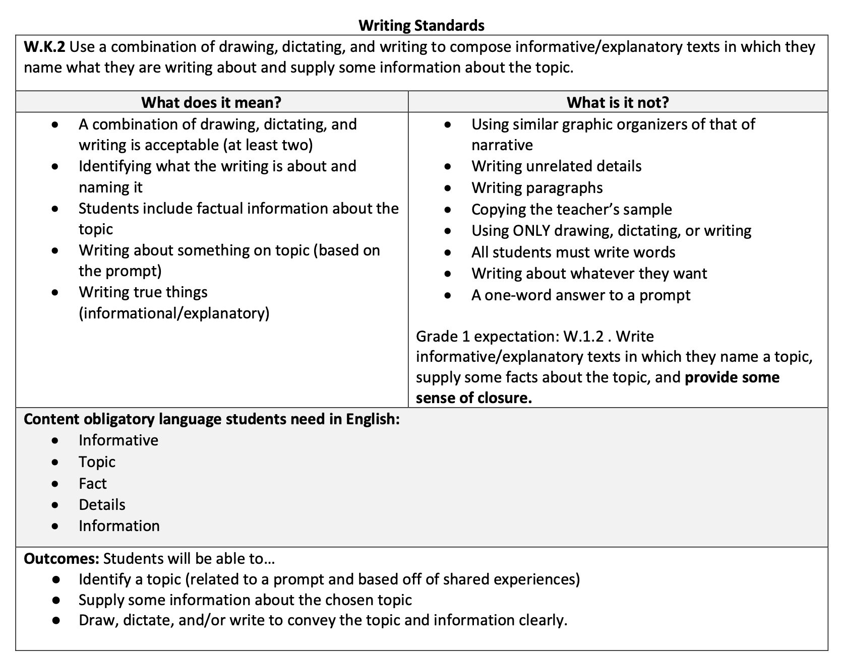

Slide 60
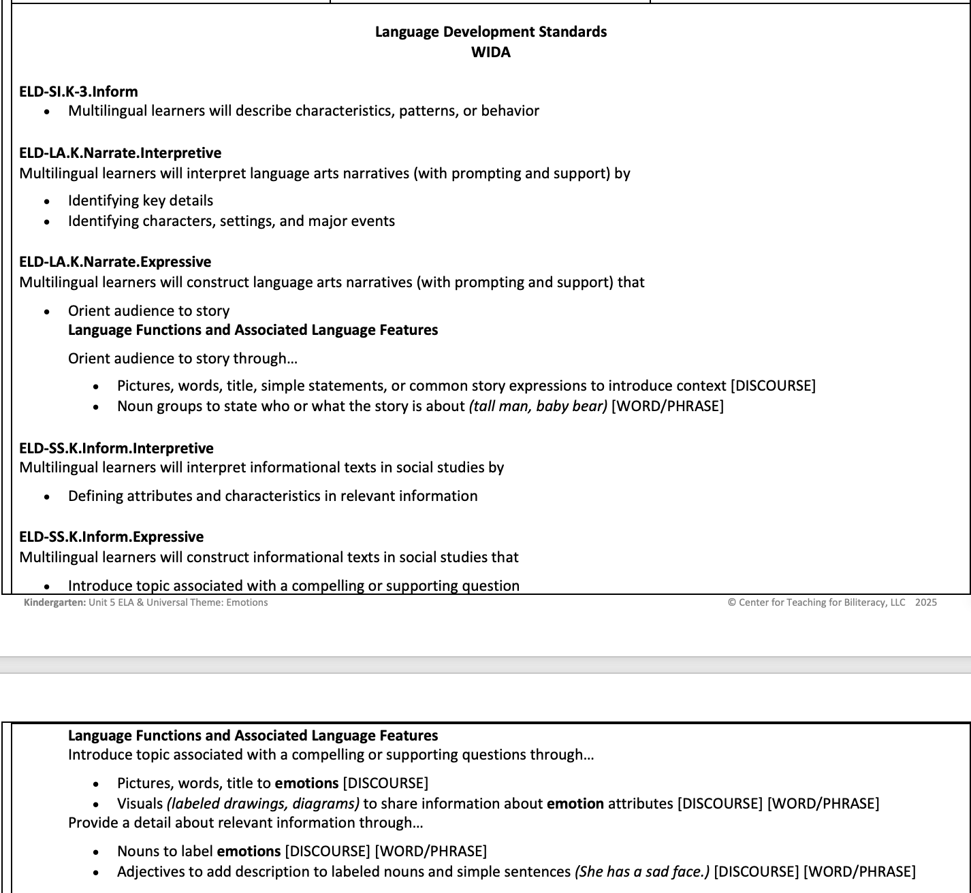

Slide 61
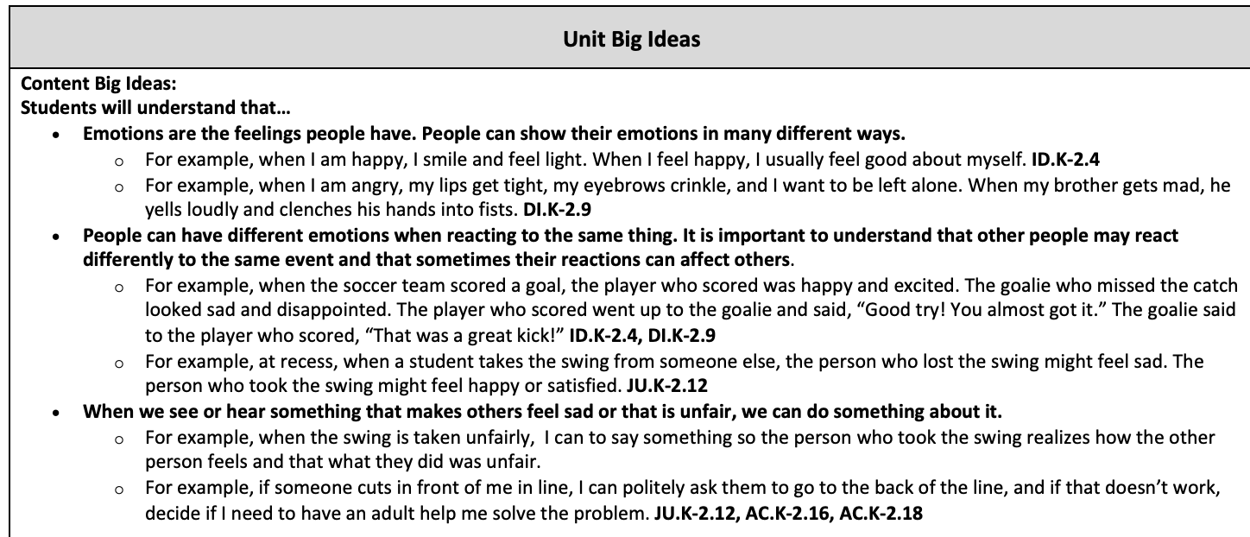

Slide 62
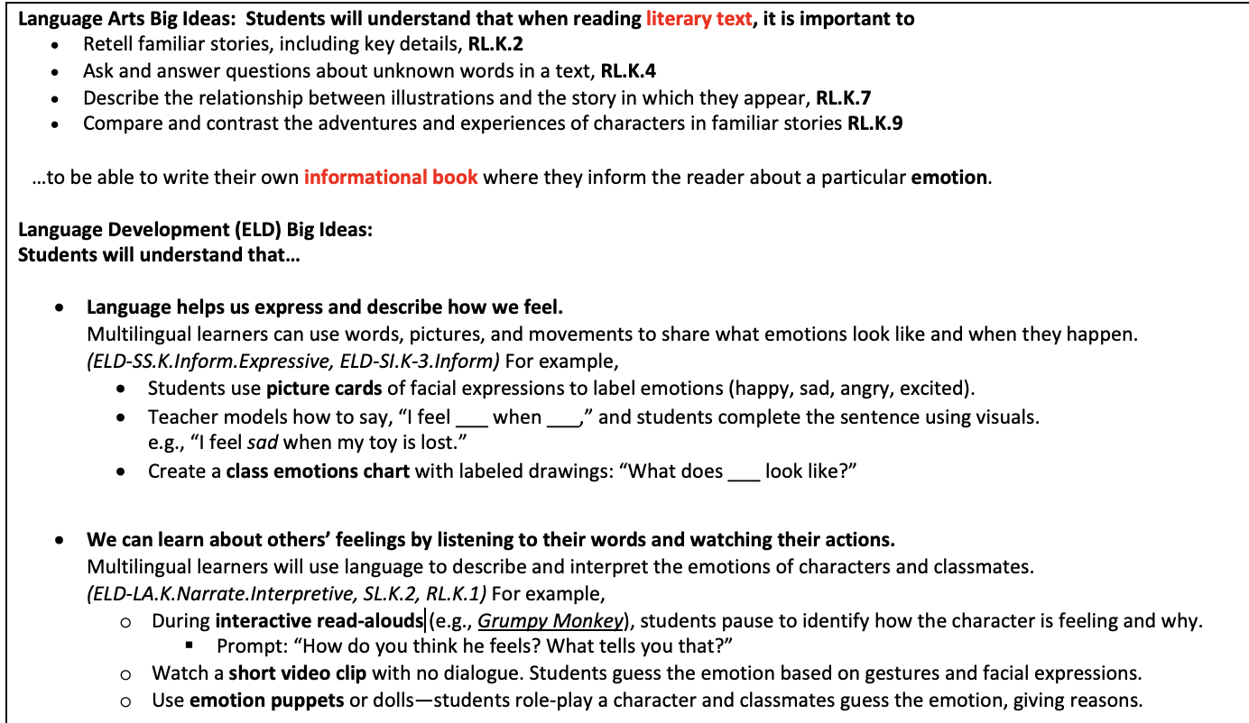

Slide 63
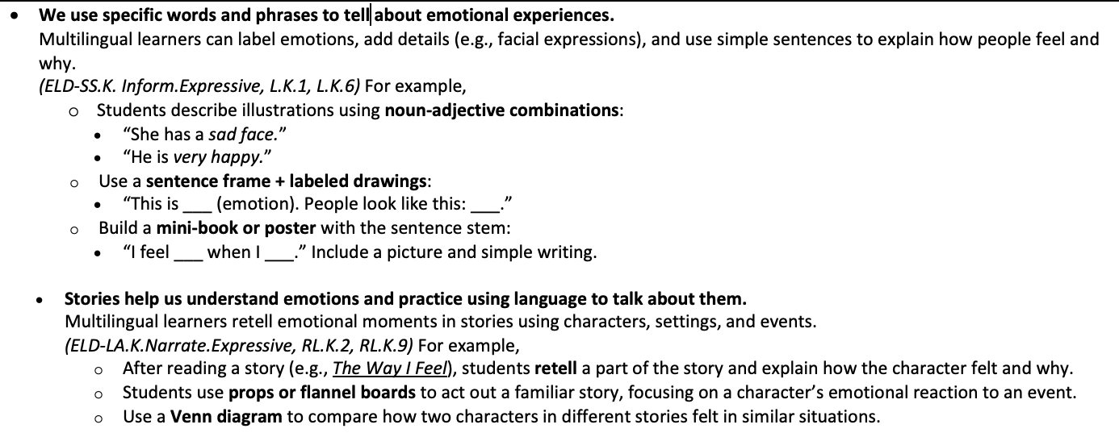

Slide 64
Performance-Based Summative Assessment
For the summative assessment of Unit 5 students demonstrate their knowledge of emotions as they answer the unit’s essential question: How do we show emotions? The class will participate in a game of emotion charades, where a student selects an emotion that was previously discussed through inquiry, reading, and writing. They act out that emotion without saying the actual name, and classmates take turns guessing what emotion the actor is expressing. When the class guesses the emotion correctly, the student can then elaborate and verbally share one or two examples of when they have experienced (or would potentially experience) the emotion they acted out.

Slide 65


Slide 66





The Events
The Emotions
happy
sad
excited
mad
scared
Notes:
Look at all these pictures! You can notice that we can label all the pictures in the white column. We have a kid who looks CLICK for each:
happy (smile)
sad (frown)
excited (hands up mouth open)
mad (grump)
nervous (chew nails)
These are all EMOTIONS (two hands toward you) CLICK
And everything in the blue column are EVENTS (hands sequence) CLICK that may cause us to feel an emotion. CLICK Like falling, winning, fighting, getting a gift, or going to a new school. Different people may experience different emotions after the same event.

Slide 67
Our face
and body can show our emotion.
Notes:
Our face and body can show our emotion

Slide 68



Different events
may cause our emotions to change.
Notes:
Different events may cause our emotions to change

Slide 69

The Bridge Transfer Chart
English | picture/foto
The emotions
The events
happy
sad
excited
scared
mad
Step 2

Slide 70

Now during the Spanish portion of the day….
Step 3

Slide 71


Mark the Bridge
Notes:
Mark the Bridge!

Slide 72
Notes:
Miran estas fotos. Todas aqui en la columna azul son eventos que puede ocurre – son acontecimientos.
Y en la columna blanca, hay otras fotos. Miren las personas que se sienten
CLICK for each:
feliz (smile)
triste (frown)
emocionado (hands up mouth open)
enojada (grump)
asustado (chew nails)
Estas son las emociones. (two hands toward you) CLICK
Las personas diferentes pueden tener emociones diferentes despues del mismo acontecimiento.
Different people may experience different emotions after the same event.

Slide 73
Los acontecimientos
Las emociones
feliz
triste
emocionado/a
enojado/a
asustado/a
Notes:
Look at all these pictures! You can notice that we can label all the pictures in the white column. We have a kid who looks CLICK for each:
happy (smile)
sad (frown)
excited (hands up mouth open)
mad (grump)
nervous (chew nails)
These are all EMOTIONS (two hands toward you) CLICK
And everything in the blue column are EVENTS (hands sequence) CLICK that may cause us to feel an emotion. CLICK Like falling, winning, fighting, getting a gift, or going to a new school. Different people may experience different emotions after the same event.

Slide 74
La cara
y el cuerpo pueden mostrar las emociones.
Notes:
Our face and body can show our emotion

Slide 75
Los acontecimientos diferentes
pueden hacer que cambien las emociones.
Notes:
Different events may cause our emotions to change
Los eventos pueden causar cambios en en nuestras emociones.

Slide 76

English | picture/foto | Español
The emotions |  | las emociones
The events |  | los acontecimientos
happy |  | feliz
sad |  | triste
excited |  | emocionado/a
scared |  | asustado/a
mad |  | enojado/a
Side-by-side Bridge
Step 4
Notes:
Add to chart paper.

Slide 77
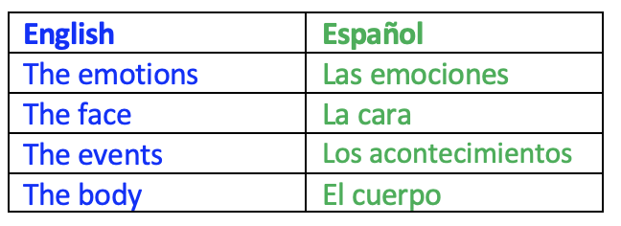
Contrastive Analysis: Grammar (Articles)
Step 5
Notes:
CHANGE to update

Slide 78
Contrastive Analysis: Pragmatics
Spanish has gender
Girl/Niña | Girl/Niña | Boy/Niño
English | Español | English | Español
I’m excited! | ¡Estoy emocionada! | I’m excited! | ¡Estoy emocionado!
I feel scared. | Me siento asustada. | I feel scared. | Me siento asustado.

Slide 79
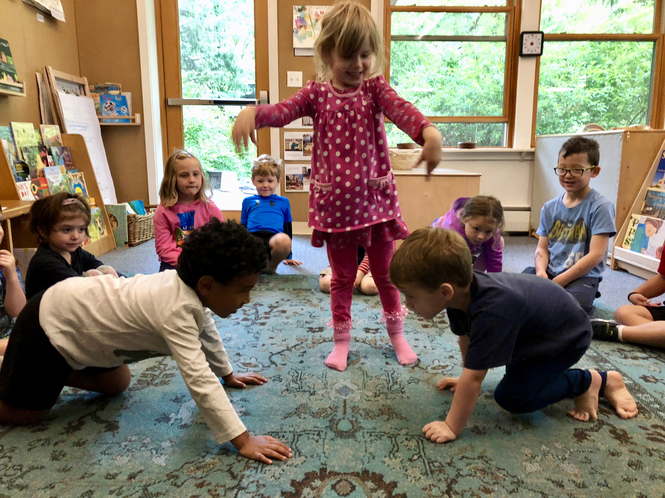
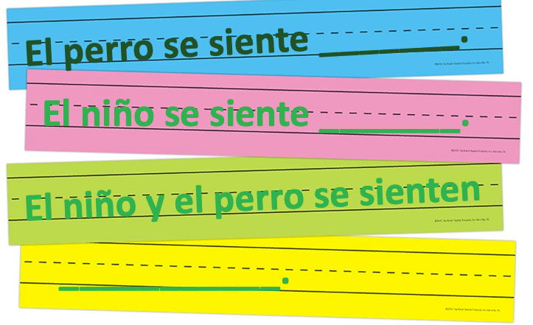
Elige la aventura:
Los estudiantes seleccionan los acontecimientos del cuento de un sombrero y luego deciden cómo se sentirá el personaje. Después actúan el cuento.
Step 6
Notes:
Choose the adventure! Students select the events of the story from a hat and decide how the characters would feel. They then act out the story.

Slide 80

Agenda:
Sample Instruction Part 3: The Bridge
Debrief Sample Instruction
The Multilingual Perspective of Language
Biliteracy Assessment
Planning for Sustainability: Creating the Lloyd Vision and Pedagogy –create “DL Look Fors
Closure

Slide 81
Debrief The Bridge
Notes:
So we know that when planning instruction, everything we plan is to support our developing bilingual students – our demeanor, the strategies, the supports .

Slide 82
What did we do during the Bridge?
Notes:
Have participants share and write on chart paper in two columns listing everything that occurred during Transfer on the left and everything that occurred during CA on the Right
(Click to next slide for examples – only if needed)
THEN, CLICK Let’s talk specifically about how this involves the 3 linguistic spaces.

Slide 83
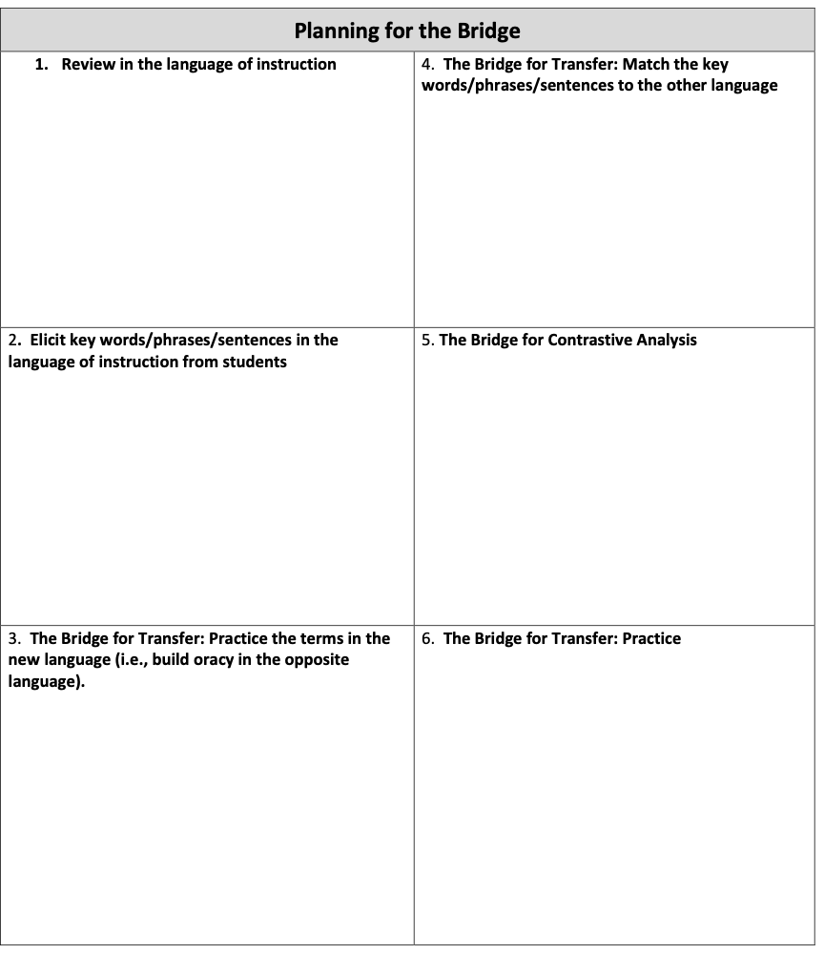
These steps are a framework to use for planning.
1
4
2
5
3
6
Notes:
Find Page 38 of your resource packet. This is how we plan for the Bridge, and you saw examples of each of the 6 steps during sample instruction.

Slide 84
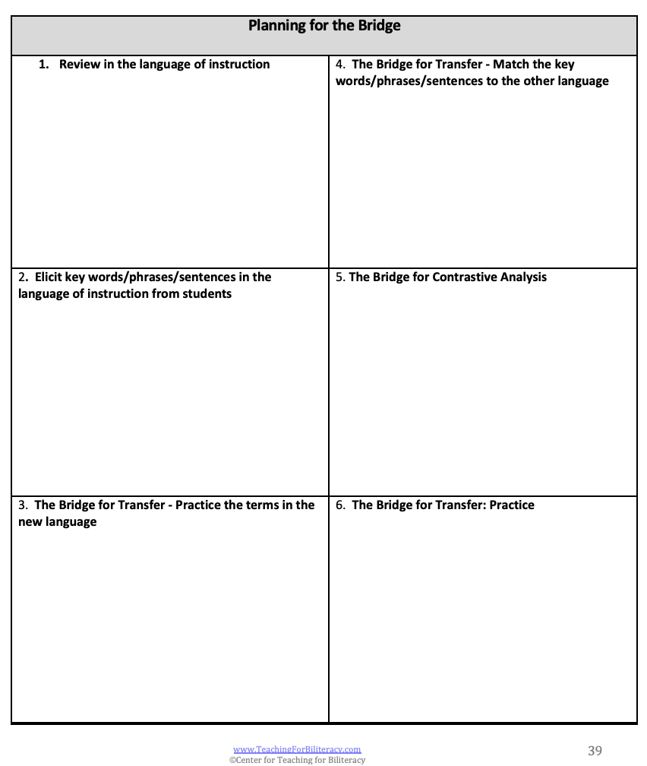
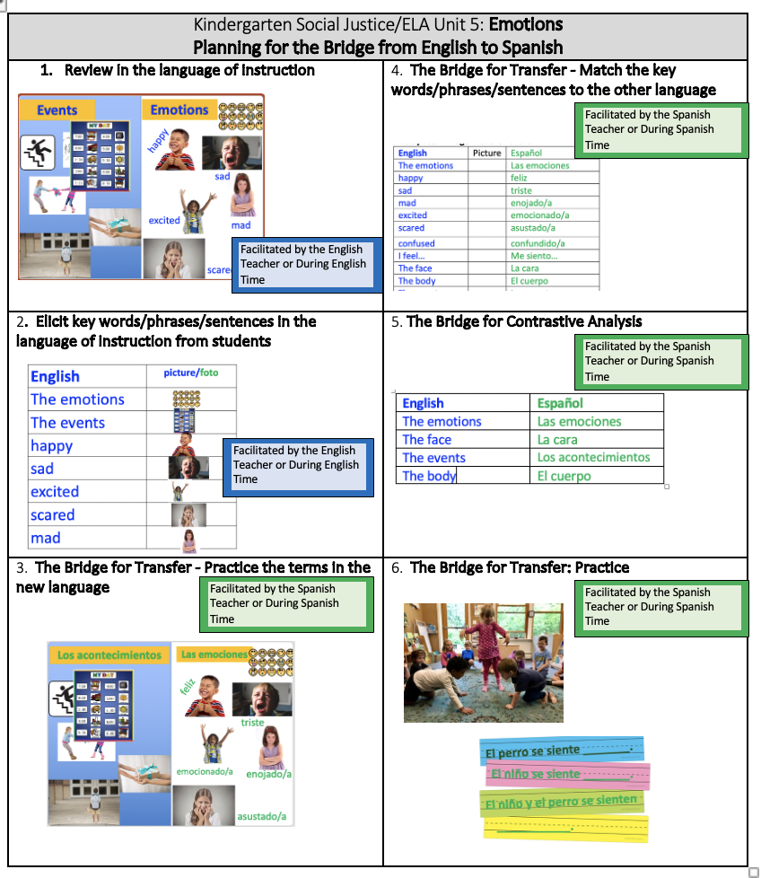
p. 36
Notes:
Get out your Bridge handouts:
Planning for the Bridge p. 41 and 6 steps of the Bridge Sample

Slide 85
The Bridge - Step 1:
Review in the Language of Instruction
Notes:
We just witnessed step 1: review in the language of instruction

Slide 86
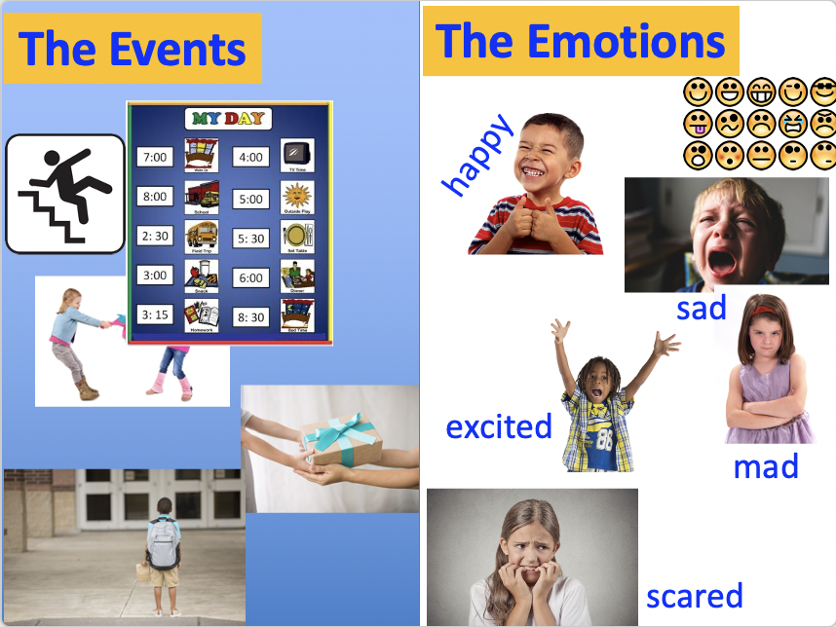
Step 1
Notes:
Insert Bridge slides

Slide 87
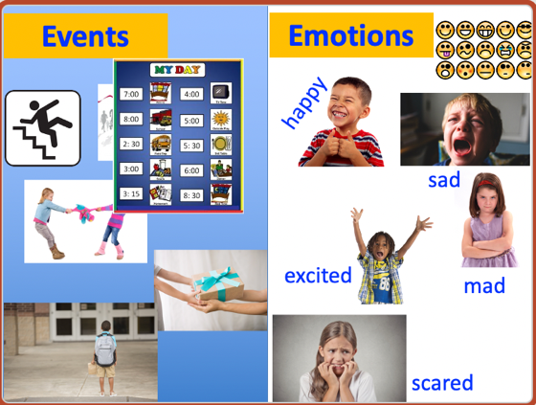
The Bridge - Step 1:
English Teacher or
During English Time
Teacher reviews in the language of instruction
Students actively engaged
Notes:
You saw… CLICK x2
And in what language? ENGLISH! WHY? Because that was the language of the unit!

Slide 88
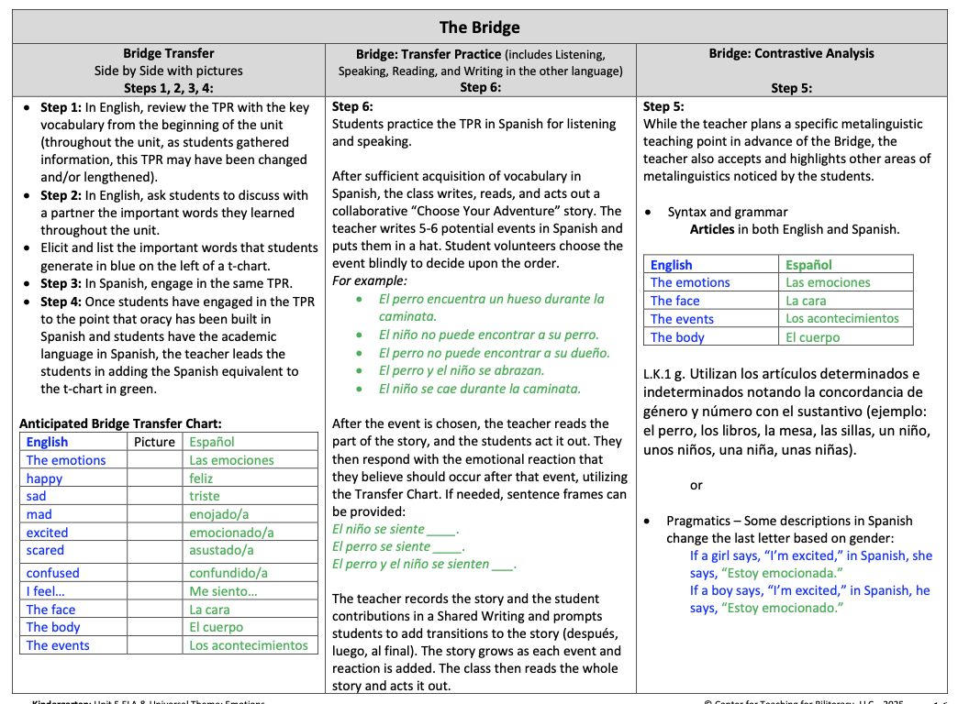
Step 1
Condensed BUF p. 16
Notes:
UPDATE screenshot to match new condensed BUF
Steps 3, 4, and 5 are noted here in the learning plan. CLICKs

Slide 89
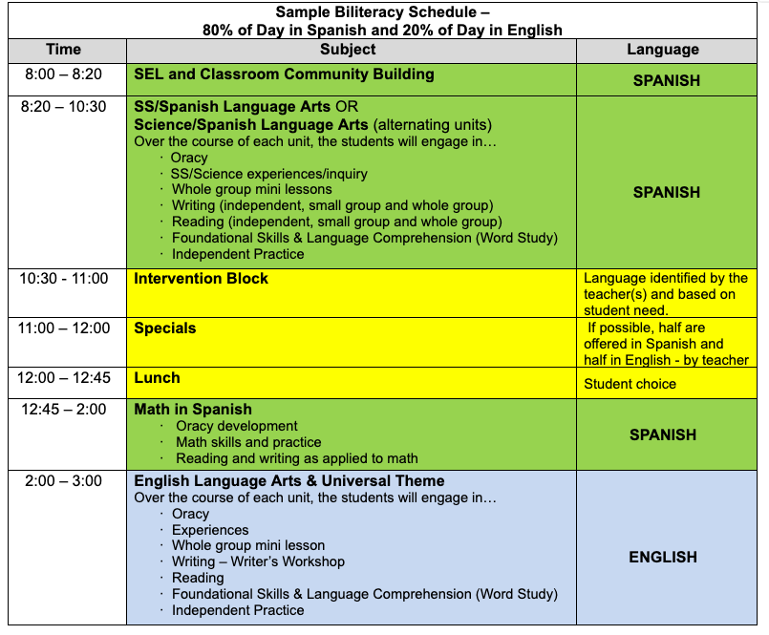
Step 1
Start new ELA/Universal Theme unit
Notes:
Remember, all of this learning is happening during this blue time in the schedule
A completely different unit is happening during the green time in the schedule

Slide 90
The Bridge - Step 2:
Elicit key words/phrases/sentences in the language of instruction from students
Notes:
In step 2, we elicit the (read slide)

Slide 91
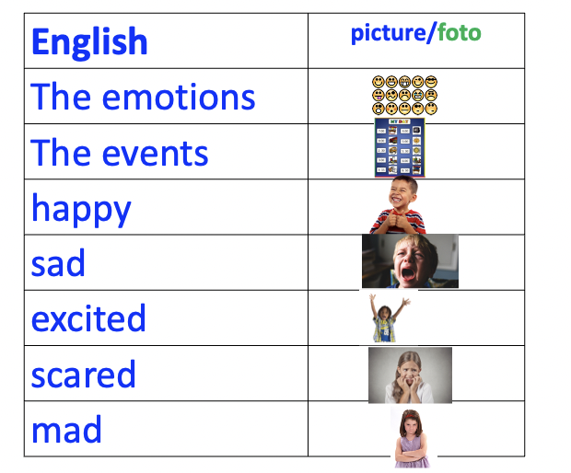
English
Photo/ foto
Español
The emotions
The events
Happy
Sad
Excited
Scared
mad
Step 2
Notes:
Insert Bridge slides

Slide 92
The Bridge - Step 2:
English Teacher or
During English Time
Students actively engaged
The language generated by students is what is transferred
The teacher does NOT tell students what words to Bridge
English Teacher or
During English Time
Notes:
You saw… CLICK x2
And in what language? ENGLISH! WHY? Because that was the language of the unit!

Slide 93
Step 2
Notes:
UPDATE screenshot

Slide 94
Steps 1-2
Start new ELA/Universal Theme unit
Notes:
-2s
Remember, all of this learning is happening during this blue time in the schedule
A completely different unit is happening during the green time in the schedule

Slide 95
The Bridge - Step 3:
The Bridge for Transfer – Practice the Terms in the New Language
Notes:
In step 3, there was a switch in language. During this step, students (read slide)

Slide 96
Step 3
Español
?
Notes:
Before we can fill out this side, we have to prepare our students to participate. HOW? By building oracy!

Slide 97
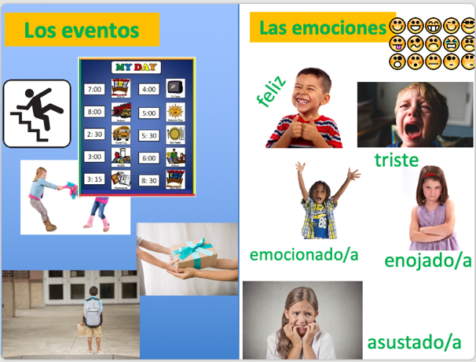
The Bridge - Step 3:
English Teacher or
During English Time
Looks like step 1 but in other language
Important to take time to PRACTICE oracy
Can happen over multiple days
English Teacher or
During English Time
Spanish Teacher or
During Spanish Time
Notes:
You saw… CLICK x2
And in what language? ENGLISH! WHY? Because that was the language of the unit!

Slide 98
Step 3
Notes:
UPDATE screeenshot

Slide 99
The next day…
Step 3
Continue with SS/SLA or Sci/SLA unit
Steps 1-2
Start new ELA/Universal Theme unit

Slide 100
The Bridge - Step 4:
The Bridge for Transfer – Match the key words/phrases/sentences to the other language
Notes:
Then we saw step 4. (read step descriptor)

Slide 101
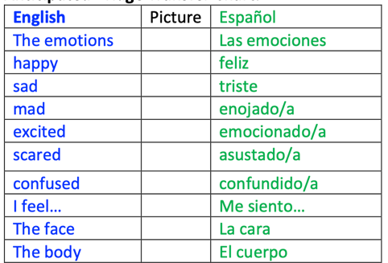
Step 4
Notes:
Insert Bridge slides

Slide 102
The Bridge - Step 4:
English Teacher or
During English Time
Spanish Teacher or
During Spanish Time
Spanish terms added to SAME chart
Color coding is important
Students actively engaged
Teacher (or students) write the Spanish equivalent
English Teacher or
During English Time
Spanish Teacher or
During Spanish Time
Notes:
You saw… CLICK x2
And in what language? ENGLISH! WHY? Because that was the language of the unit!

Slide 103
Step 4
Notes:
UPDATE Screenshot

Slide 104
How did our chart compare to the anticipated chart?
Notes:
UPDATE Screenshot

Slide 105
The next day…
Steps 3-4
Continue with SS/SLA or Sci/SLA unit
Steps 1-2
Start new ELA/Universal Theme unit

Slide 106
Steps 1-4
Notes:
UPDATE Screenshot

Slide 107
The Bridge - Step 5:
The Bridge for Contrastive Analysis
Notes:
We just witnessed step 5.

Slide 108


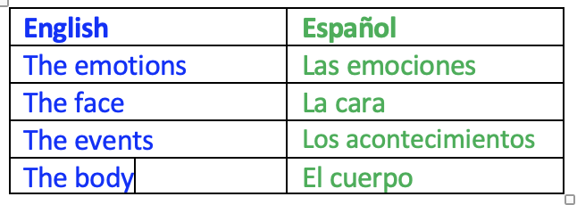
El
La
Los
Las
the
Step 5
Notes:
Insert Bridge slides

Slide 109
The Bridge - Step 5:
English Teacher or
During English Time
Spanish Teacher or
During Spanish Time
Where the second chart is created
Students actively engaged
Example of contrastive analysis focus comes from the transfer chart
English Teacher or
During English Time
Spanish Teacher or
During Spanish Time
Spanish Teacher or
During Spanish Time
Notes:
You saw… CLICK x2
And in what language? ENGLISH! WHY? Because that was the language of the unit!

Slide 110
Step 5
Notes:
UPDATE Screenshot

Slide 111
Steps 3-5
The next day…
Continue with SS/SLA or Sci/SLA unit
Steps 1-2
Start new ELA/Universal Theme unit
Start new ELA/Universal Theme unit

Slide 112
The Bridge - Step 6:
Continued Practice in the Other Program Language
Notes:
We just watched step 6 –read slide

Slide 113
Elige la aventura:
Los estudiantes seleccionan los acontecimientos del cuento de un sombrero y luego deciden cómo se sentirá el personaje. Después actúan el cuento.
Step 6
Notes:
Choose the adventure! Students select the events of the story from a hat and decide how the characters would feel. They then act out the story.

Slide 114
The Bridge - Step 6:
English Teacher or
During English Time
Spanish Teacher or
During Spanish Time
Students need time to use the language in a new experience
Includes Listening, Speaking, Reading, and Writing
English Teacher or
During English Time
Spanish Teacher or
During Spanish Time
Spanish Teacher or
During Spanish Time
Spanish Teacher or
During Spanish Time
Notes:
You saw… CLICK x2
And in what language? ENGLISH! WHY? Because that was the language of the unit!

Slide 115
Step 6
Notes:
UPDATE Screenshot

Slide 116
The next day…
Steps 3-6
Continue with SS/SLA or Sci/SLA unit
Steps 1-2
Start new ELA/Universal Theme unit
Notes:
In the 50/50 it would just be the opposite times in a Spanish to English Bridge, and in an 80/20, like you see here, Steps 1 & 2 would occur during Spanish instruction, and steps 3-6 may end up taking a large chunk of your English instruction time because 20% of the day is so little.

Slide 117
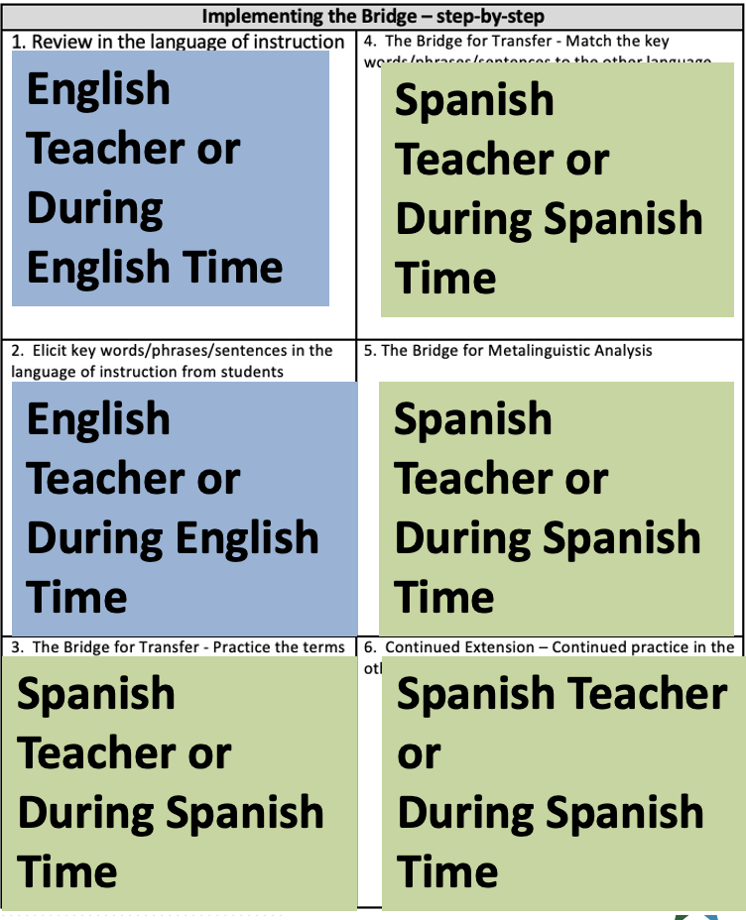
English to Spanish Bridge
Notes:
What we saw was a Bridge that went from Spanish to English.
If the Bridge went from English to Spanish, then this is when each step would happen. This is true in a one teacher model AND in a two teacher model.

Slide 118
Spanish to English Bridge
Spanish Teacher or
During Spanish Time
English Teacher or
During English Time
Bridge Steps at the conclusion of a Spanish Unit of Instruction
Spanish Teacher or
During Spanish Time
English Teacher or
During English Time
English Teacher or
During English Time
English Teacher or
During English Time
Notes:
IF this was a unit from Spanish to English, the steps would be exactly the opposite.

Slide 119
Steps 1-2
Bridge from Spanish to English
Start new SS/SLA unit or Sci/SLA unit
Steps 3-6
Continue ELA/ Universal Theme unit
Notes:
In the 50/50 it would just be the opposite times in a Spanish to English Bridge, and in an 80/20, like you see here, Steps 1 & 2 would occur during Spanish instruction, and steps 3-6 may end up taking a large chunk of your English instruction time because 20% of the day is so little.

Slide 120
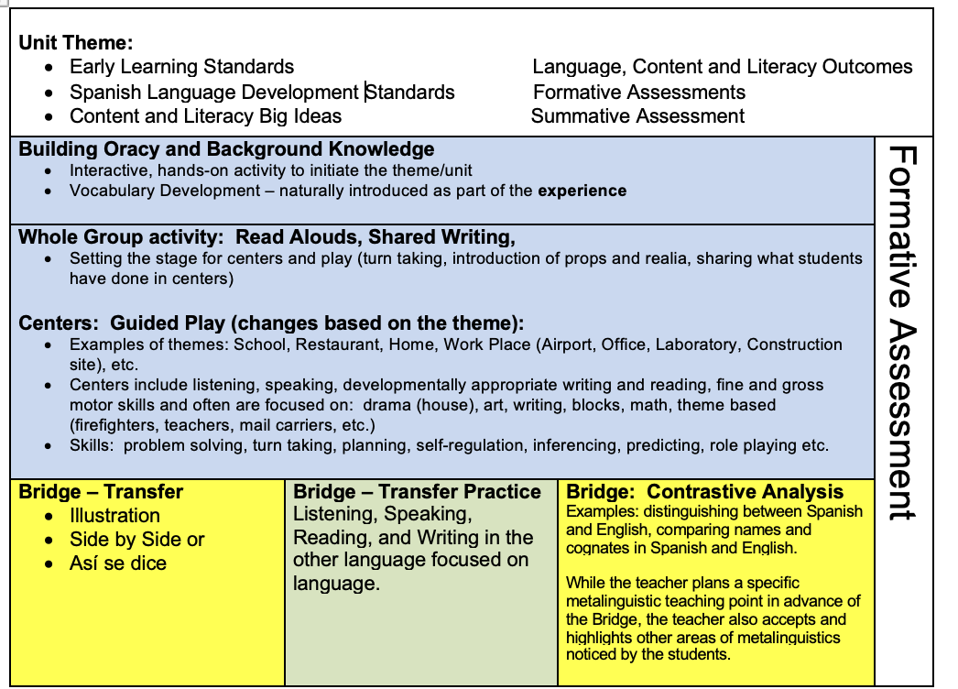
The Bridge in PreK/TK
Happens at the END of the Unit
Notes:
PreK has just one chart for the Bridge: The transfer chart.
While students wouldn’t necessarily be writing on the charts like you see here, they may have pictures to put on it or can add sentence strips with the words pre-written.

Slide 121
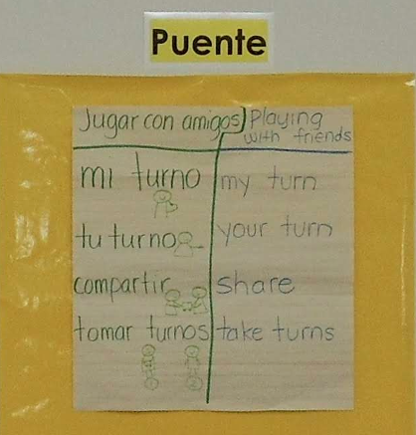
Typically, only a Transfer Chart is created
Notes:
PreK Transfer Chart

Slide 122

PreK/TK Contrastive Analysis
Notes:
PreK Contrastive Analysis is more about them understanding that they have two langauges.

Slide 123
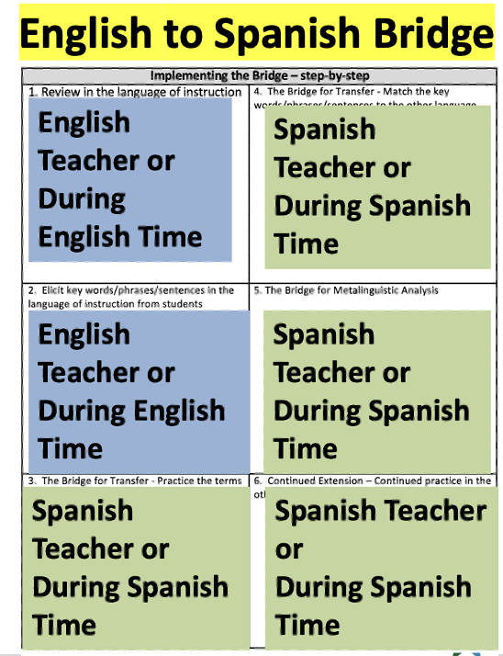
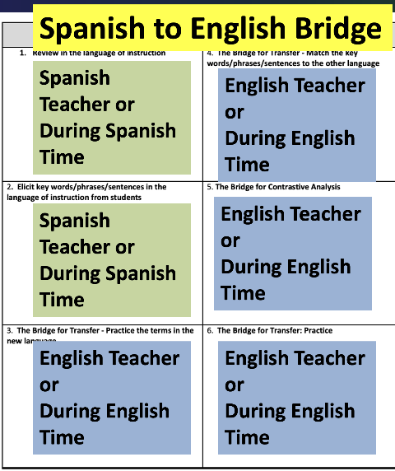
The Bridge in PreK/TK
Step 6: Emphasis on listening and speaking
in TK
Notes:
What we saw was a Bridge that went from Spanish to English.
If the Bridge went from English to Spanish, then this is when each step would happen. This is true in a one teacher model AND in a two teacher model.

Slide 124

The Bridge for Transfer
Page 33 Resource Packet
Notes:
Let’s look at different types of charts

Slide 125



Three Types of Bridge Transfer Charts
Illustration | Side-by-Side | Así-se-Dice

Slide 126

Four Areas of Contrastive Analysis
Page 35 of the Resource Packet and 142 of the Text

Slide 127

p. 34

Slide 128

Kindergarten: CCSS for Language Arts – Foundational Skills

Slide 129

Kindergarten: CCSS for Language Arts – Language Standards

Slide 130
Christmas por David
What area of contrastive analysis would help this student?
Vamos a mi tio Kurtis's casa. Miramos el television y jugamos algo. Ellos tienen un pequeño niño que le llaman Benjamin. Tambien tienen un perro, Hannah. La trip es muy largo y lasts mucho tiempo. El paseo es muy largo y no me gusta. Mis relativos son muy dibertidos y me gusta el tiempo con ellos.

Slide 131
What area of Contrastive Analysis would help David?
Syntax and Grammar -
  Possessive: Casa de mi tío Kurtis / Uncle Kurtis’ house

Slide 132
Christmas por David
What area of contrastive analysis would help this student?
Vamos a mi tio Kurtis's casa. Miramos el television y jugamos algo. Ellos tienen un pequeño niño que le llaman Benjamin. Tambien tienen un perro, Hannah. La trip es muy largo y lasts mucho tiempo. El paseo es muy largo y no me gusta. Mis relativos son muy dibertidos y me gusta el tiempo con ellos.

Slide 133
What area of Contrastive Analysis would help David?
Syntax and Grammar -
  Possessive: Casa de mi tío Kurtis / Uncle Kurtis’ house
  Articles: la televisión / the television

Slide 134
Christmas por David
What area of contrastive analysis would help this student?
Vamos a mi tio Kurtis's casa. Miramos el television y jugamos algo. Ellos tienen un pequeño niño que le llaman Benjamin. Tambien tienen un perro, Hannah. La trip es muy largo y lasts mucho tiempo. El paseo es muy largo y no me gusta. Mis relativos son muy dibertidos y me gusta el tiempo con ellos.

Slide 135
What area of Contrastive Analysis would help David?
Syntax and Grammar -
  Possessive: Casa de mi tío Kurtis / Uncle Kurtis’ house
  Articles: la televisión / the television
  Cognates: Cognados falsos -False cognates
    Relativos – Relatives
    Embarazada – Embarrassed
    Grocerías - Groceries

Slide 136
Christmas por David
What area of contrastive analysis would help this student?
Vamos a mi tio Kurtis's casa. Miramos el television y jugamos algo. Ellos tienen un pequeño niño que le llaman Benjamin. Tambien tienen un perro, Hannah. La trip es muy largo y lasts mucho tiempo. El paseo es muy largo y no me gusta. Mis relativos son muy dibertidos y me gusta el tiempo con ellos.

Slide 137
What area of Contrastive Analysis would help David?
Syntax and Grammar -
  Possessive: Casa de mi tío Kurtis / Uncle Kurtis’ house
  Articles: la televisión / the television
  Cognates: Cognados falsos -False cognates
    Relativos – Relatives
    Embarazada – Embarrassed
    Grocerías – Groceries
Spelling/Phonology: Dibertido to divertido –b/v rules in Spanish/ b/v rules in English

Slide 138
Notes:
Carmen was given a picture and asked to write about it.
”The kids playing in the park. The mom waiting for the kids. And the father is waiting for the kids too. Oh the grandmother waiting for the kids too.”
She knows what she is saying! She is using all her linguistics resources (especially Spanish phonology)

Slide 139
Use student writing. What area of contrastive analysis would be helpful to this student
Notes:
Would benefit from some high frequency words like the – and create a contrastive analysis chart. Overemphasizing it early helps students in later grades write it correctly in English.
High frequency – don’t want students to just memorize by sight (because there are phonological patters within high frequency words)

Slide 140
Phonology/Grammar: Articles
En español | In English
El parque | The park
La mamá | The mom
Los niños | The kids
Las | The
Notes:
Keep in mind, when a contrastive analysis chart has been created, it is now a living document. We find opportunities to keep these charts alive by capitalizing on student language use in every day contexts. When students notice – or when we want them to notice – an example of an area of contrastive analysis we’ve discussed, we want them to add it to the charts as an additional exam[le, and that may happen in either language and at any time of the day.

Slide 141

The Two Purposes of the Bridge
Transfer
Contrastive Analysis
Notes:
The second purpose is contrastive analysis. As you noted, this is when the two languages are compared to analyze similarities and differences between the languages.
This can only be done if students have a conceptual understanding of the words they are analyzing. That is why the Bridge happens after the summative assessment and at the end of the unit.

Slide 142

Characteristics of the Bridge for Biliteracy
Two Purposes
Two Charts
Notes:
Since there are two purposes, there are two charts.

Slide 143


Transfer Chart
Contrastive Analysis Chart

Slide 144

Characteristics of the Bridge for Biliteracy
Happens at the END of the Unit
Two Purposes
Two Charts
Notes:
The second non-negotiable is that the Bridge happens at the end of the unit. It is not a place to re-teach. It is an instructional moment that has been strategically planned for by the teacher.

Slide 145

Characteristics of the Bridge for Biliteracy
Happens at the END of the Unit
Includes High Student Interaction
Two Purposes
Two Charts
Notes:
The third non-negotiable is that it includes high student interaction. This means that the students play an active role in the construction of BOTH charts.

Slide 146
Cross-Linguistic Connection Considerations
A cross-linguistic connection (AKA contrastive analysis) is the 2nd purpose of the Bridge: comparing the 2 languages in terms of
  Phonology
  Morphology
  Syntax and grammar
  Pragmatics

Slide 147
Page 35

Slide 148
Cross-Linguistic Connection Considerations
A cross-linguistic connection is the 2nd purpose of the Bridge: comparing the 2 languages using phonology, morphology, syntax and grammar, and pragmatics
Select the cross-linguistic connection skill based on what students need (review student writing, speaking, and your foundational skills and language standards)
Students need repeated practice with cross-linguistic connections to internalize them
Focus on only connection for each chart
Introduce the connection within a context, preferably as part of the Bridge
Continue to add examples to the chart throughout the year and make sure STUDENTS add examples, not just the teacher

Slide 149
Turn and Talk
I learned that ___________.
I was surprised by______________.
I wonder _____________________.

